Slide 2
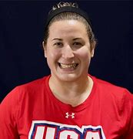
Welcome
Nina Cutro-Kelly
Move United Competition Manager
2021 Judo Olympian
2022 Deaflympic Judo Champion
Dog & Turtle Mom
Learn more about Nina! Listen to "The Gentle Way" on Move United's Redefining Disability Podcast!
Notes:
I have been working at Move United since 2023 as a Competitions Manager. Specifically, I manage the Sanctioned Competition Network and support Nationals. Before Move United, I worked as an Olympic Athlete Fellow at LA28, the Olympic Organizing Committee for the next Games in 2028 and before that, I was an English as a Second Language Teacher for 17 years. I am hard of hearing since birth, wear bilateral hearing aids, and have a hearing support dog. As a judoka, or judo player, I am passionate about adaptive sport as Judo is by definition an adaptive sport, seeking to make the sport accessible to anyone and everyone. Outside of Judo and my work at Move United, I love my dogs, my pet turtle, and I enjoy cooking and taking care of plants, as well as running and lifting weights.

Slide 3
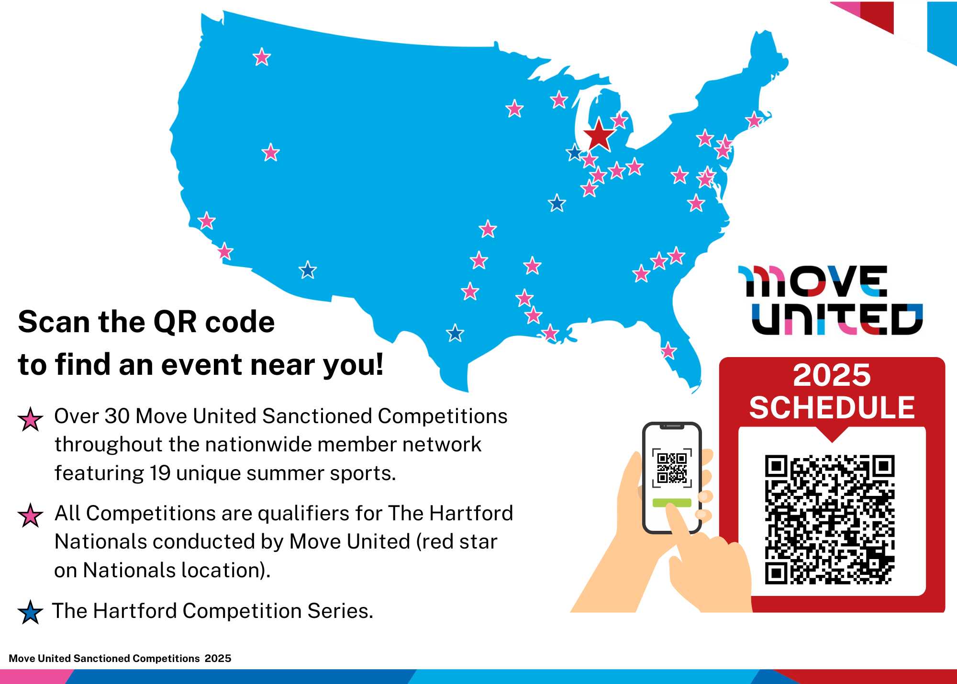
2025 Competition Calendar
37 competitions in 25 states

Slide 4
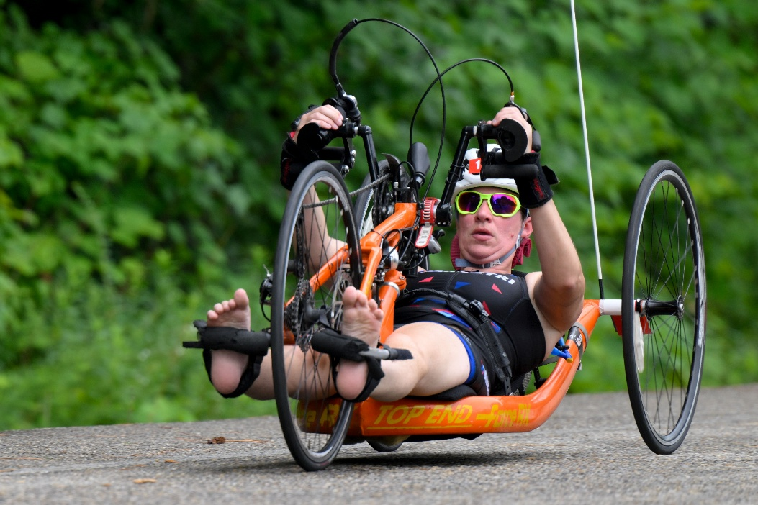
2025 Competition Calendar
Single- and multi-sport competitions
Sports included
Archery
Boccia
Paratriathlon
Powerlifting
Shooting (Air Rifle)
Swimming
Track and Field
Wheelchair Tennis
Open to all athletes with a permanent disability
Questions around eligibility should be sent to Event Director
National classification opportunities at some of the competitions
Download the Virtual 2025 Sanction Competition Promotional Brochure Here!

Slide 5
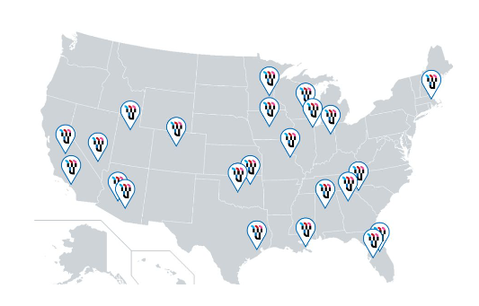
Adaptive Shooting League
Comprised of Move United’s member organizations and community partners from across the country. Program offerings differ by location.
Monthly virtual competitive opportunities

Slide 6
2025 The Hartford Nationals

Slide 7
Classification
What is Classification?
Classification provides a structure for competition among athletes with impairments.
Learn more at https://www.paralympic.org/classification
Interactive guide to classification: https://lexi.global/sports
Move United 90 and 91 Classifications at The Hartford Nationals
For athletes with a permanent physical impairment that do not meet criteria to be classified under the IPC classification system
Athlete may be classified in one sport but deemed “ineligible” in another. In this example, the athlete may compete as MU90 or MU91 for the ineligible sport.
Open Division at Sanctioned Competitions
Athlete must have a permanent, documented disability
Connect with Event Director if there are questions around your eligibility

Slide 8
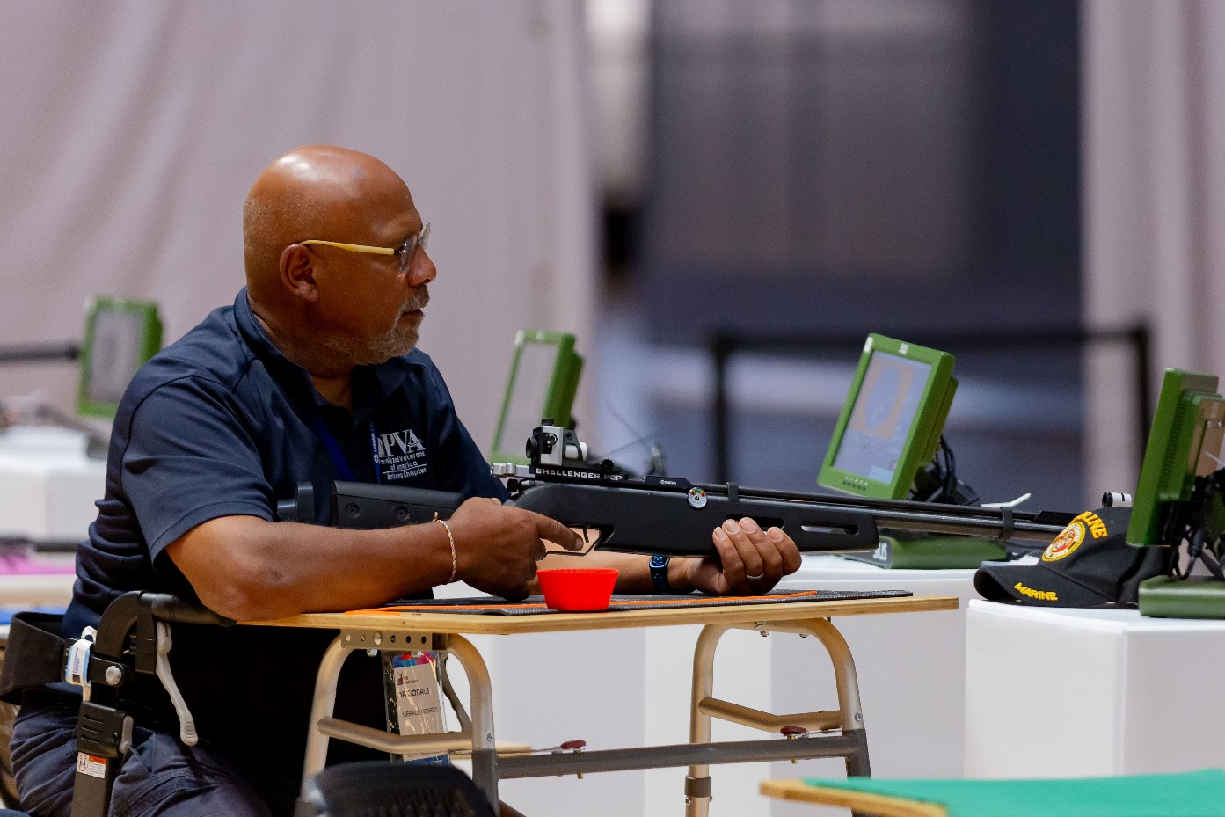
Grant Opportunities
Important Competitions’ Grants
Warfighters’ Scholarship – up to $500 travel support for The Hartford Nationals
Tatyana McFadden Scholarship – up to $500 travel support for Sanctioned Competition or The Hartford Nationals
Must be under 18 years of age to apply

Slide 9
Thank you! Questions?
CONTACT
Nina, Competition Manager - Administration ncutrokelly@moveunitedsport.org
Jessie, Competition Manager - Operations jcloy@moveunitedsport.org
Susan, Director of Competition srossi@moveunitedsport.org

