Slide 1

Navigating Nonprofit Challenges
The Power of Transparent Communication
Conference Theme: Disability Inclusion: Catalyzing Change Through Sport
Presented by: Vince Abramo, Bambooshoot Coaching & Consulting

Slide 2


Slide 3
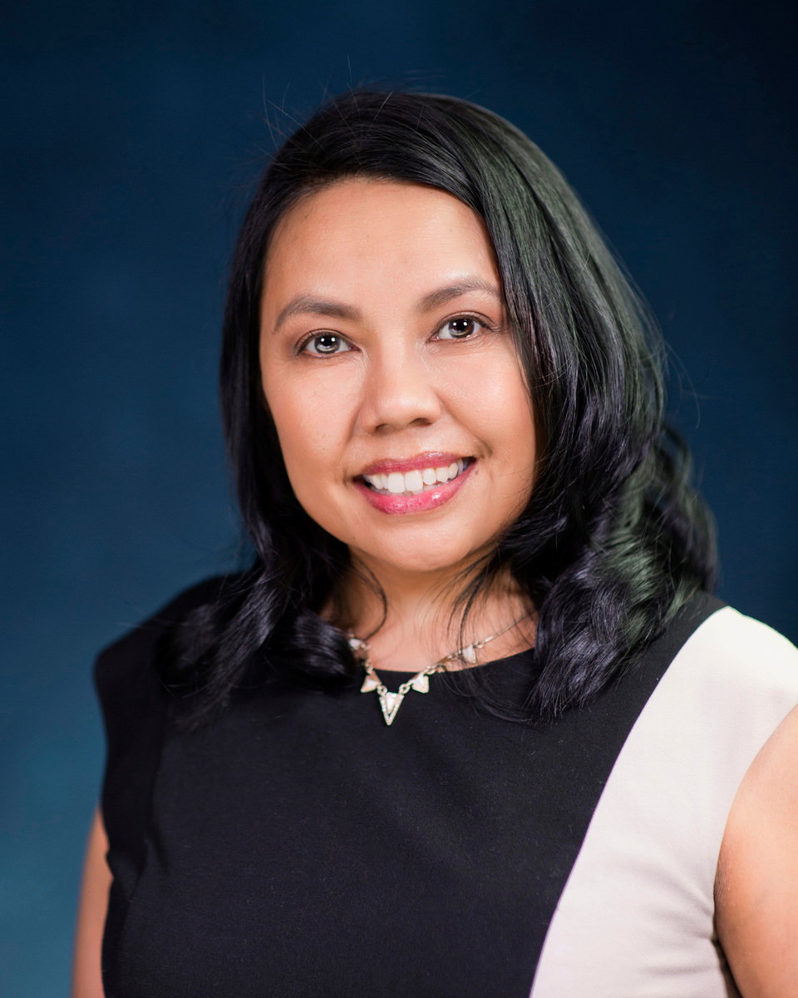
About Me
Masters in Public Administration
Bachelors in Public Relations in Internal Communication
Certifications:
  Conflict Resolution
  Maxwell Leadership and Communication
  Center for Creative Leadership
  Volunteer Management
  Nonprofit Management
  Neuroencoding
  Brain Health Trainer
  Neuroscience Leadership and Coaching
  Thriving Women in Business
Facilitation:
  EPIC Ohana Conferences - DHS and Family Court
  Conferences

Slide 4
Learning Objectives
  Understand the Role of Transparent Communication
  Identify Strategies for Enhancing Inclusion
  Develop Actionable Communication Plans

Slide 5

Why Transparency Matters

Slide 6


Examples of transparent objects are glass, clear water, and air.
All of these allow light to pass through completely without being absorbed or refracting.

Slide 7

We can classify transparency into three degrees : opaqueness, translucency and clarity.
Opaqueness is when a work group does not disclose any information to its stakeholders and hence a opaque work group is not a transparent work group.
Translucency is when a work group discloses its information partially.

Slide 8

Another Way to Think of Transparency and Opacity
Transparency:
  Think of it as a "light-path":
  Touch analogy – like a tunnel:
  Sound analogy – clear and ringing:
Opacity:
  Think of it as a "light-block":
  Touch analogy – a wall covered with thick, heavy fabric
  Sound analogy – listening to music through a thick wall

Slide 9
Transparency Creates Trust and Collaboration

Slide 10
Role of Transparency
  Build trust and collaboration across teams
  Open communication: feedback from all levels
  Clarity: define goals, expectations, and roles
  Accessibility: multiple formats for all abilities
  Inclusivity: Where everyone feels welcomed
  Accountability: live your values visibly

Slide 11
Strategies to Enhance Inclusion
  Use inclusive language and visual design
  Train board members, staff, and volunteers on disability awareness
  Provide personalized accommodations and support
  Encourage feedback and implement it visibly
  Celebrate diversity and maintain safe spaces

Slide 12


Slide 13
Develop Communication Plans
•Start with an honest assessment
•Align plan with vision, mission, and values
•Build in feedback loops and accessibility
•Monitor, evaluate, and update regularly
•Integrate with meetings and team updates

Slide 14
Conflict and Communication Practices
•Set clear confidentiality and expectations
•Use a 3-step dispute resolution system
•Correct misinformation quickly and openly
•Hold open Q&As to prevent gossip
•Document outcomes and lessons learned

Slide 16
Tools & Template
•Communication Plan Template
•Conflict Resolution Tracker
•Inclusive Communication Checklist
•Transparency Culture Survey

Slide 17
Final Takeaway
•Transparency builds culture, not just policies
•Conflict is normal—resolution must be modeled
•Every voice matters—design for all abilities
•Reinforce trust with action, not just words

Slide 18

Mahalo

