Slide 1
Building Better Boards
By Ed Bronsdon, President, Bronsdon for Good
v2025

Slide 2
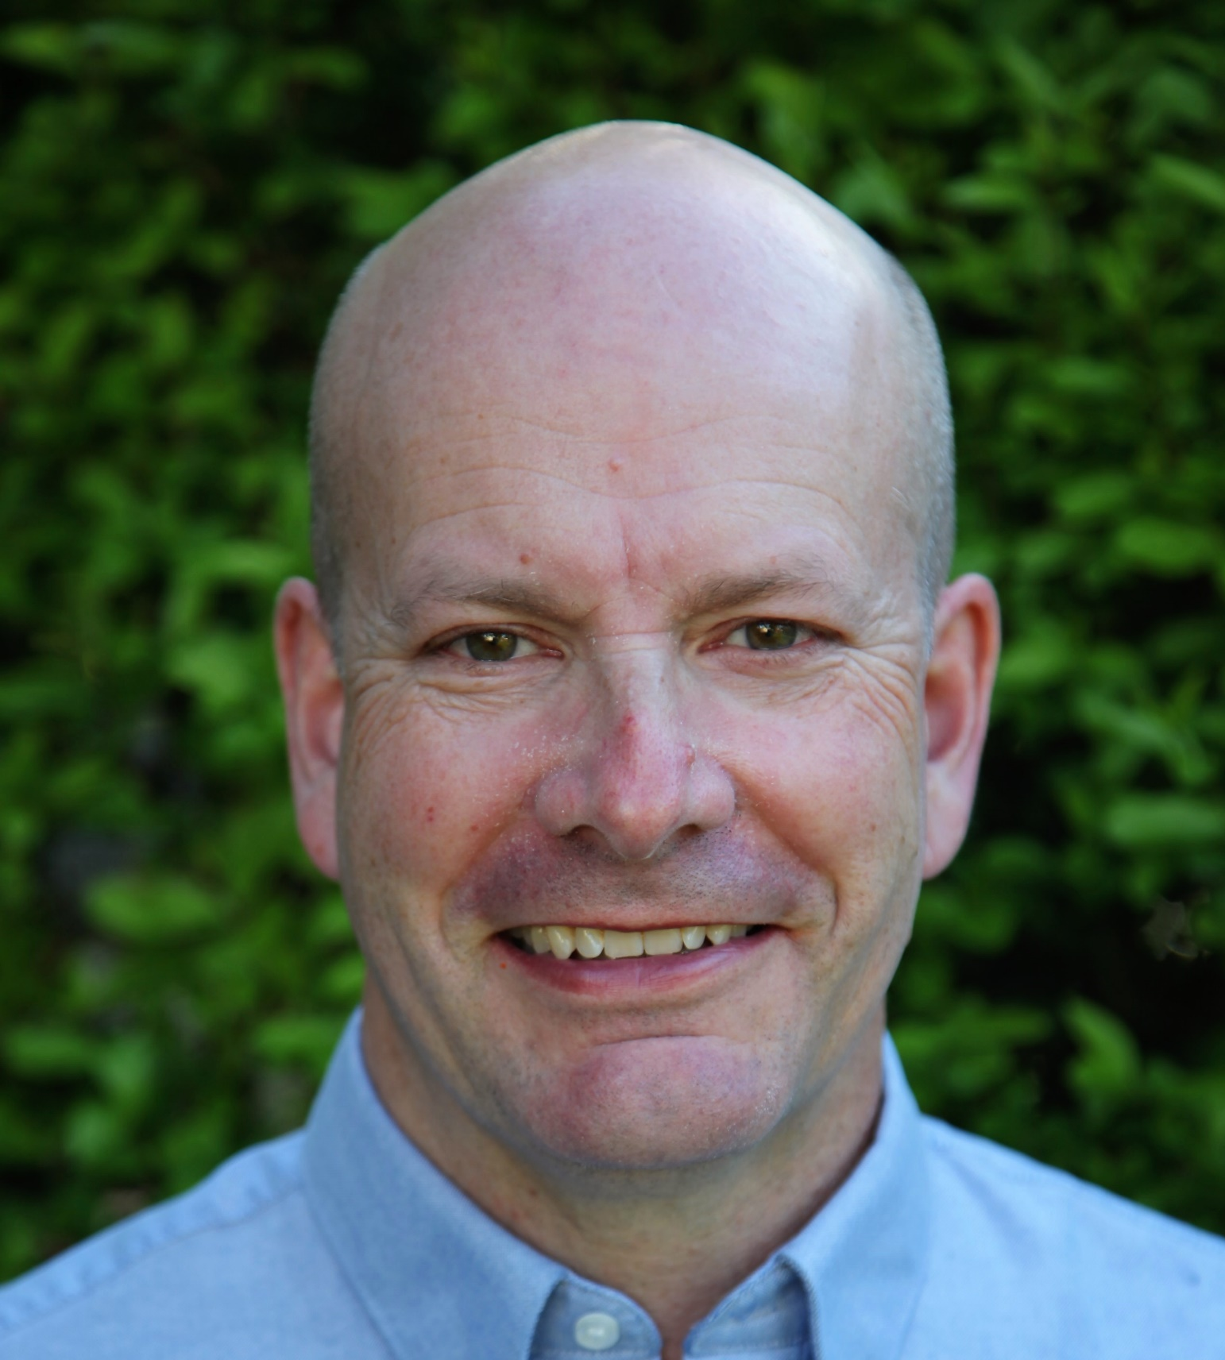
Session Presenter
Ed Bronsdon
Bronsdon for Good, LLC
Mission driven, business minded consulting for nonprofits and their leaders
edbronsdon@icloud.com
206.499.5821
Notes:
QUALIFY the room

Slide 3
Learning Objectives
1
Introduce best practices of The Board-Building Cycle
2
Review and showcase the three phases of building better boards
3
How to put together an action plan to engage better board governance work for your organization
Notes:
Review and showcase the three phases of building better boards Phase 1: Strategic Recruitment Phase 2: Effective Engagement Phase 3: Intentional Revitalization
3 phases; 9 steps

Slide 4
Key Reference Tools:
1) The Board-Building Cycle – Susan S. Meier
2) BoardSource Membership 3) BoardSource Board Assessment
4) Five Life Stages of Nonprofit Organizations – Judith Sharken Simon

Slide 5
Key Questions
What are your Board Governance needs now and for the future?
Do you have agreement to pursue best practices? If so, then conduct a self-assessment
Do all involved understand board vs staff roles? If not, educate.
Do you have agreement on who will do what and when? Engage a task force or committee for follow up.
How do you eat an elephant? Three phases for follow up: Recruit + Engage + Revitalize Remember, it is an ongoing cycle.
Notes:
\

Slide 6
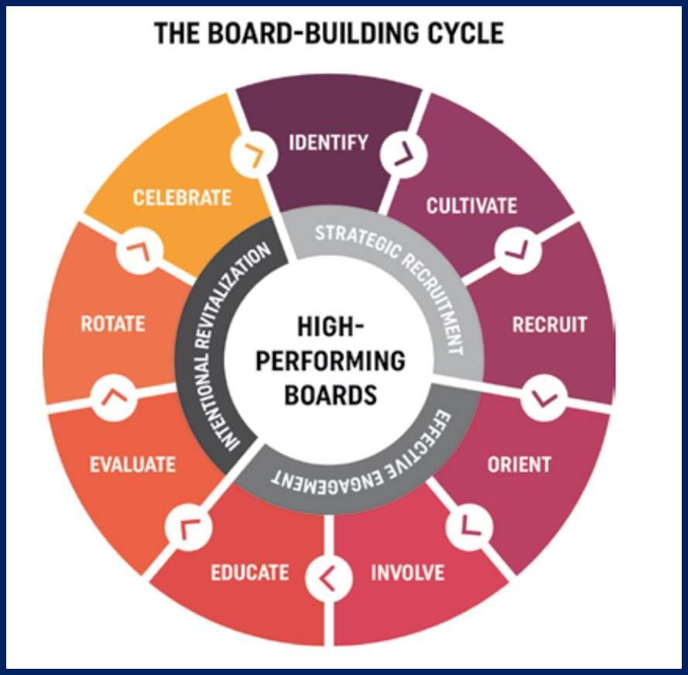
The Board-Building Cycle

Slide 7
Phase 1: Strategic Recruitment
Three step process: 1) Identify +
2) Cultivate +
3) Recruit
Notes:
Boards are human resources

Slide 8
Phase 1: Strategic Recruitment
Step 1: Identify the future needs of the board. Determine the diversity of skills, knowledge, backgrounds, and perspectives you need to implement the strategic plan or framework and address upcoming opportunities and challenges. What do you have? What is missing?
Step 2: Cultivate potential board members and identify individuals with the desired characteristics. Ask current board members, senior staff, past board leaders, and key supporters to suggest potential candidates, but also seek diverse prospects from beyond familiar circles of connections. Find ways to connect with candidates, get them interested in your organization, and keep them informed of your process.
Step 3: Recruit prospects. Describe why prospective members are wanted and needed. Explain THE BOARD-BUILDING CYCLE 13 Introduction expectations and responsibilities of board members, and don’t minimize requirements. Invite questions, elicit prospects’ interest, and find out if they are prepared to serve.
Notes:
Anyone here MARRIED or in a RELATIONSHIP?

Slide 9
Phase 2: Effective Engagement
Also three steps:
1) Orient +
2) Involve +
3) Educate
Notes:
Ongoing

Slide 10
Phase 2: Effective Engagement
Step 4: Orient new board members to the organization and to the board, explaining the history, programs, pressing issues, finances, facilities, bylaws, and organizational chart. Share information on committees, board member responsibilities, current board composition, and key staff members. Speak to your board’s culture and how board members engage with one another in discussions and decision making. Assign a board mentor to each new board member.
Step 5: Involve all board members. Discover their interests, talents, and availability. Involve them in committees or task forces. Solicit feedback. Hold everyone accountable. Identify emerging leaders. Express appreciation for work well done.
Step 6: Educate the board. Share information about your mission area, programs, community, and good governance. Promote exploration of issues facing the organization. Hold retreats and encourage board development activities by sending board members to seminars and workshops. Don’t hide difficulties.
Notes:
How do you do any of these?

Slide 11
Phase 3: Intentional Revitalization
And yes, three more steps: 1. Evaluate +
2. Rotate +
3. Celebrate
Notes:
Ongoing

Slide 12
Phase 3: Effective Engagement
Step 7: Evaluate the board as a whole, as well as individual board members. Engage the board in assessing its own performance, and identify ways in which the board can improve its effectiveness. Encourage individual self-assessment. Examine how the board and chief executive work as a team.
Step 8: Rotate board members. Establish term limits. Do not automatically re-elect board members for an additional term; consider the board’s needs and the board member’s performance. Explore the feasibility of asking inactive members to retire from the board. Continually develop new leadership.
Step 9: Celebrate! Recognize genuine victories and progress, no matter how small. Acknowledge individual contributions to the board, the organization, and the community. Honor those who have excelled in their board service
Notes:
SUPER important to have your board do a self-assessment

Slide 13
Key Questions
What are your Board Governance needs now and for the future?
Do you have agreement to pursue best practices? If so, then conduct a self-assessment
Do all involved understand board vs staff roles? If not, educate.
Do you have agreement on who will do what and when? Engage a task force or committee for follow up.
How do you eat an elephant? Three phases for follow up: Recruit + Engage + Revitalize Remember, it is an ongoing cycle.
Notes:
\

Slide 14
Putting together an action plan for your board
BOARD GOVERNANCE
Issue | Discussion | Recommendation | Who | When
What are _____ Board Governance needs now and for the future? | Discuss as a board at April 30, ___ meeting | If agreement, then act. | Board | April 30, ____
Is there agreement on a call to action? We may not need consensus, but do seek a strong majority to move forward | Educate and Communicate: | Utilize The Board-Building Cycle book as a framework for best practices; confirm Who will do What by When | Board Governance Work Group >> Executive Com. >> Full Board | April 30, ____
Board-Building Cycle Strategic Recruitment Effective Engagement Intentional Revitalization Should this framework be used? | More details in the notes below. | Use best practices to Intentionally Revitalize the board and our actions to support the future needs of the organization | Board & E.D. / CEO | Beginning ____ + timeline going forward
If agreement, then conduct board self- assessment | ____________ | Use BoardSource tool | Each Board Member | By May 31, ____ (self-assess); each Board Member

Slide 15
Be clear about Board vs Staff roles. | Is there mutual understanding of these differing roles? | Clarify through education. | _________ | By July 1, _____ through Board Assessment
Currently a relatively passive board; | Is that what is best for the future of _________ | ____________ | Board & Executive Staff | By July 1, _____
Assess board efficacy What is our division of labor as a board? What are we called to do? | Should we utilize the BoardSource tool to assess this? Cost? If so, Executive Summary and Recommendations for follow up | Yes? No? Need more info? | Board | By August 1, ___
Use recommendations from the board assessment to update our Board Governance | Job description? Committees? Term limits? Recruitment? Orientation? Executive Com titles? Elections? | ____________ | ________ | By Oct. 31, __
Renew / refresh board engagement by individual board members and the board collectively | ____________ | ____________ | ________ | By Oct. 31, ___

Slide 16
Sustain the renewal of board engagement so that Board Governance best practices are codified into regular annual, quarterly and other time-related best practices | ____________ | What are annual metrics to keep us on the renewed track? | ________ | By August 31, __ December 31, __ April 30, (following year)
Board Governance Committee reviews self-assessment and presents recommendations to the Executive Committee | ____________ | ________________ | Board Governance | By June 30, ____
What are the needs of the organization today and for the future for board members? What are we asking board members to do? | Should sponsors / major donors have a seat at the table? Should we have more than one board? One, a board of governance and another, an advisory board? | Review, update if necessary, and share out job descriptions for board members. | Board Governance | By July 31, ____
Executive Summary of Board Self-Assessment shared with full Board along with recommendations for action | ____________ | ________________ | Board Governance and Executive Committee | By July 31, ____
What else….?

Slide 17
Summary
Building a better board is an ongoing process
It is a cycle with three key phases: finding, engaging and strengthening
It is a human resources endeavor

Slide 18
Thank you! Q&A

Slide 19
Learning Objectives
1
Introduce best practices of The Board-Building Cycle
2
Review and showcase the three phases of building better boards
3
How to put together an action plan to engage better board governance work for your organization
Notes:
Review and showcase the three phases of building better boards Phase 1: Strategic Recruitment Phase 2: Effective Engagement Phase 3: Intentional Revitalization

Slide 20
Session Presenter
Ed Bronsdon
Bronsdon for Good, LLC
Mission driven, business minded consulting for nonprofits and their leaders
edbronsdon@icloud.com
206.499.5821

