Slide 1
ACTION SPORTS PRESENTATION
SKATE & WCMX
-
-
101 WORKSHOP

Slide 2
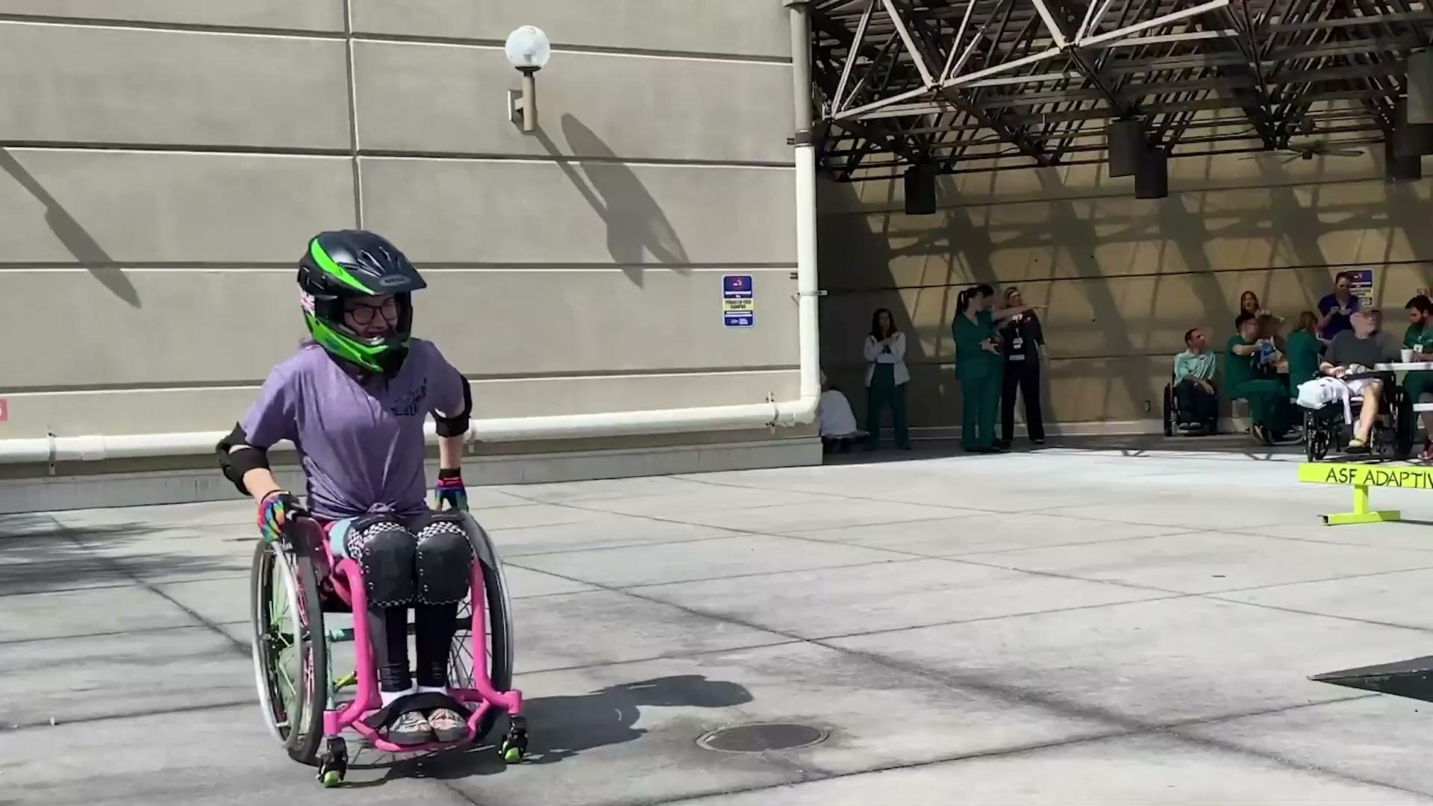
ADAPTIVE
SKATEBOARDING & WCMX
0‹#›
101 WORKSHOP

Slide 3
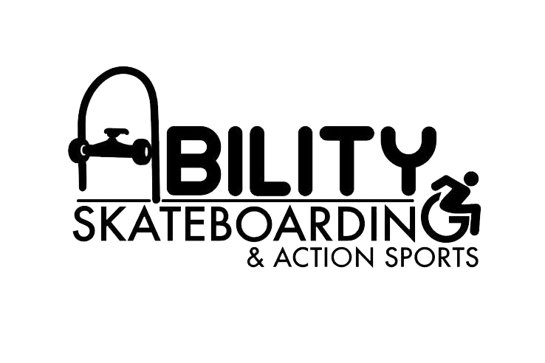
WHO WE ARE
Our mission is to include, teach & support people living with & without dis(abilities) to be a part of the skateboarding and action sports community.
S.M.C.L. Foundation & Associates Inc. is a non-profit organization focused on improving the quality of life for military veterans, citizens with disabilities, and economically disadvantaged individuals..
Founded in 2023
Based in San Antonio, TX
Established in 2006
Current Programs/Projects
Based in New Orleans, LA
All inclusive sports

Slide 4
TEAM PROFILES
Andrew Garcia
Tony Torres
SPEAKER
SPEAKER
Executive Director/Lead Coach
Board Member /
Adaptive Athlete
Tomas Woods
Damien Munoz
ATHLETE
ATHLETE
Demo
Demo

Slide 5
What to Expect
Sport Break Down
and Q&A
(15-30 Minutes)
Closing Statements and Q&A( 15-30)
Recap & Appreciation
Open Floor for Question
Next Steps & Resources
Adaptive Skateboarding
WCMX (Wheelchair Motocross)
Closing Remarks: Q&A
Demo (2 Hours)
Equipment overview
Safety equipment
Skatepark demo (Skateboarding/WCMX
Mega Ramp demo (Skateboarding/WCMX)

Slide 6
Adaptive
SKATE
PRESENTATION

Slide 7
What is Adaptive Skateboarding?
Adaptive Skateboarding is a modified version of traditional skateboarding that allows individuals with disabilities to participate in the sport and enjoy the benefits of skateboarding. The focus is on making skateboarding accessible and inclusive for people with a variety of physical, sensory, and cognitive challenges. It involves modifications to equipment and environments to facilitate participation and can encompass a wide range of techniques and styles.

Slide 8
ACCESSIBILITY
Challenges and Benefits
Adaptive Equipment
Gear should be safe, fitted, and sport-specific.
Barriers exist, but adaptive sports empower and build confidence.
Suggested trainings
Programming
Provide hands-on sessions, disability etiquette, and safety basics.
Recreational/
competitives
Educational awareness
Creating the environment
Teach staff and community about inclusion and disability
Foster safety, respect, and accessibility for all.

Slide 9
Inclusion
Benefits of Inclusion in Adaptive Skateboarding & WCMX
CHALLENGES
& BENEFITS
It's important to have interventions of inclusion in adaptive sports, particularly skateboarding and wcmx because of its autonomous structure to fit anyone's needs in regards to their disabilities. This will help prevent the cycle of health risk and give people living with disabilities ways to stay active while enjoying recreational inclusion in skateboarding & wcmx.
People with disabilities who engage in skateboarding and WCMX (wheelchair motocross) gain greater independence, as these sports allow them to enjoy the activity without relying on teams or other individuals..
Inclusive Challenges
Adaptive recreational opportunities that give more independence and autonomy for someone with a disability such as adaptive skateboarding and WCMX have many barriers to participants that include accessibility, resources, information and very few adaptive programs at the local, state, national and international levels.
The lack of investment into the adaptive opportunities of skateboarding and wcmx have slowed the growth and potential..

Slide 10
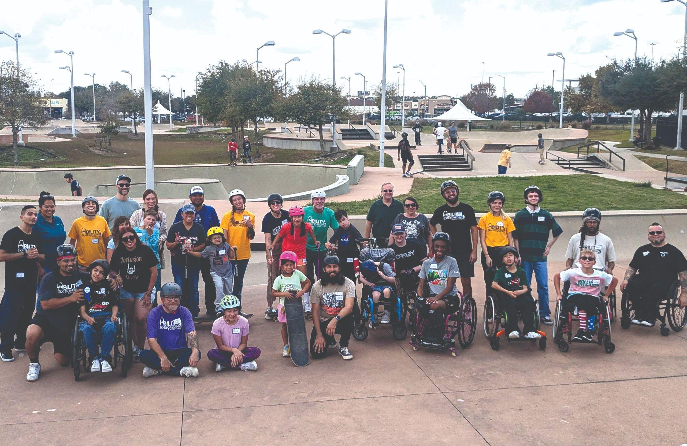
COMMON
MISCONCEPTIONS
& HOW TO ADDRESS THEM
A common misconception about adaptive skateboarding is that it's only for people with certain types of disabilities or that it's too dangerous for individuals with mobility impairments. Some people believe it’s only suitable for those with minimal physical limitations, assuming that adaptive skateboarding requires a high level of fitness or coordination.
MAIN OPTION
“Ut wisi enim veniam, quis nostrud exerci tation.”
SKATing content 1
SKATing content 2
In reality, adaptive skateboarding can be adapted to a wide range of abilities and can be done safely with the right equipment and modifications, making it accessible to a variety of people with different disabilities.

Slide 11
1
PARTICIPATION
2
RECREATIONAL
VS
COMPETITIVE
Recreational Programs are becoming increasingly common among adaptive sport organizations. These programs promote greater accessibility compared to competitive-focused programming.
These recreational opportunities cater to people of all disabilities and ages. The focus of these programs is to have fun and have the experience of skateboarding and WCMX.
Unlike more traditional adaptive sports, skateboarding and WCMX represent emerging opportunities within the adaptive sports community. These programs bring valuable diversity to adaptive athletics, complementing established options and expanding possibilities for participants.
Competitive Programs are focused on para athletes that will have opportunities for sanctioned competitions in skateboarding and wcmx. Participants with physical disabilities would be the candidates for these programs with a focus on progressions and athlete development.

Slide 12
ADAPTIVE EQUIPMENT
Traditional
Skateboard
Walker Skateboard
01
02
(No Adaptations)
Standard board used by athletes without mobility aids.
Modified walker on wheels for added stability while skating.
Dual-Cane Skateboard
Crane Assist Frame
03
04
Skateboard with two canes for balance and support.
Overhead or side-mounted frame providing balance and lifting aid.

Slide 13
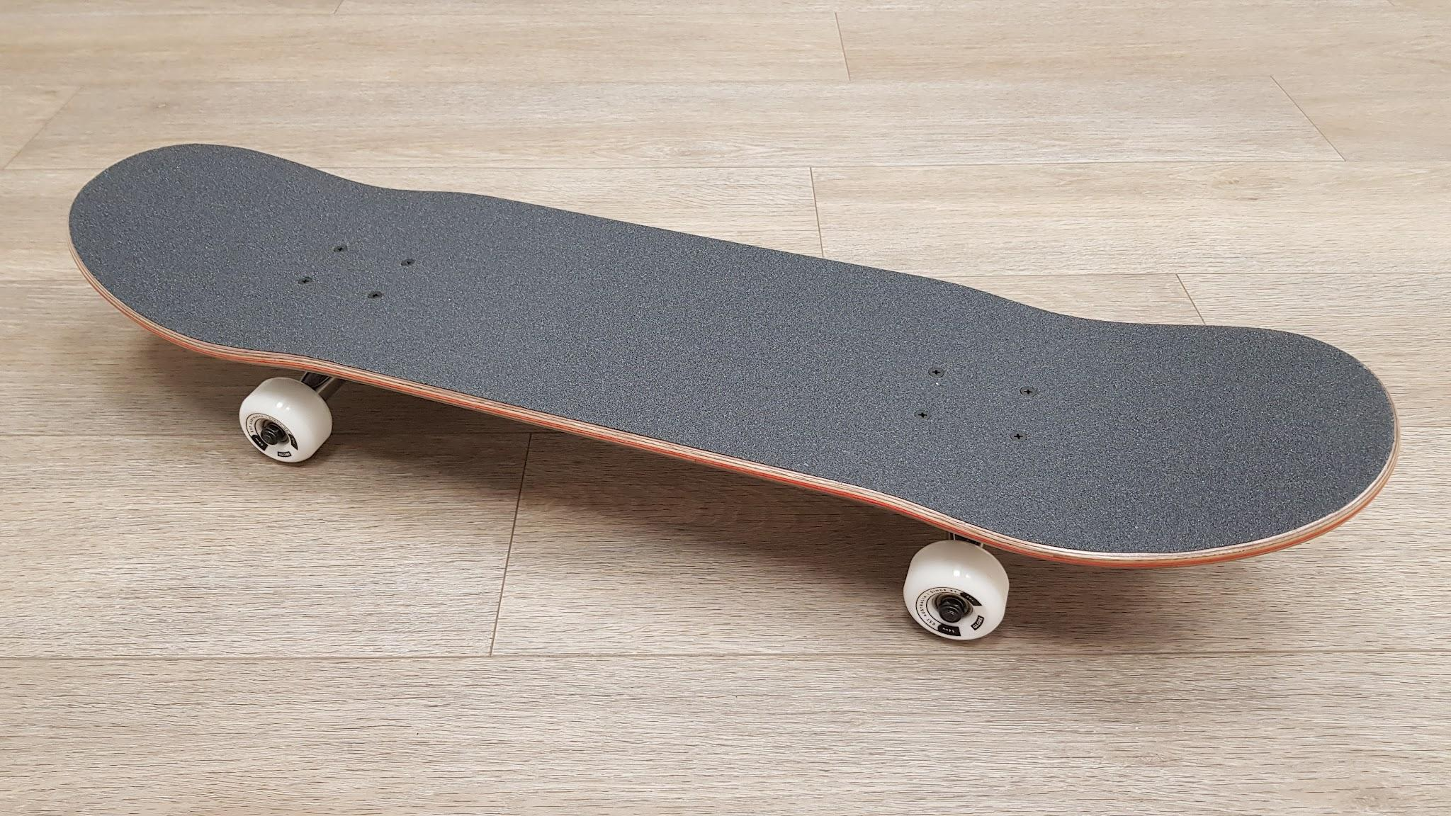
EQUIPMENT, FUNCTION
& LIMITATIONS
SKATEBOARD- NO ADAPTATIONS
Description-A skateboard typically consists of a flat, rectangular board made from layers of wood, usually maple, that is designed to be lightweight and durable. The board is mounted on two sets of wheels, one at the front and one at the rear, which are attached to metal trucks and grip tape on top of board.
Functions- The overall design allows for a combination of balance, control, and mobility, making it ideal for tricks, stunts, and transportation.
Limitations- A skateboard has no limitations in relations to progressions. Some participants will still need physical assistance but one-to-one support is may be optional varying on participant.

Slide 14
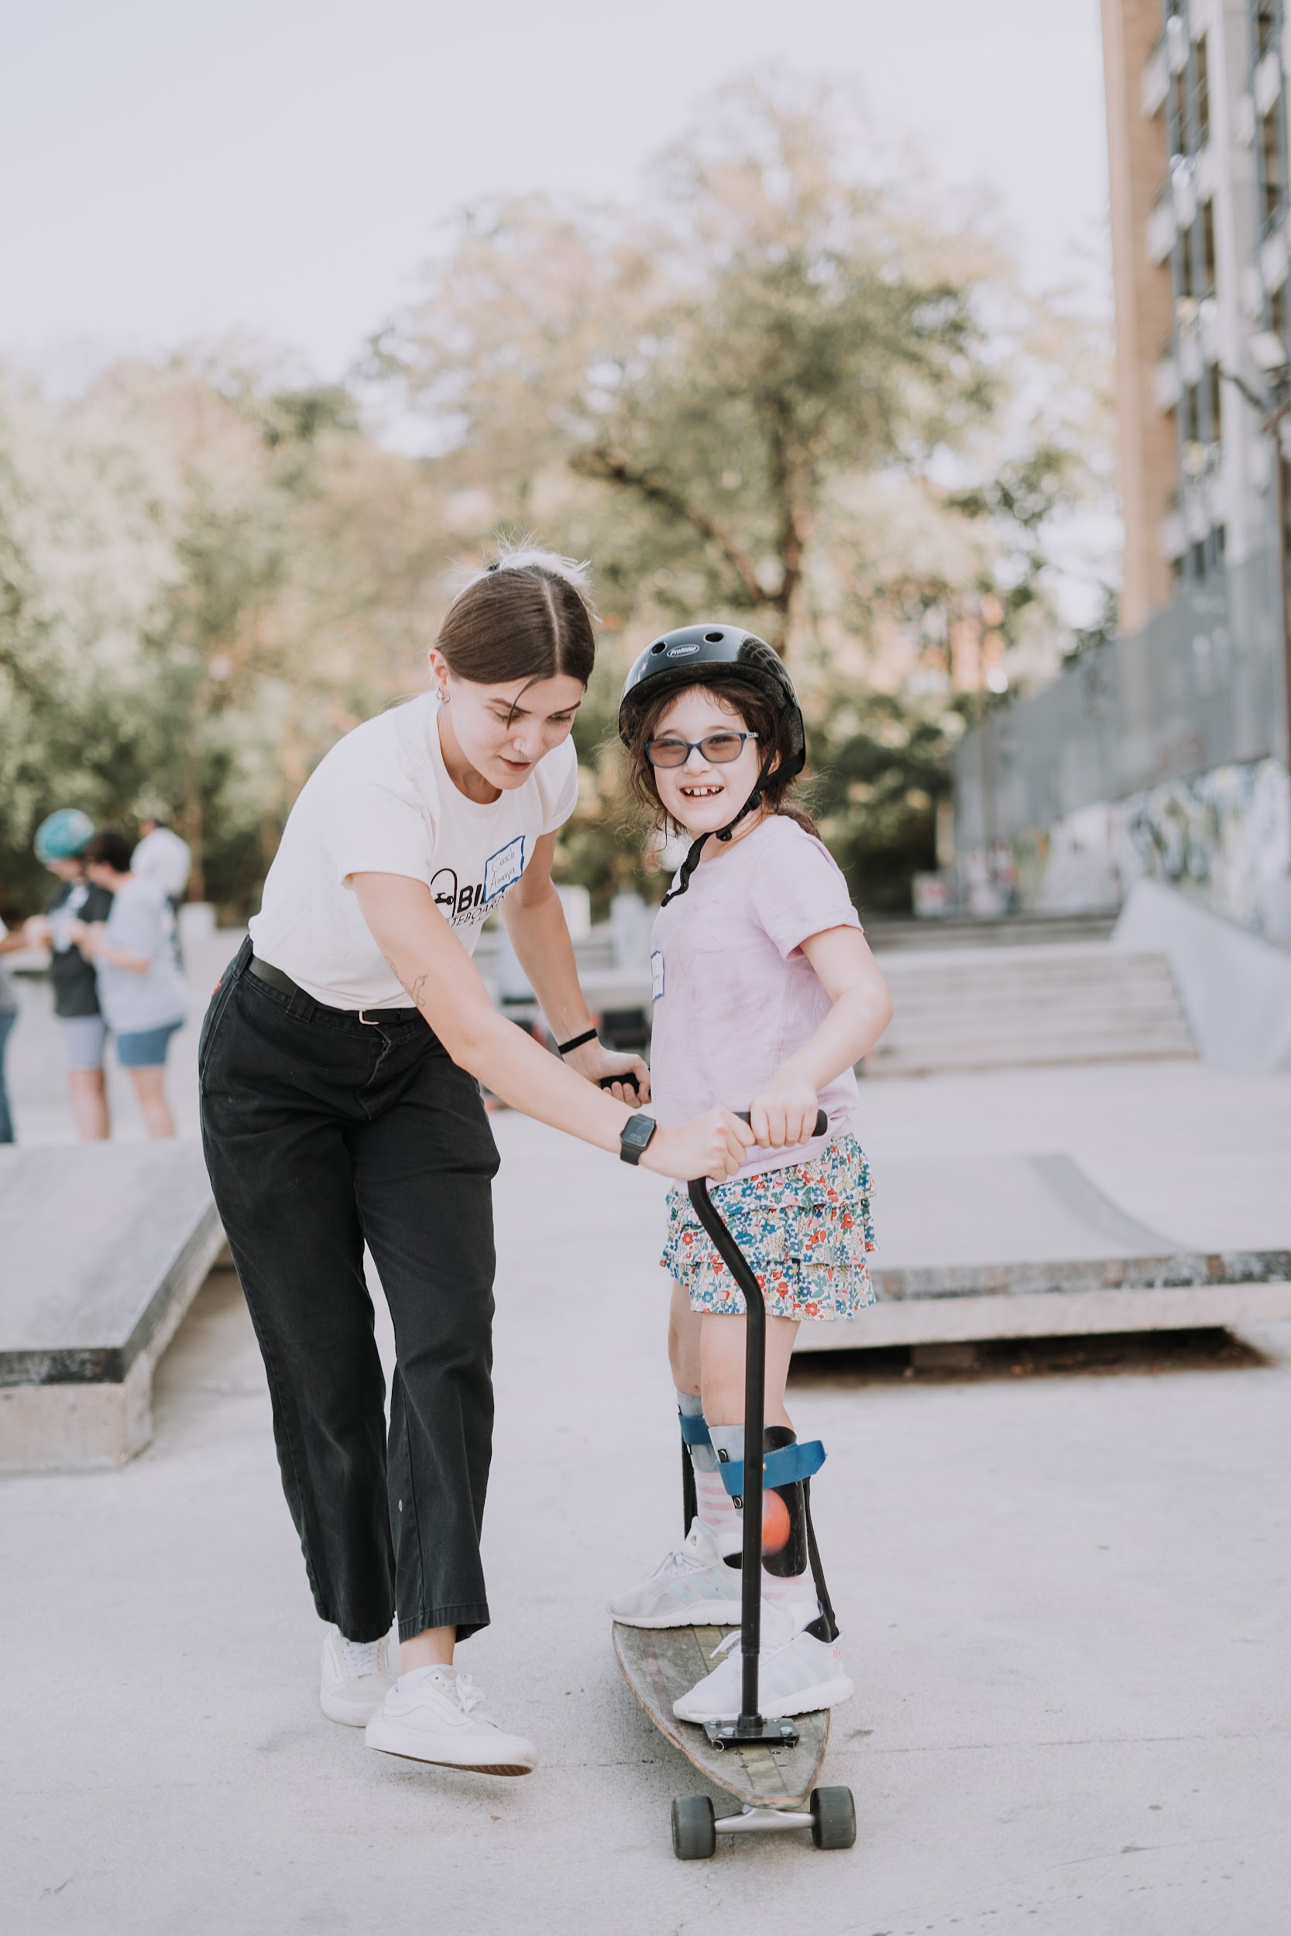
EQUIPMENT, FUNCTION
& LIMITATIONS
Description - A dual-cane skateboard is a traditional skateboard with two cane-like supports mounted to the board and trucks secured by hardware. This is an assistive device.
DUAL-CANE
SKATEBOARD
Functions- Functions- The supports are adjustable to meet each participants height needs. This adaptive device provides balance support, enabling participants with limited motor skills to experience and enjoy the sensation of riding with less physical ability required.
Good for riding long flat areas, riding up and down inclines, riding mini-ramp transitions, and grinding ride on rails/curbs. Good for introduction to build confidence and assess their skill level.
Limitations - Participants who use this device are limited to one-to-one support because the device is not made with intention of self propelling (pushing). If someone has balance issues or uses assistive devices they will always need assistance.

Slide 15
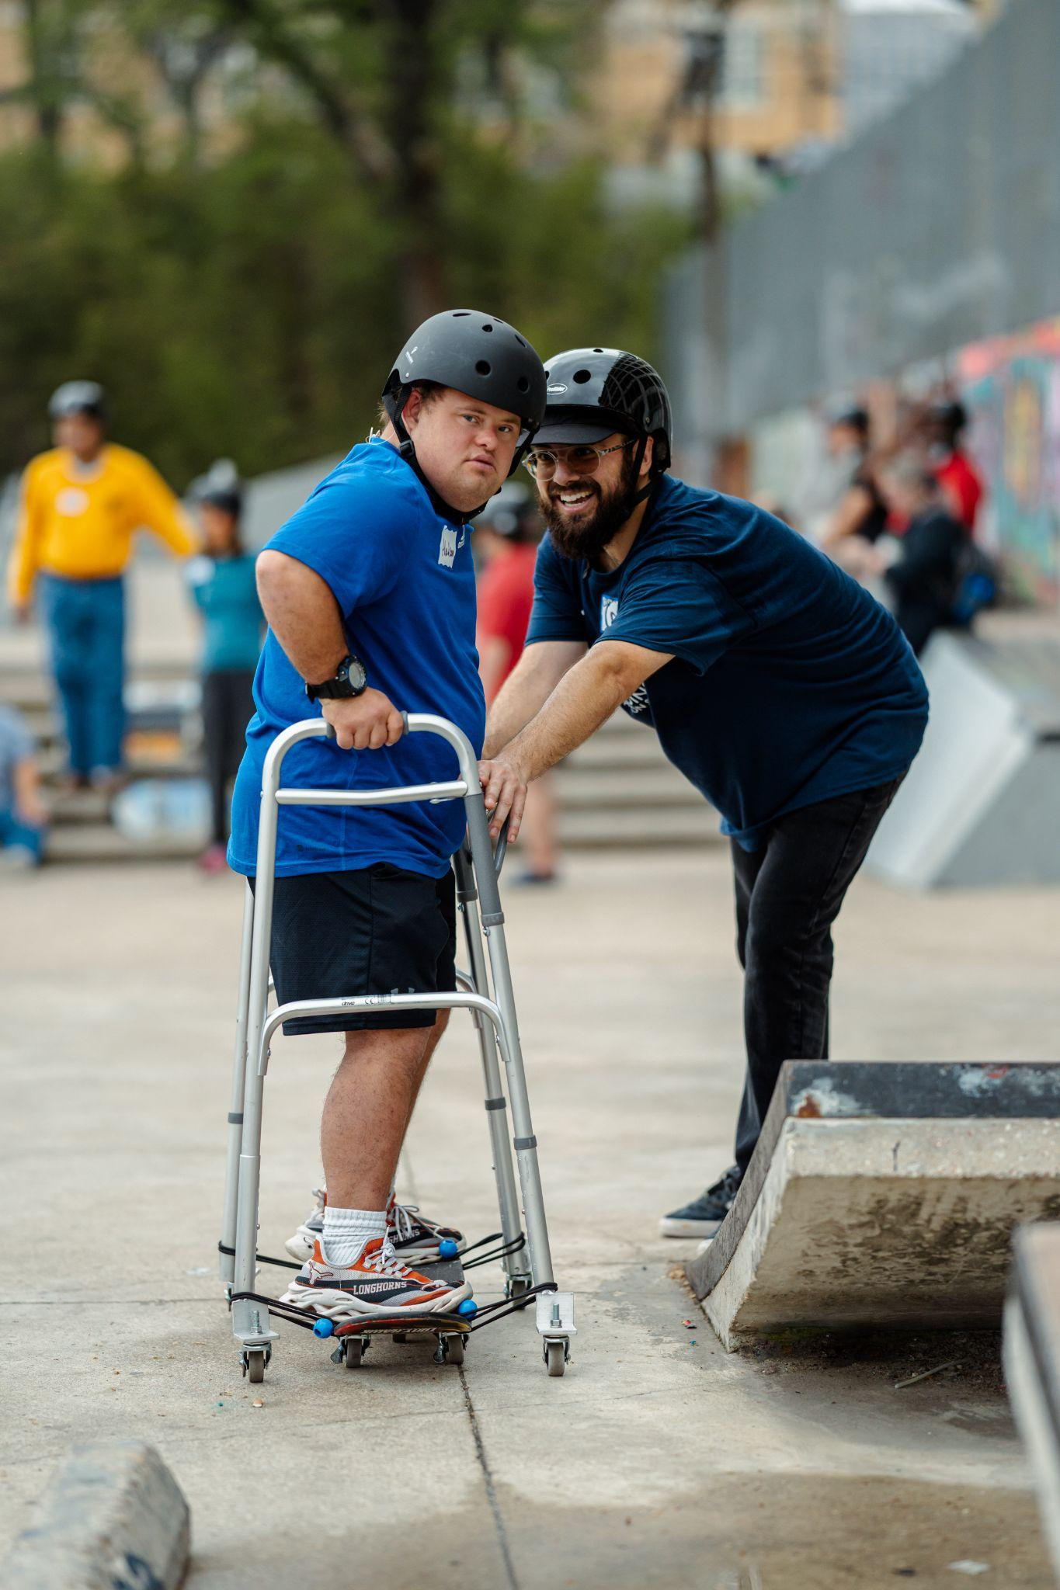
EQUIPMENT, FUNCTION
& LIMITATIONS
WALKER- SKATEBOARD
Description - A walker-skateboard is a traditional skateboard plus a walker tethered together by elastic cords. This is an assistive device.
Functions- The walker-board is adjustable to meet each participants height needs. This adaptive device provides balance support, enabling participants with limited motor skills to experience and enjoy the sensation of riding with less physical ability required. Walker boards can use traditional skateboard trucks or caster wheels. Traditional skateboard trucks will roll in a back and forth direction. Caster wheels will roll back and forth as well as left to right which allows for more mobility on assisted turns and direction of riding.
Good for riding long flat areas, riding up and down inclines, riding mini-ramp transitions, and grinding ride on rails/curbs. Good for introduction to build confidence and assess their skill level.
Limitations- Participants who use this device are limited to one-to-one support because the device is not made with intention of self propelling (pushing). If someone has balance issues or uses assistive devices they will always need assistance.

Slide 16
EQUIPMENT
& FUNCTION
CRANE ASSIST-FRAME
Description - A Crane Assist Frame is a traditional skateboard plus a crane frame (body suspension) system. The skateboard is tethered to the frame and the participant is harnessed and suspended. In addition braces for legs and trunk of body are needed to increased stabilization of participant. This is an assistive device.
Functions - The crane assist frame is adjustable to meet each participants height needs. This specialized adaptive device secures and suspends participants who cannot walk or bear weight, allowing them to safely experience the sensation of skateboarding even with minimal or no motor function.The Crane Frame system can use traditional skateboard trucks or caster wheels. Traditional skateboard trucks will roll in a back and forth direction. Caster wheels will roll back and forth as well as left to right which allows for more mobility on assisted turns and direction of riding.
Good for riding long flat areas, riding up and down inclines, and grinding ride on rails.
Limitations- Participants who use this device are limited to one-to-one support because the device is not made with intention of self propelling (pushing). If someone has balance issues or uses assistive devices they will always need assistance.

Slide 17
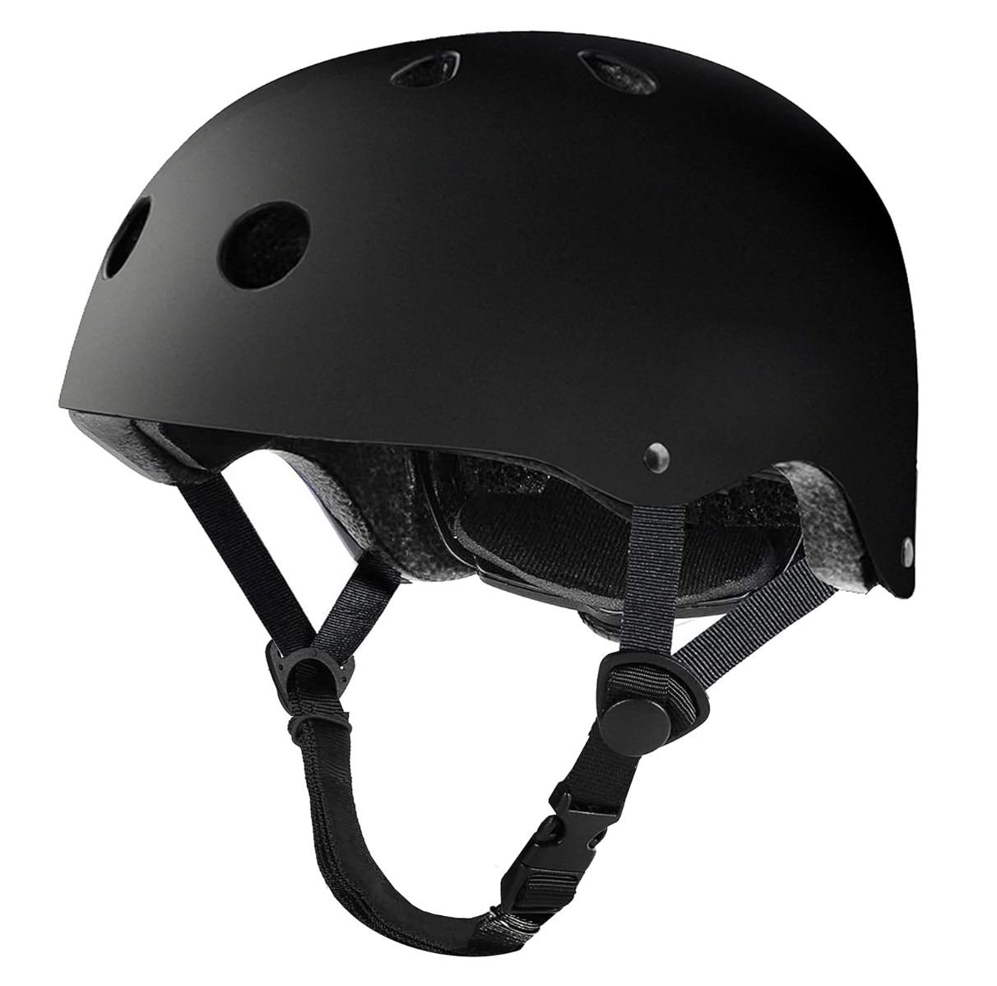
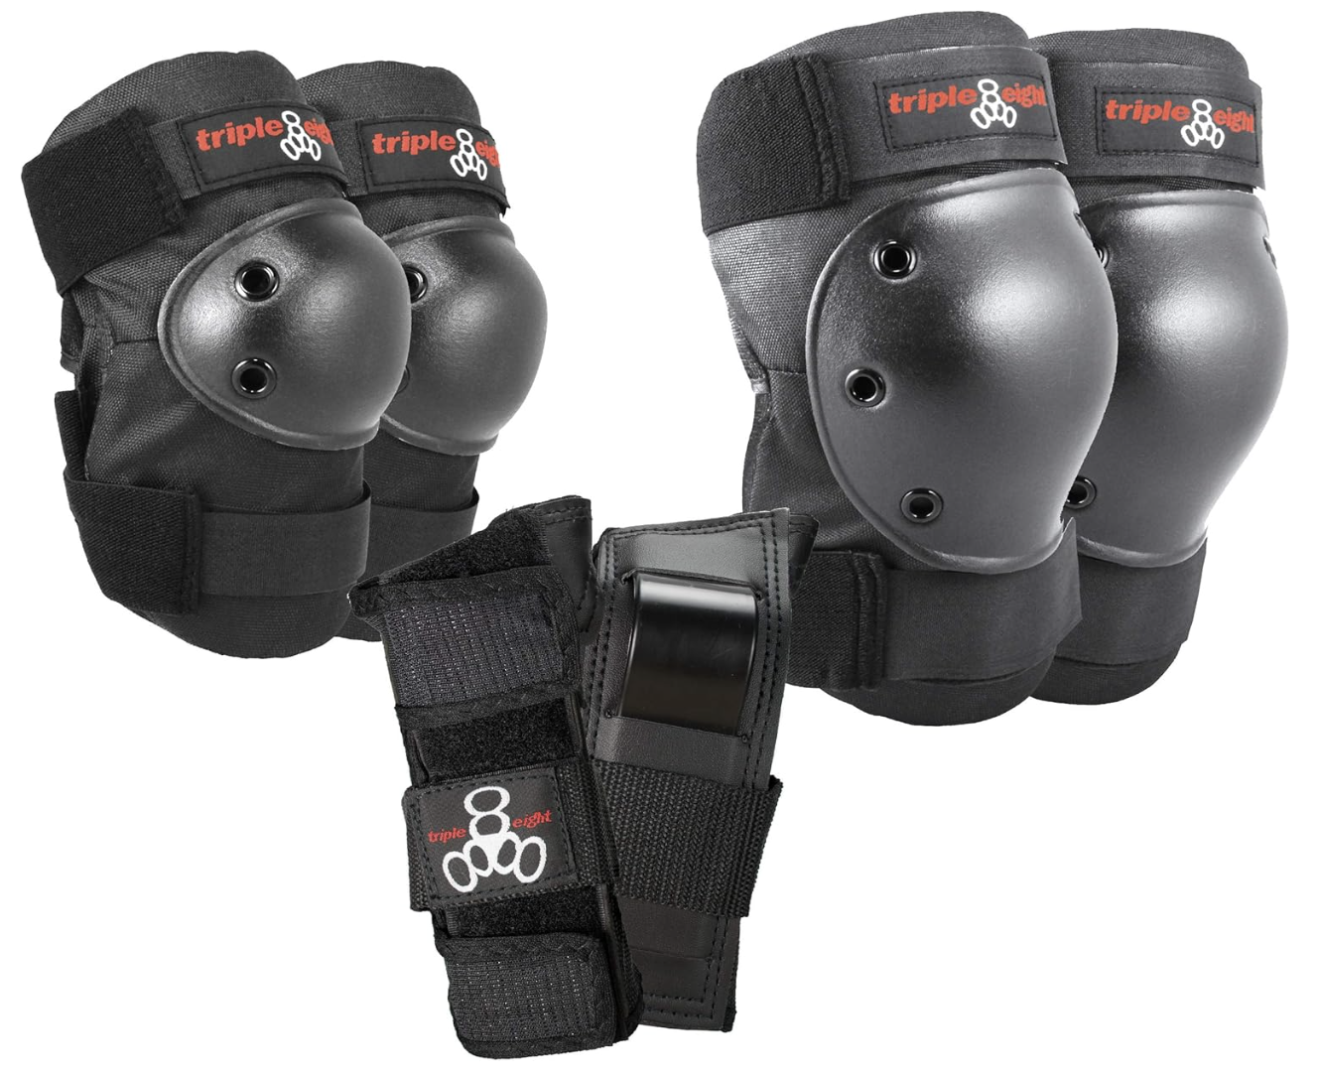
SAFETY
EQUIPMENT
01
Helmet
The foam inside a skateboard helmet compresses during impact to absorb shock to reduce the risk of traumatic brain injury.
02
Knee pads/Elbow pads
Protective gear worn on knees and elbows that shields joints from impact injuries when falling or colliding with obstacles. Also provides cushioning for extended periods of kneeling.
03
Wrist Guards
Protective gear that encases and stabilizes the wrist joint to prevent sprains, fractures, and other injuries commonly associated with falls during skating and action sports.

Slide 18
CREATING THE ENVIRONMENT
When using skateparks, gyms, or other spaces its important to use the best practices to run a safe program.
Location- Having a good location is important. This could be a skatepark, empty parking lot, basketball court, tennis court, gym or pavillion. Make sure the area is smooth with no big cracks in ground, gravel, trash or other debris.
Timing- Picking a good time of day for right weather climate. If using a skatepark go at a less than busier time of day.
Equipment- Having properly fitting helmets, different sizes of skateboards, adaptive skateboards, wcmx chairs and other adaptive equipment.
Participants- Have participant sign up with questions regarding diagnosis to have general idea of equipment, volunteers and other preparation needs to make a successful program.
Instructors- A minimum of two trained instructors per 10 participants is recommended
Volunteers- Volunteer support is also highly encouraged if possible to make programs successful. Volunteers can help keep participants safe and motivated
Successful Program- If all these pieces come together then your participants should have fun and enjoy themselves
Risk Management- Have safety and risk management protocols in place

Slide 19
Building a Welcoming & Inclusive Environment(Language)
When meeting an individual, it's crucial to approach them without assumptions. A person’s physical disability, inability to communicate verbally, or difficulty being understood doesn’t automatically suggest they have a cognitive or intellectual disability, nor does it mean they cannot understand what is being said. It’s essential not to speak over them or treat them as though they are absent. Always be respectful, mindful, and use age-appropriate language.
Take the time to get to know each participant as an individual. Understand their abilities, preferences, and communication style. Engage with the participant, their volunteers, and their families. If you’re uncertain about a diagnosis, take the initiative to research or consult a licensed professional. Sometimes, rare diagnoses may require extra learning and attention.
It’s important to never generalize or stereotype someone based on a particular diagnosis. While certain traits may be common among individuals with the same condition, it’s crucial to remember that each person is unique, and their experience may differ. Embrace their individuality and avoid assumptions based on labels.

Slide 20
What's currently Available
USA Skateboarding Open Class(3 competitions 2025)
Worlds WCMX- Online, National and International Competitions
World Skate International Federation
Brazil Para Skate Competitions
What's happening
2026 USA Skateboarding will adopt Brazil Classification ( VI, Upper Limb, Three Lower Limb)
2026 USA will have new NBG(May control future classification and competition pipeline)
What's Needed for Paralympic Inclusion
12 Countries Need NBG’s recognized by the IPC and World Skate
Creation of a Unified Classification System-Agreement with all NBG’s
Competition Pipeline for point system(local,regional,national and international)
COMPETITION
& TIMELINE
SKATEBOARDING

Slide 21
Better
LIFE IS
WHEN YOU SKATE

Slide 22
WCMX
Wheelchair Motocross
PRESENTATION

Slide 23
WCMX uses modified wheelchairs for skatepark-style tricks.
01
WHAT IS WCMX?
02
Athletes perform wheelies, grinds, spins, and aerials.
Born from BMX/skateboarding culture—powered by innovation & community.
03

Slide 24
Why WCMX Matters
1. Empower Through Defiance
3. Rise Together
Forges inclusive communities where everyone pushes each other forward, creating spaces where ability is celebrated and limits are left behind.
Empowers athletes to rewrite the stereotype of disability by redefining what’s possible—on wheels, on ramps, and in life.
2. Strength in Motion
Builds strength, balance, and fearless creativity through adaptive action sports that challenge both body and mind.

Slide 25
LAUNCHING A WCMX PROGRAM
Define Audience
02
Set Goals
01
youth beginners, adult veterans, aspiring competitors
fun, therapy, competitive pathway.
Secure Venue
Assemble Crew
03
04
smooth concrete, rolled transitions, wide decks.
coaches, spotters, medical support.
05
Promote
social media, local news, rehab‑center, flyers.

Slide 26
Reinforced WCMX chair (Box, Finch)
PROGRAM
Helmet (SKATE//BMX)
ESSENTIALS
Pads + gloves + wheel guards
CHECKLIST
Volunteer spotters (1:4 ratio)
Liability waivers & insurance

Slide 27
SAFETY FIRST
Teach tuck‑and‑roll & slide‑outs for safe falls.
Mandatory gear every session—no exceptions.
Warm‑up: 5 min roll, dynamic stretches, balance drills.
Emergency Action Plan posted & practiced.

Slide 28
SKILL PROGRESSION & CLASSIFICATION
LEVEL | CORE FOCUS | SAMPLE TRICKS
Beginner | Control & Confidence | Wheelie hold, small roll‑in
Intermediate | Technical Flow | 180‑wheelie, low rail grind
Advanced | Aerial & Combos | Backflip, 360 moto whip

Slide 29
CLINICS THAT INSPIRE
1-
Welcome & goal‑setting
Skill stations (by level)
-4
Gear & safety rundown
Fun challenge: Best Trick or Balance Battle
-5
2-
Mentorship is key—pair new athletes with experienced ones.
3-
Reflection & shout‑outs
-6
Warm‑ups

Slide 30
ADAPTIVE
SKATEPARK
DESIGN
A truly inclusive skatepark is more than accessible—it’s inviting. Work with city officials and park designers to include adaptive-friendly elements. Don’t wait for perfect—modifications go a long way.
Smooth concrete and seamless transitions
Wide bowls, low rails, and shallow ramps
WENTWOOD SKATE
SKATEPARK
KENNER,LA
ADA pathways and bathrooms, parking, and shaded rest areas
Pads on hard surfaces and safe layout flow

Slide 31
COMPETITIONS & EVENTS
BEST AWARD
1
2
Divisions: Non Competitive • Intermediate • Pro
Formats: Jam, 90 s Run, Run + Best‑Trick
Judging: Difficulty 40 % • Execution 30 % • Flow 20 % • Style 10 %.s
Awards that celebrate effort & creativity
ANNUAL WORLD WCMX CHAMPIONSHIPS
WORLD WCMX
SERIES
More and more events open adaptive skate classes every year.
SEPTEMBER 12TH
BULLE, SWITZERLAND
Running since 2014
Running since 2024

Slide 32
0‹#›
SPONSORSHIP & SUPPORT
Programs need resources to grow. Funding isn’t just about dollars—it’s about building relationships with people who believe in your mission. Show them the impact, and invite them into the journey.
How to Build Support
Craft tiered packages (Friend $1k → Title $25k).
Target adaptive‑friendly brands & local businesses.
Grants: CAF, Move United, VA Adaptive Sports
Community fundraisers: demo days, silent auctions.

Slide 33
GROWING THE WCMX MOVEMENT
WCMX and adaptive skateboarding grow when we stay visible and active. Outreach, mentorship, and athlete advocacy are the heartbeat of expansion. Let every roll forward be a step toward building more inclusive spaces.
Ways to Expand:
Social storytelling (#WCMXLife #WorldWCMX).
Ambassador mentorship programs.
Advocacy at city council for inclusive parks.
Outreach demos at schools & rehab centers.

Slide 34
Whether you're looking for inspiration, funding, equipment, or community, these trusted sources support the growth of adaptive action sports at every level.
RESOURCES
Organizations:
Equipment:
Funding
Learning
World WCMX Federation • Move United • CAF
Box Wheelchairs • Finch Adaptive • Spinergy
IM ABLE • High Fives • AMBUCS
YouTube/@worldwcmx • other athletes

Slide 35
USA
TEXAS
NEW ORLEANS
CALIFORNIA
B-HAM
ATLANTA
EUROPE
UNITED KINGDOM
SWITZERLAND
GERMANY
CALL TO
ACTION
BRAZIL
SÃO PAULO
AUSTRALIA
CANBERRA
Join World WCMX Federation ➜ worldwcmx.org ➜ Local adaptive sports organizations like the SMCL Foundation & Associates and Abilities Skateboarding
Apply to be a Global Ambassador.
Host a beginner clinic in your city.
Share your first WCMX trick or event video with #WCMX.

Slide 36
THANK YOU
Ride
TOGETHER WE
TOGETHER WE RISE
TONY TORRES

