Slide 1
Pioneering Concussion Baseline Testing in Collegiate Para Athletes

Slide 2
Session Overview
History of concussions and standardized measures and testing
The current state of para sport and concussion
Concussion baseline testing discussion and demonstration
Future directions of concussion knowledge in para sports

Slide 3
Meet our Team
Lily Tiefel MPH
Dr. James Eckner Associate Professor, Department of Physical Medicine & Rehabilitation
Dr. Melissa Tinney Clinical Assistant Professor, Department of Physical Medicine & Rehabilitation
Kurt Beach ATC

Slide 6
University of Michigan's Adaptive Sports and Fitness Concussion Program
Objective was to develop and implement a baseline concussion testing program for the University of Michigan’s Adaptive Sports and Fitness (ASF) competitive sports teams.
The UM ASF program pioneered its first concussion evaluation program in 2024
43 athletes completed the baseline concussion assessment
Baseline program ran between May-August 2024

Slide 7
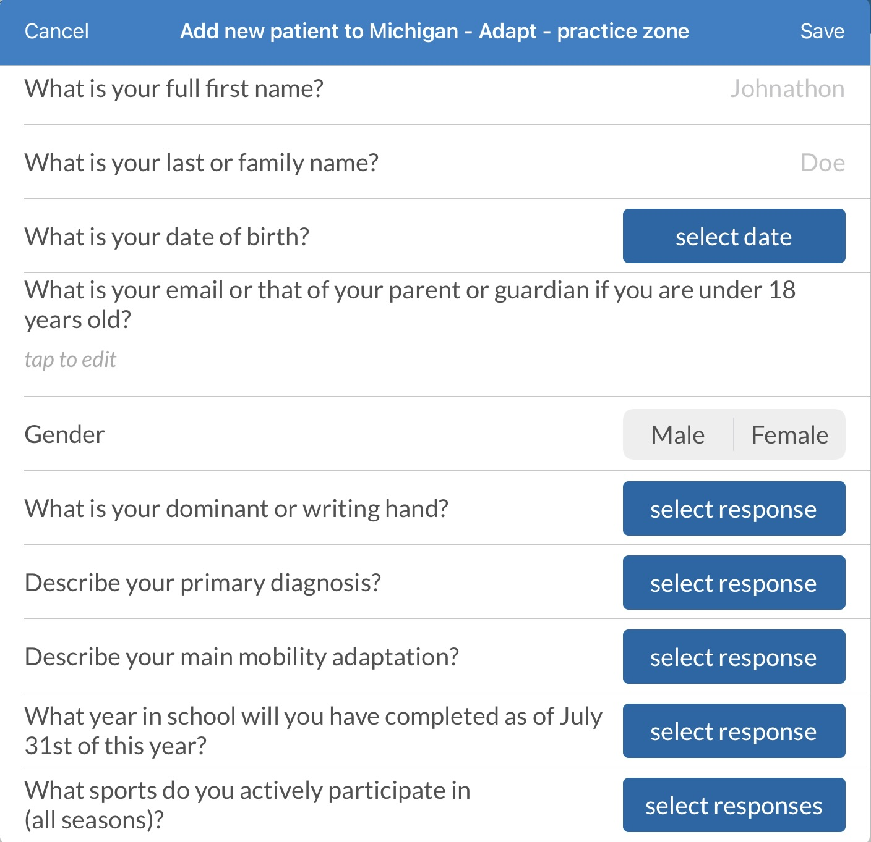
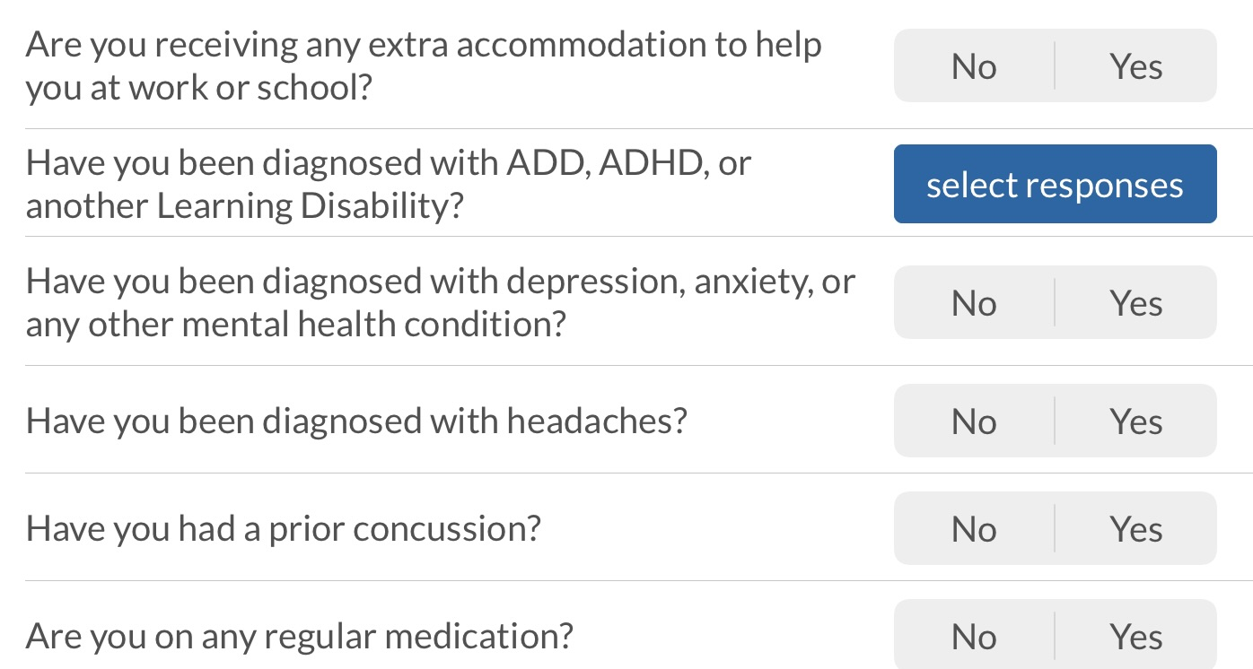
Workflow Steps
Graded Symptom Checklist
Standardized Assessment of Concussion
Balance Assessment: WESS
Delayed Recall
Visual Acuity
Processing Speed Test
Simple Reaction Time
Choice Reaction Time
Trail-Making Test A
Trail-Making Test B

Slide 8
Findings
Graded Symptom Checklist- Para athletes reported more symptoms overall
Standardized Assessment of Concussion responses were mostly verbal
Executive function tests were impacted by motor control
Visual Accuity- Athletes would turn their head to a metronome rhythm, testing their motor control of whether they could turn their head to the beat instead of visual acuity
Trails Tests- Athletes' manual dexterity and motor control affected the cognitive processes' purpose of the tests

Slide 9
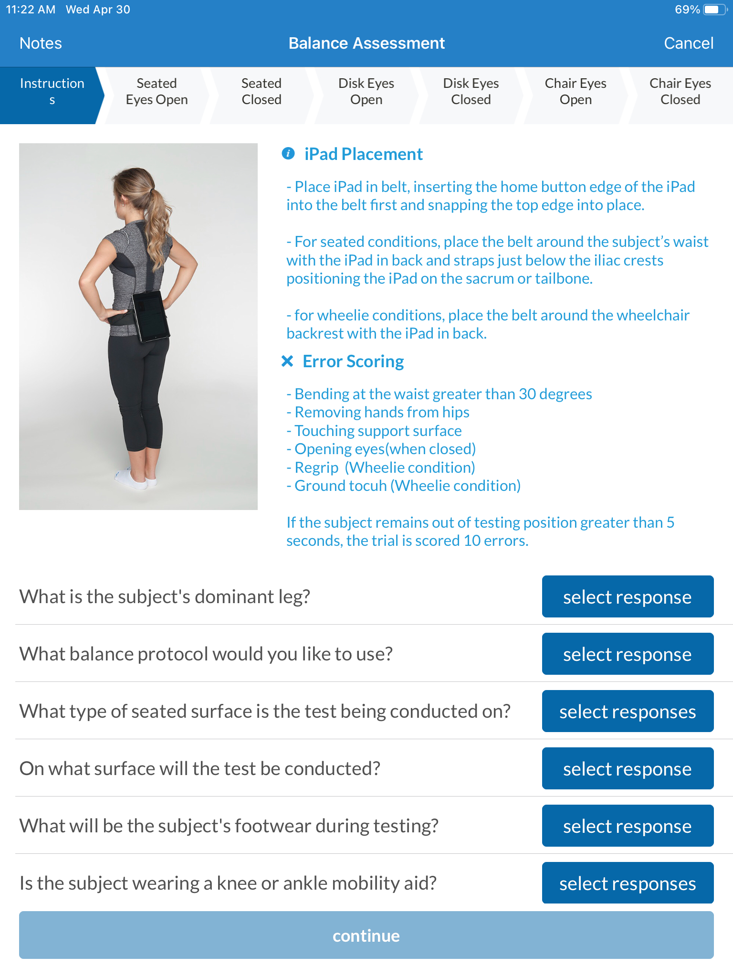
Wheelchair Error Scoring System
Currently the only balance protocol offered
The WESS has six parts to the assessment.
Seated on PT table with eyes open
Seated on PT table with eyes closed
Seated on a disc on top of the PT table with eyes open
Seated on a disc on top of the PT table with eyes closed
Wheelie in chair, eyes open
Wheelie in chair, eyes closed

Slide 10
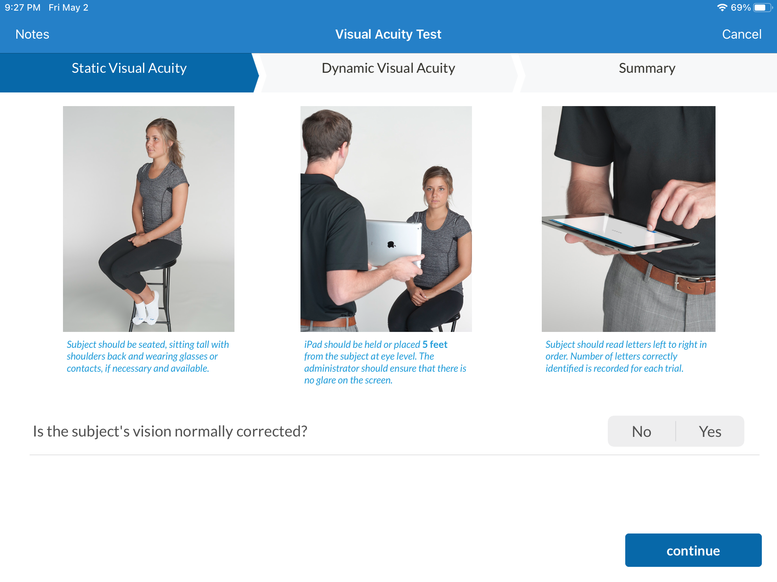
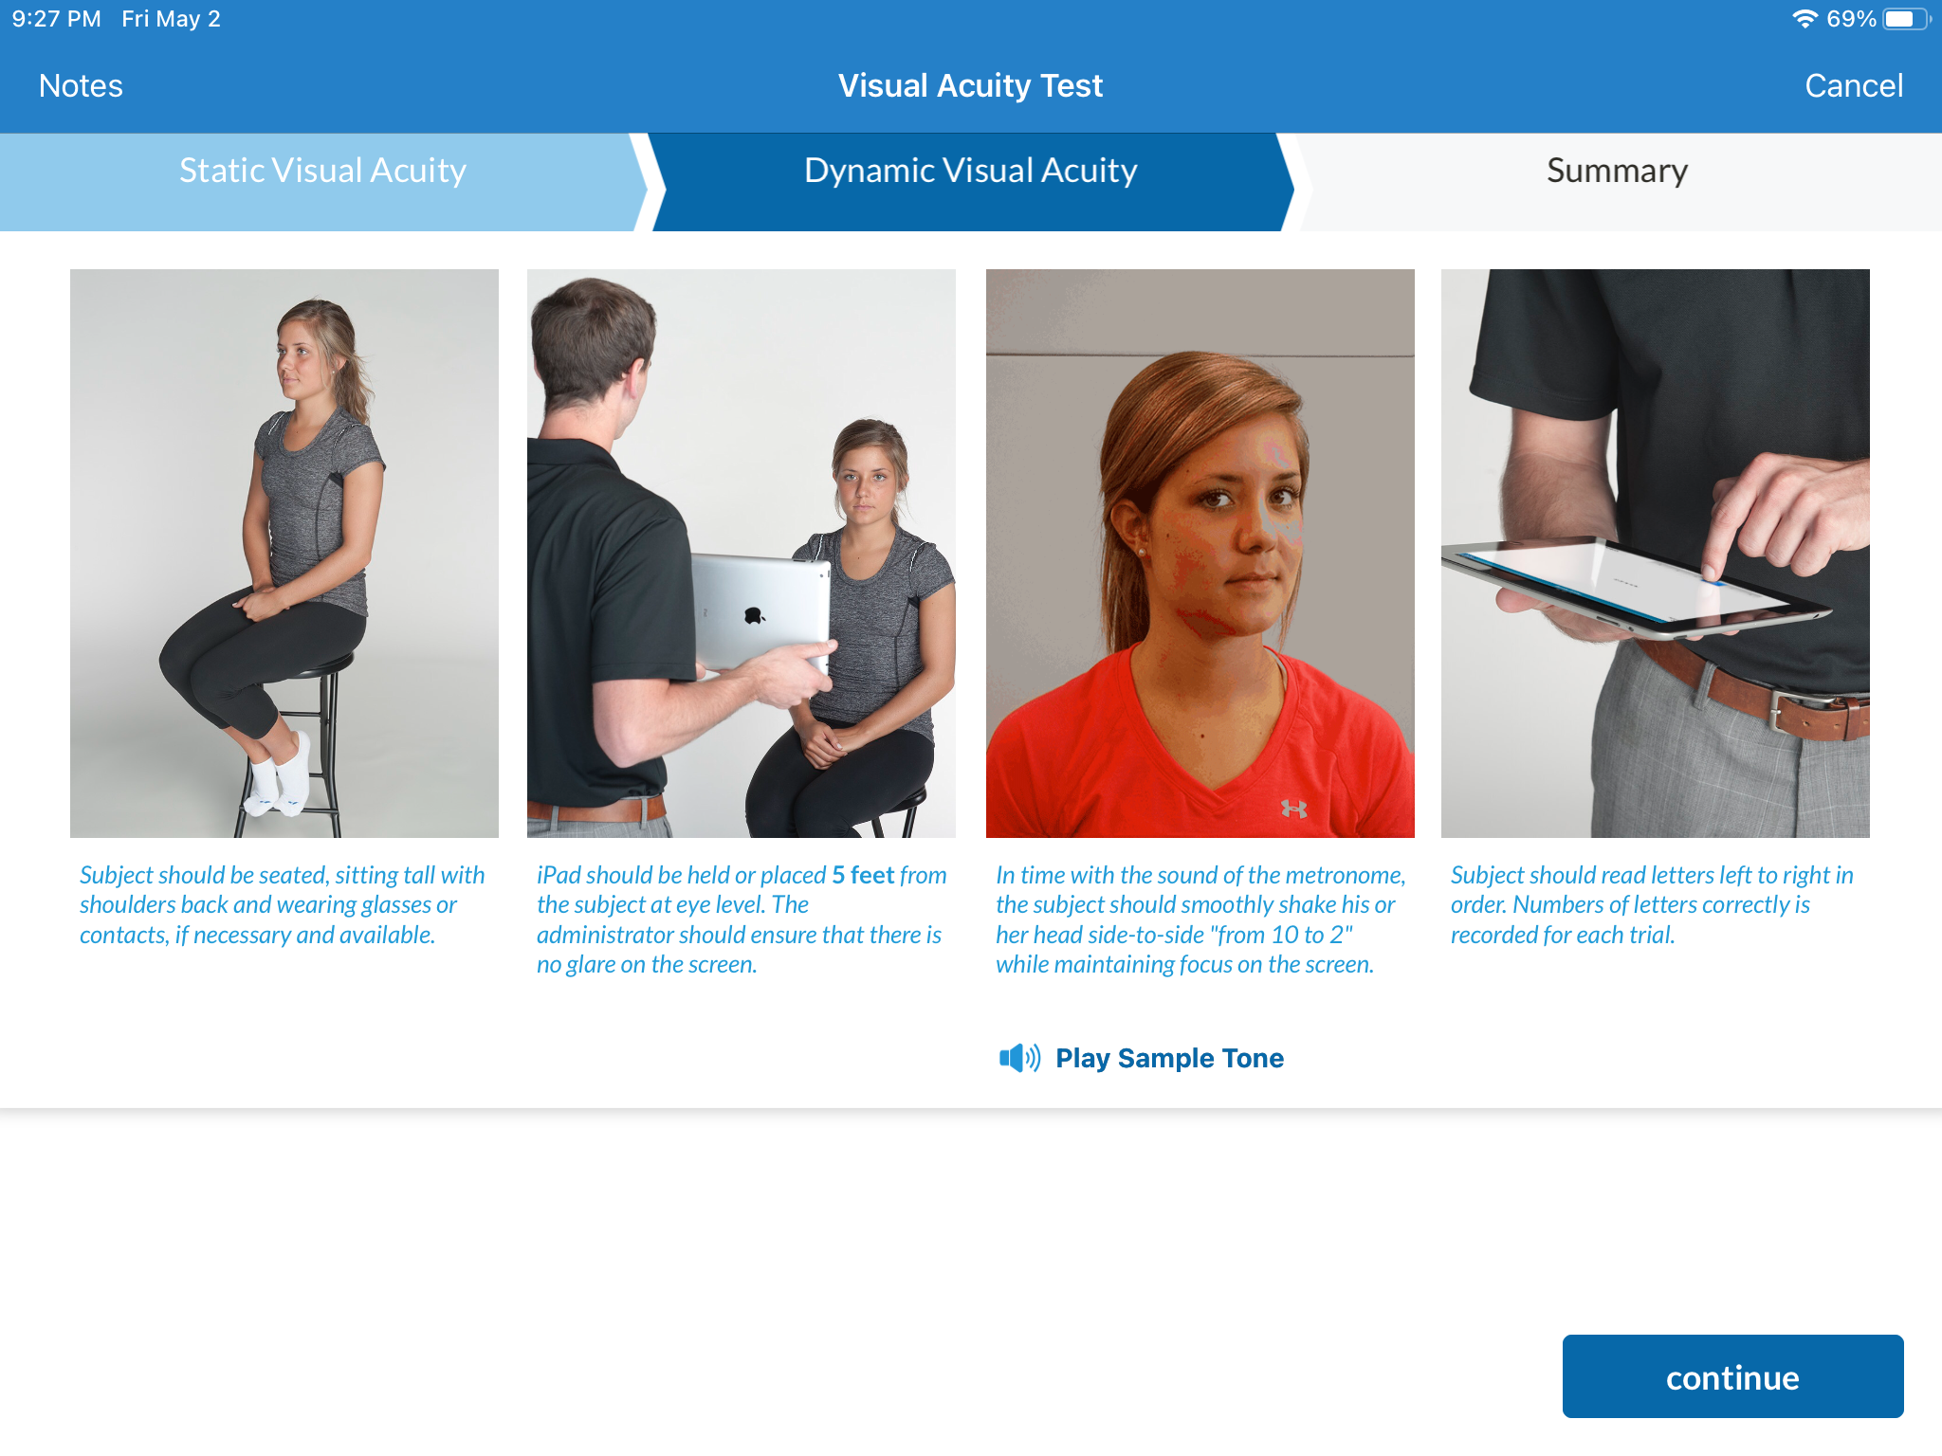
Visual Acuity Test

Slide 11
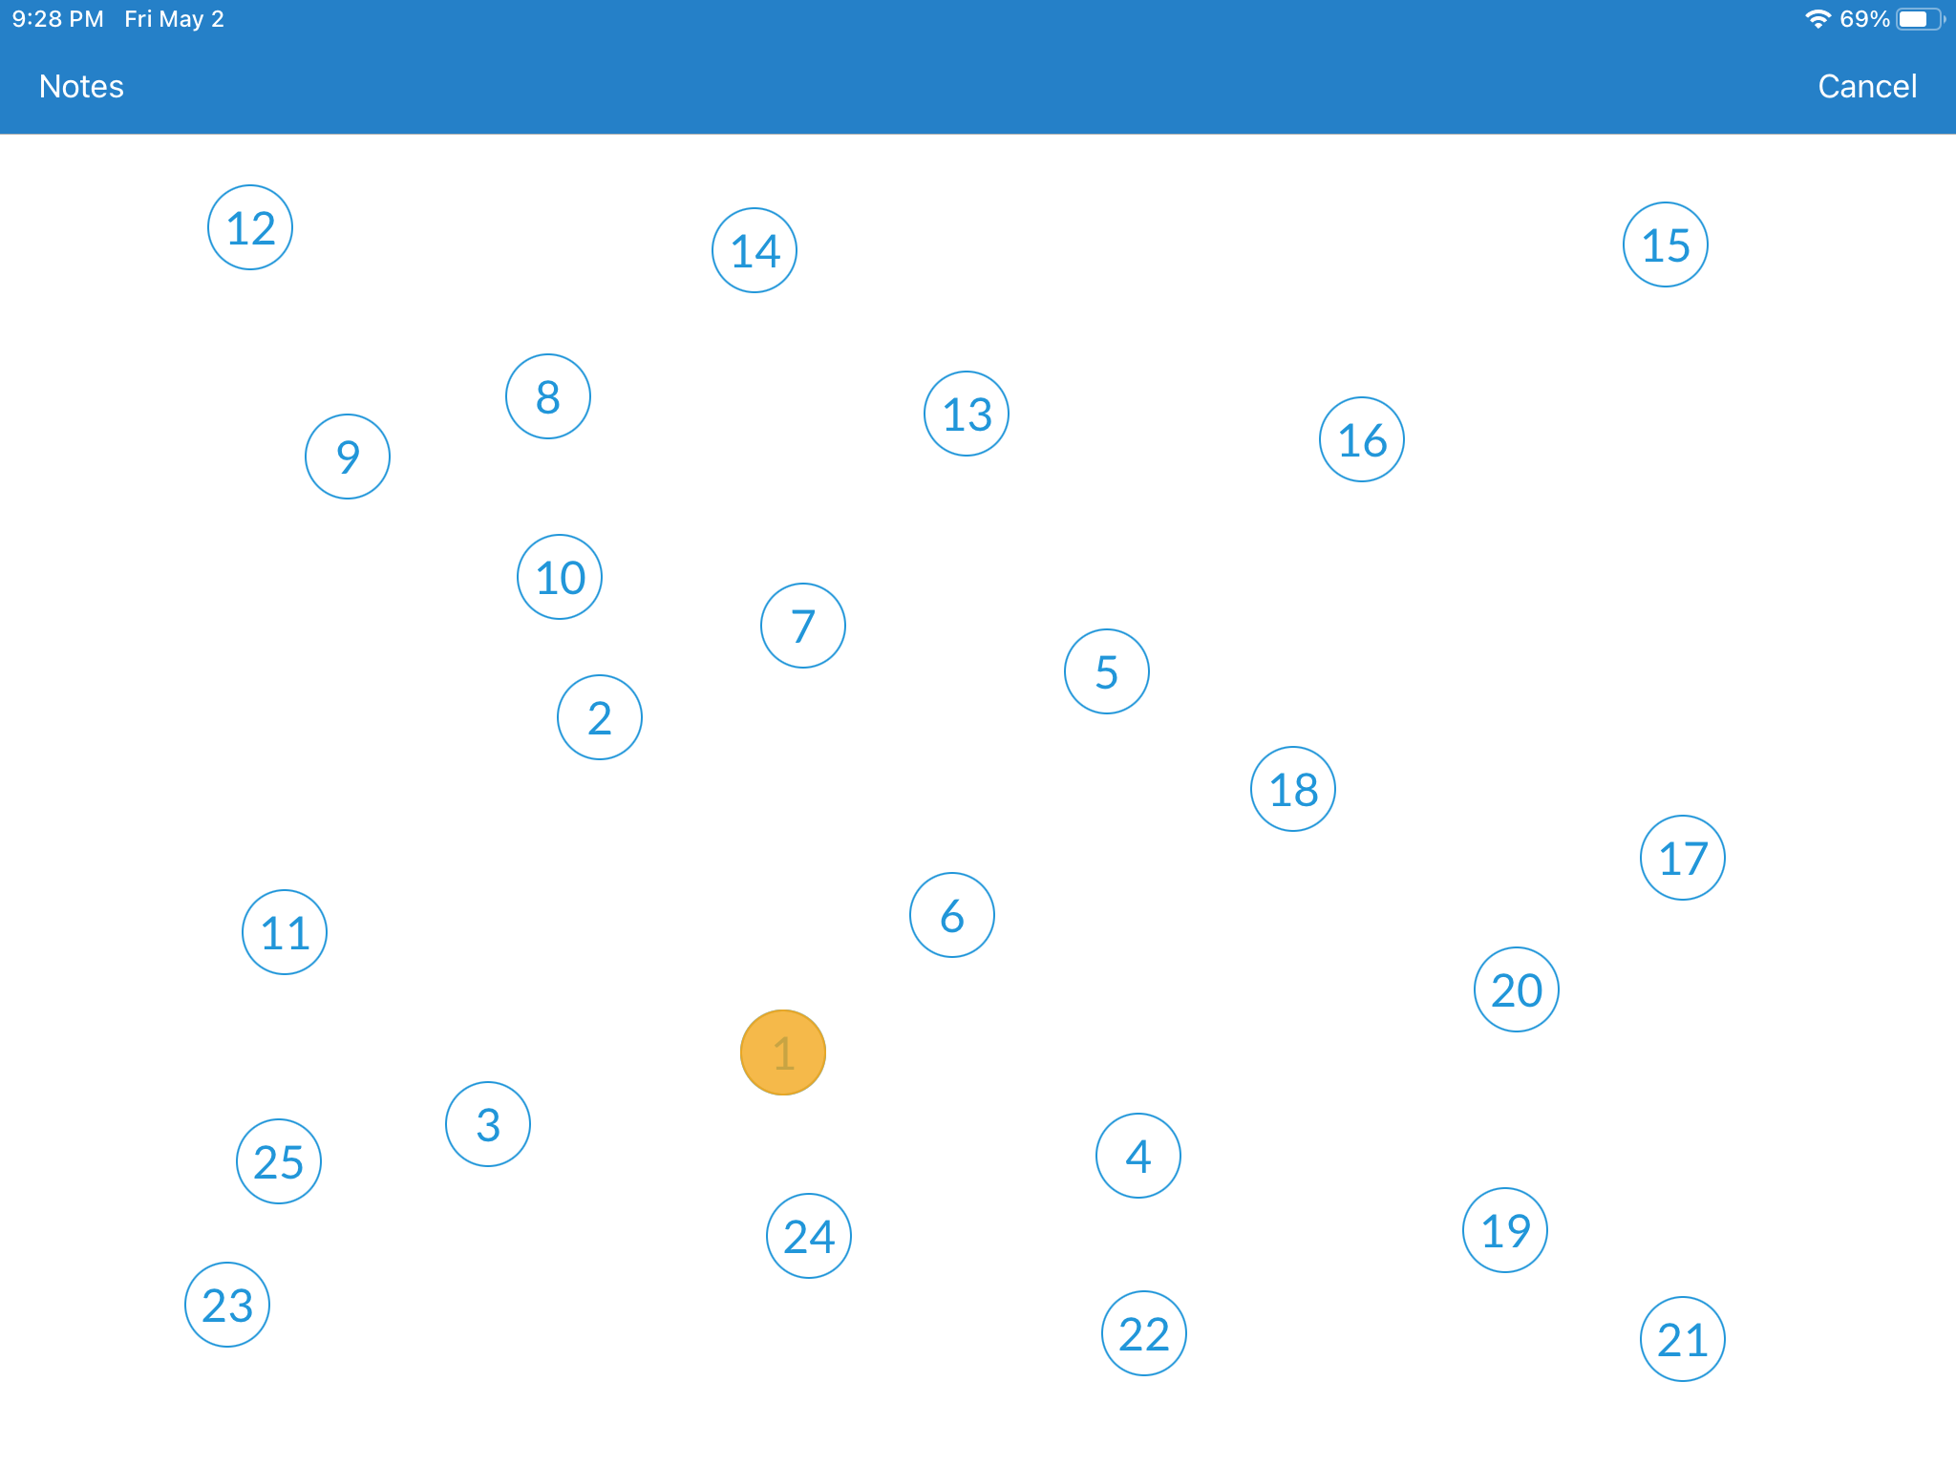
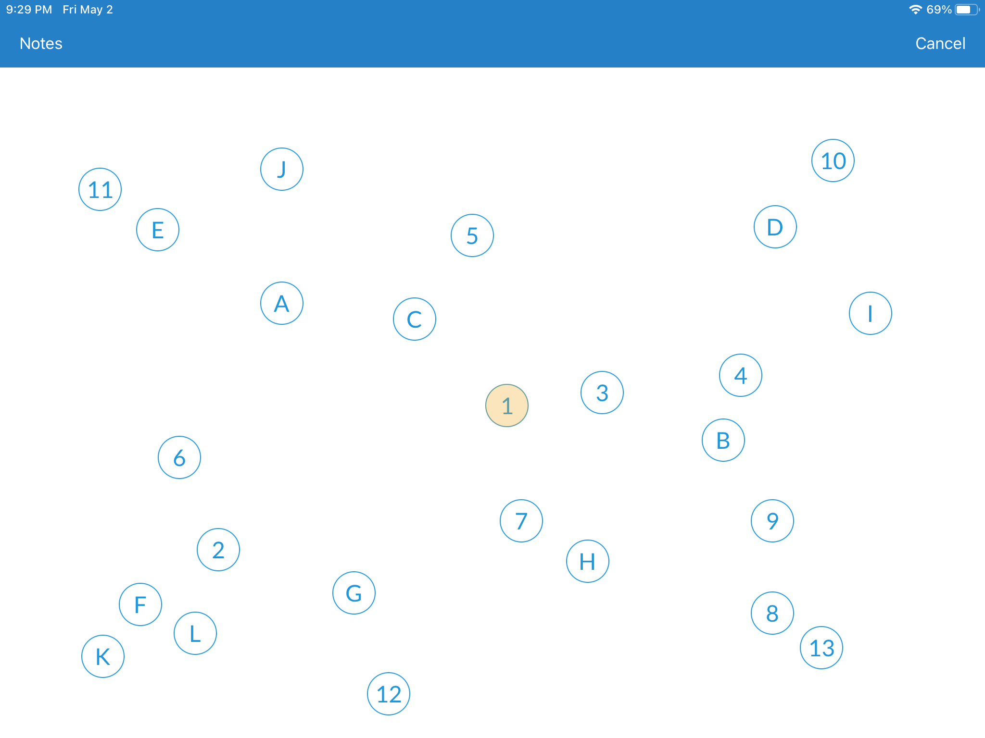
Trails

Slide 12
Future Direction
Symptom checklists and baseline information has been useful for treatment of para athletes who have sustained concussions in season
Recognize current tests are not testing what we want to test. A need to create and modify tests to increase variability and inclusivity
Collaborate with outside groups (e.g., Adaptive Cognitive Lab)
Research to further understand how concussions are experienced by para athletes

Slide 13
Contact Information
Lily Tiefel
Tiefelli@umich.edu

Slide 14
Thank You

