Slide 1
Volunteers: Recruiting, Training and Retaining Tricks of the Trade
Eileen Andreassi, Director, Therapeutic Recreation and Adaptive Sports,

Slide 2
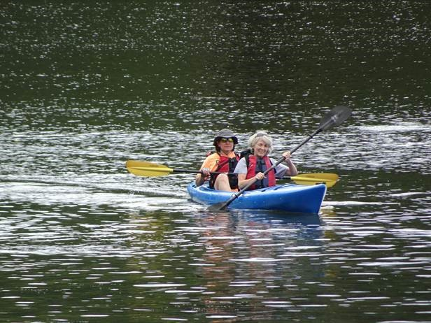
Volunteer Help Makes it all Happen
Notes:
Difficult to safely host programs without volunteers

Slide 3
Objectives
Identify
Objective 1: Identify three key steps to recruiting volunteers.
List
Objective 2: List three critical volunteer training concepts.
Identify
Objective 3: Identify three strategies to retain volunteers.

Slide 4
Quick Facts
About 63 million Americans volunteer.
One-third of the nonprofit workforce is volunteers.
35% of individuals volunteer to socialize.
62% of nonprofits state recruiting volunteers is “a big problem.”
Approximately 1 in 3 American volunteers donate their time to religious organizations.
Most U.S.-based volunteers are between the ages of 35 and 44.
https://www.councilofnonprofits.org/articles/new-data-and-resources-volunteers
Notes:
25% of the adult US population volunteers
Specifically, social volunteers give their time more frequently than others
tend to volunteer with more than one organization, which is not the norm.
For these volunteers, the community your nonprofit builds is what matters and what makes them dedicated to your cause.
FL-lowest % of volunteers-in 2017, 22.8% of the population volunteered; 2022 dropped to 15.9%.
Utah- highest percentage-51%), many participate in volunteer opportunities provided through their churches.

Slide 5
2022 national survey of 1,200 nonprofit CEOs
2/3 reported demand for services is up
28.7% are operating with less funding and fewer paid staff than they had before the pandemic.
Continued to identify finding volunteers – and avoiding burnout of current volunteers – as an ongoing challenge.
University of Maryland’s DoGood Institute, “The State of Volunteer Engagement,”

Slide 6
Lifecycle of a Volunteer

Slide 7
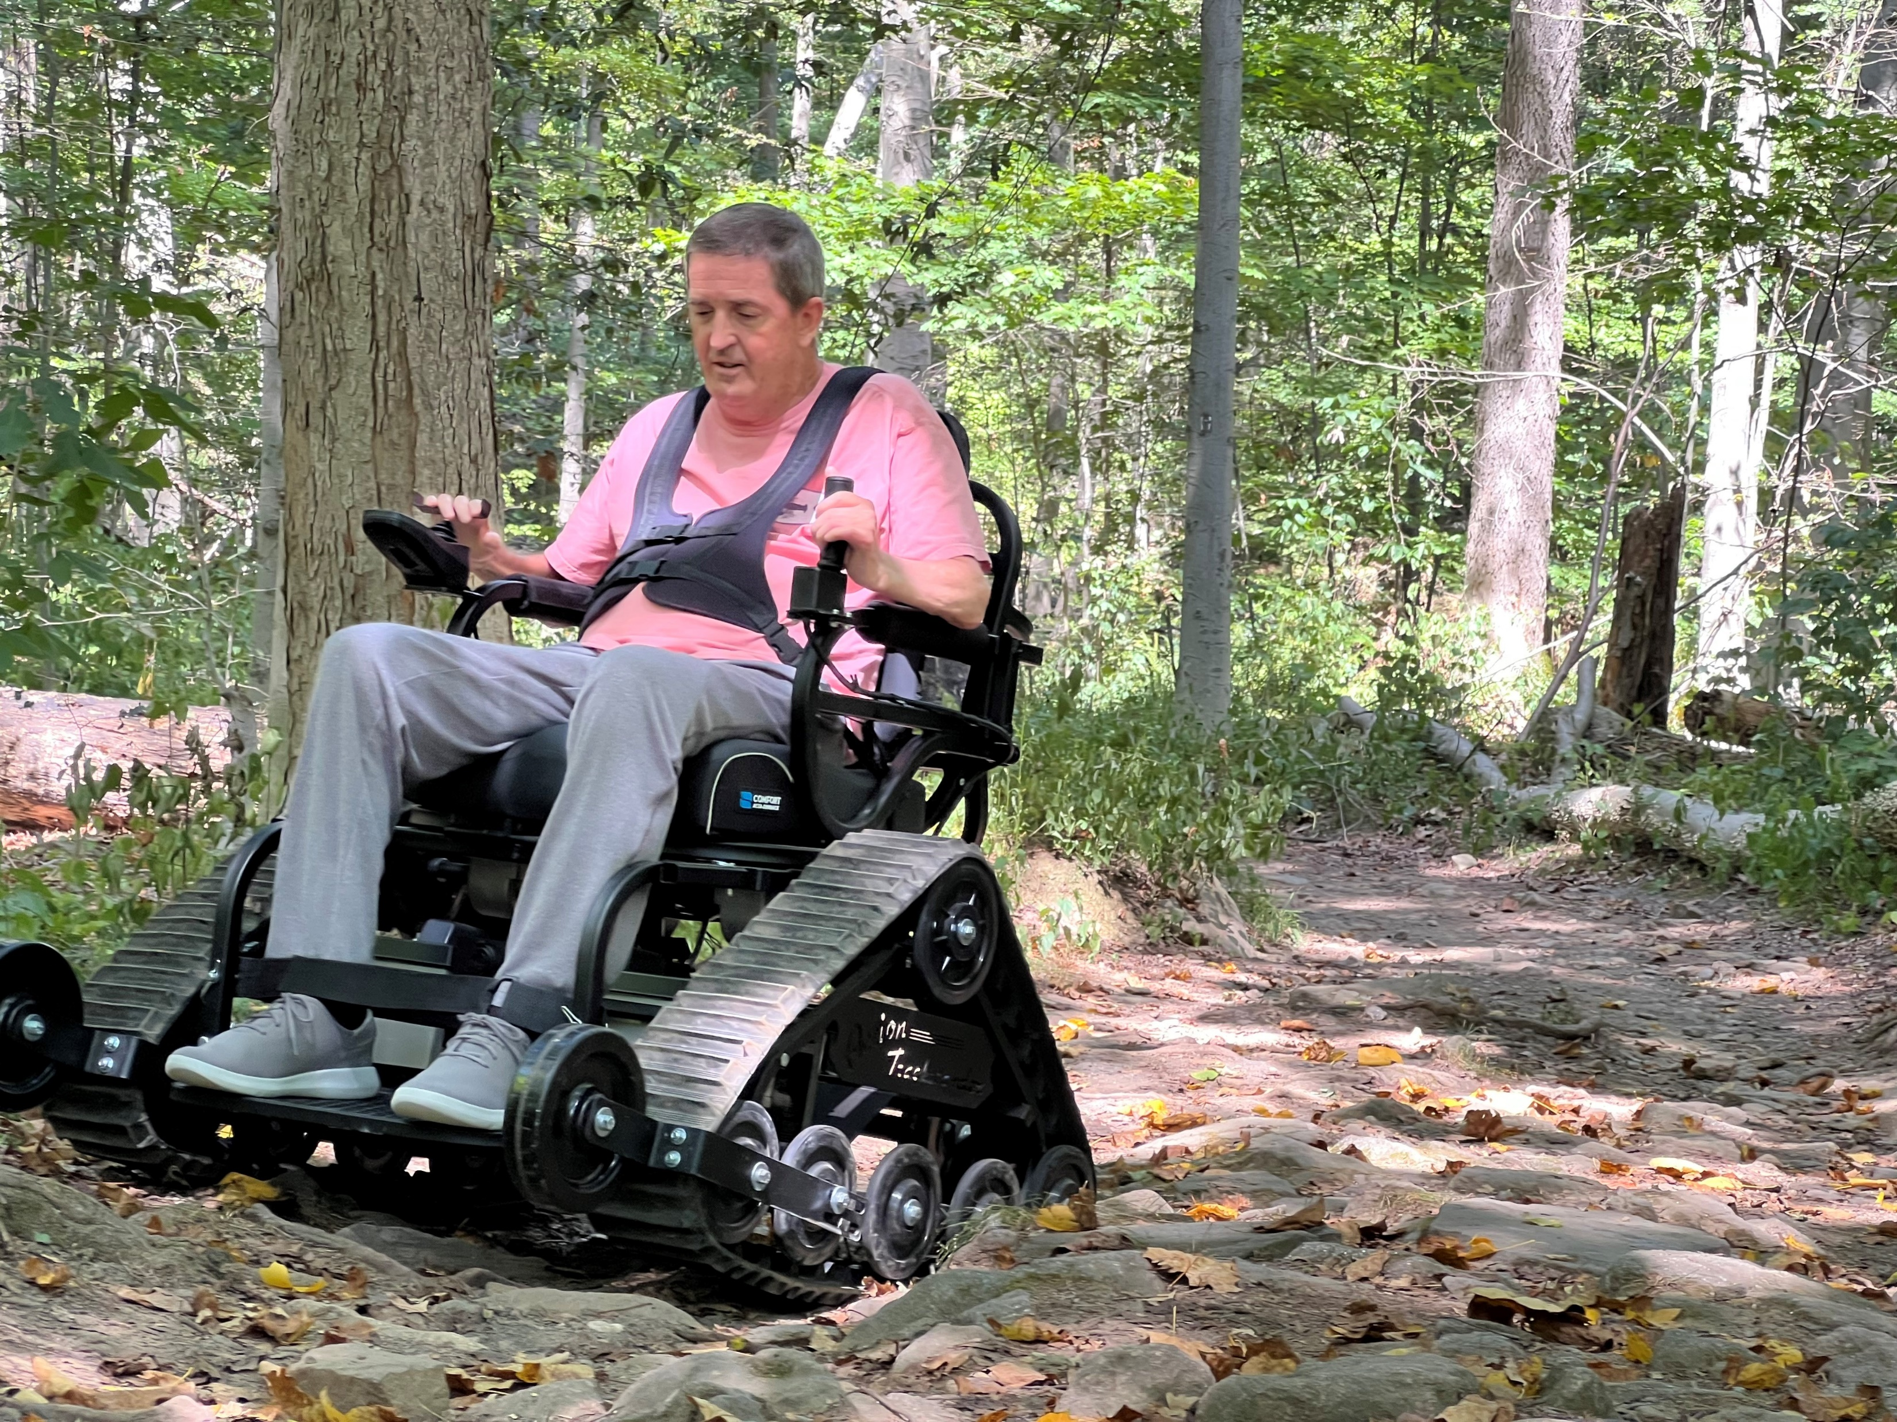
Volunteer Recruitment Step 1-Determine Needs
Task Analysis
1
Which tasks can be handled by a volunteer vs need for a professional
2
Create list of specific tasks a volunteer can do for you
3
Consider risk manage-ment issues
4
Develop Process
5
Notes:
Task Analysis-Marketing e-mails, flier creation, registration, follow up e-mails/calls, maintain DL list;
Ensure signed releases; equipment set-up; help at event tables; accompany new participants; infection control
Professional-Program Development, P&P’s, Risk Management Plan/Implementation; Recruit and train volunteers;
Represent at local/state/regional events; Recruit/Reach out to potential participants; Teach/Coach new participants;
Transfers; Procure and maintain Equipment
Risk Management-Age range. Ability level. Do volunteers need to be HIPPA trained if have access to personal information?
Are volunteers permitted to assist with transfers? Take participants to the bathroom?

Slide 8
Volunteer Recruitment Step 2-Outreach
Add volunteer tab to website
1
Create a 1-page application & post on website
2
Post ‘Need Volunteers’ on social media & all program announcements
3
Develop list of likely pools of volunteers from which to recruit
4
Determine Contact Person for each school/organization & reach out personally
5
Ask to attend a meeting/assembly/event to either give presentation or have a table
6
Consider hosting an event *include food
7
Notes:
-Some family members/friends may volunteer
-Be aware of overzealous personalities to avert potential issues up front
Volunteer Pools-High Schools, Senior Centers, Service Clubs, Scouts, Teams, Veteran Organizations, Houses of Worship
“My name is Eileen and I’m running a community based ___________ program. I’m anticipating a need for volunteers
interested in helping individuals successfully participate during practices/clinics/events………
Contact Person -Create a 20-30 second pitch for initial contact if a cold call
Critical Consideration-You should be well organized when making an ‘ask’ especially if a cold call as need to be professional even
If you yourself are a volunteer.
Typical questions-When is the program (date/time(s)? How many people do you need? How long is the program? Do they need any type of experience?
What role will they play? Is training available and if so, how long is it?

Slide 9
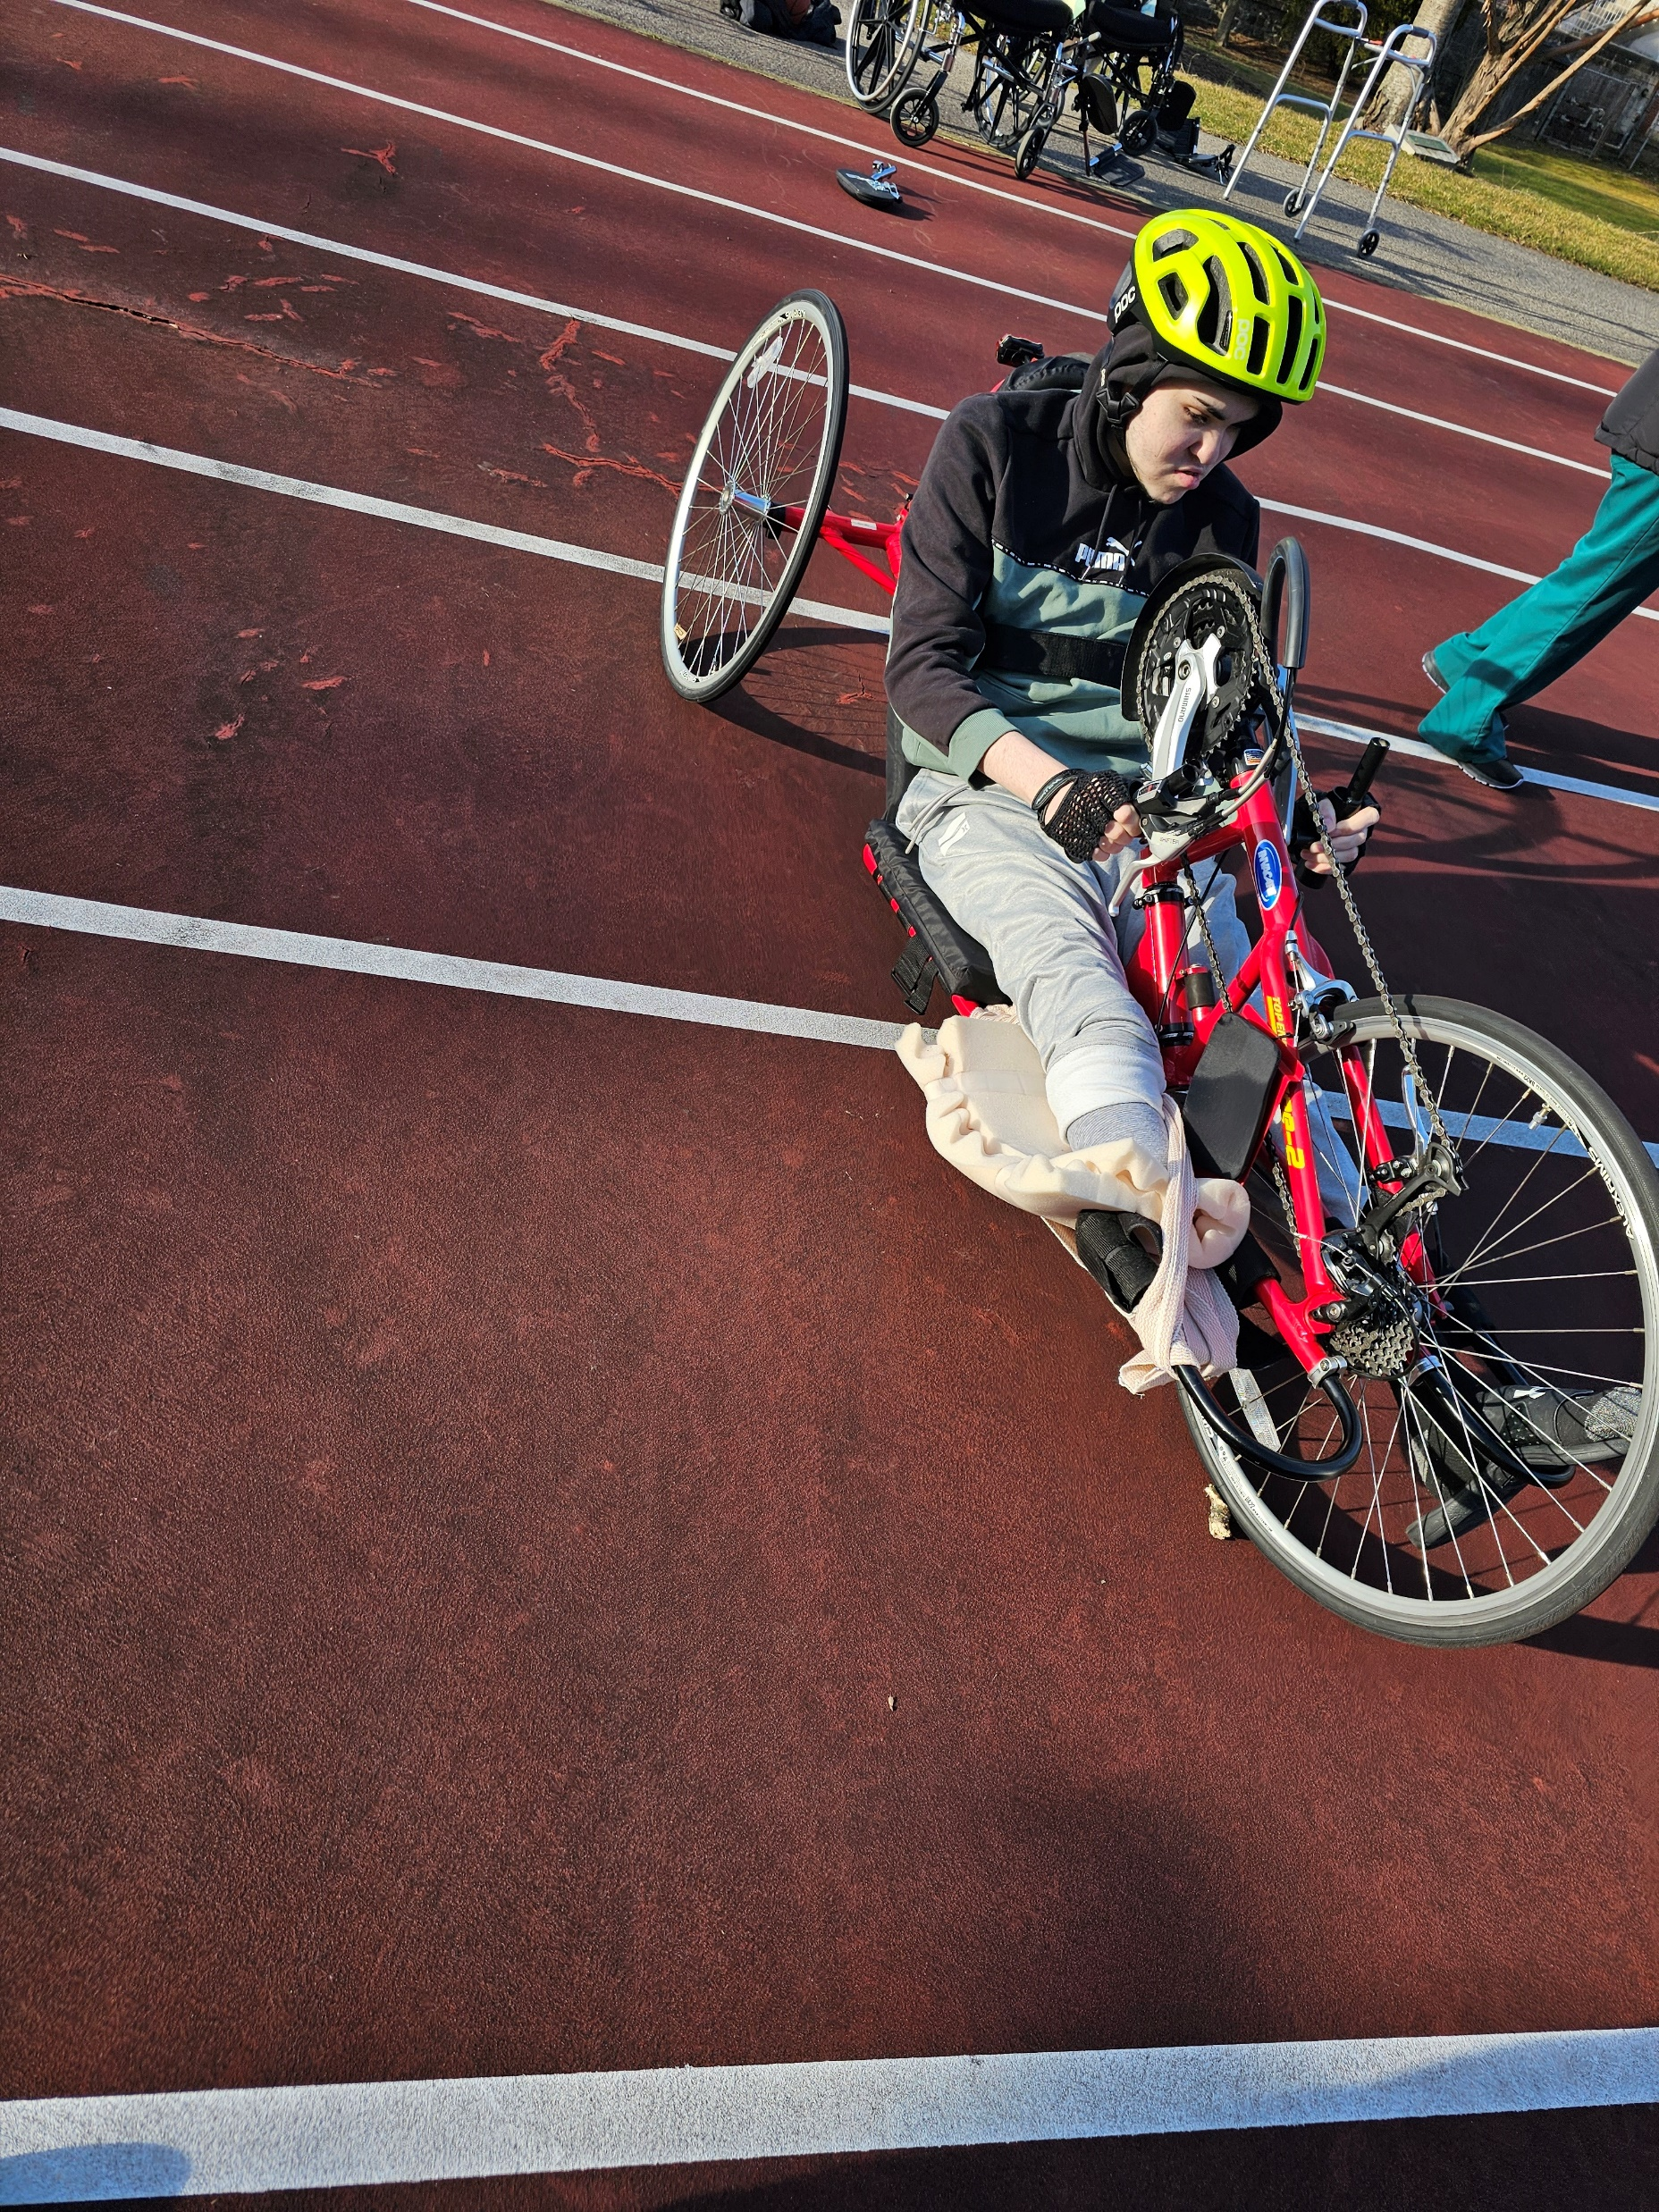
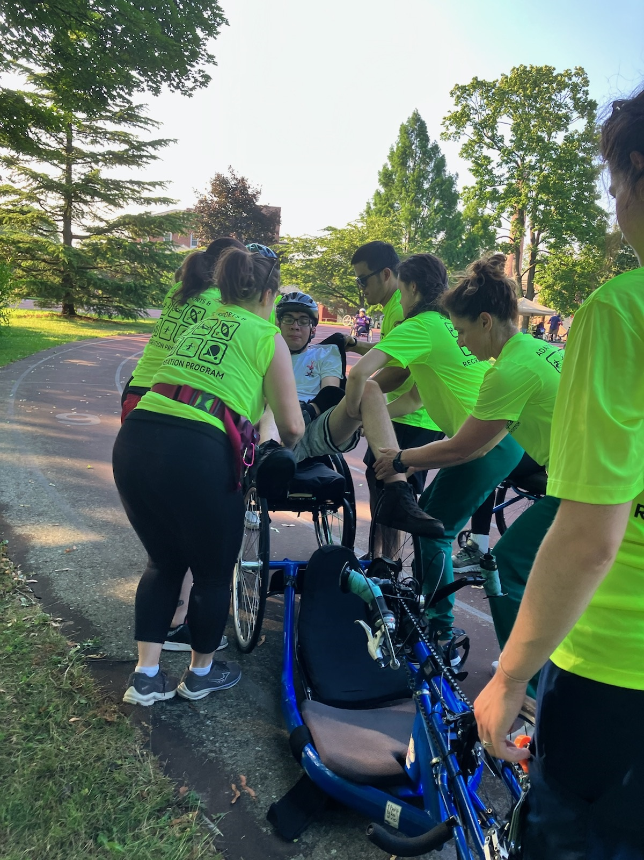
Volunteers are there-Find Them
Per latest data, volunteering via an organization is rebounding.
Formal Volunteering
Formal volunteering involves helping others through organizations to support:
-public health efforts
-food banks
-tutoring students to help them stay on track
75.7 million (28%) of Americans formally volunteered
between September 2022 and 2023.
-served an estimated 4.99 billion hours
-economic value $167.2 billion.
https://americorps.gov/about/our-impact/volunteering-civic-life
Notes:
AO-biking full body weight; in-patient and community;

Slide 10
Reach Out to Larger Companies
60% of companies offer paid volunteer time off (VTO).
Companies w/paid VTO programs offer an average of 20 hours per team member annually.
67% of survey respondents said having paid time off to volunteer would make for a positive experience.
62% desire paid time off work to have an optimal volunteer experience.
Notes:
ability to volunteer during business hours is the top factor for a positive experience.
1 day events and lso multi-day if a big company

Slide 11
Motivating Prospective & New Volunteers
Make It Easy to Sign Up.
Have a streamlined organized on-boarding process.
Offer Short Commitment and/or
long-term assignment
Why Volunteer? Communicate the Mission of the Organization.
Respect Your Volunteers' Time.
Encourage Them to Invite Others.

Slide 12
Recruitment Considerations
Critical
Be Professional
Use language at their educational level
Don’t use unfamiliar acronyms
Awareness of vulnerability/Accommodate their schedule
What tasks person is interested in performing/helping with?
Be prepared:
-for follow up questions re: program and needs
-to repeat information to interested candidates as it’s all new to them
-for candidate who seems gung-ho, then ghosts you

Slide 13
Volunteer Recruitment Step 3-Selection
Create list of interview questions
Decide if you want to accept applicants on the spot
Set up initial interviews/can also be on the spot
Pay attention to non-verbal communication
Explain next steps if you both agree it’s a good idea
?Background check? References?
Notes:
On-line Interviews easier for candidates but you want to meet them in person
After ice breaker, great first question is ‘what interests you about volunteering with us?
-What is your background in ___________?
-How do you react to changes?

Slide 14
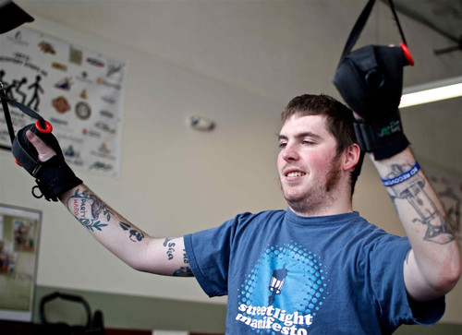
Volunteer Orientation & Training
Thank everyone for volunteering
Provide a general orientation
Include DisAbility Etiquette
Stress importance of Safety measures
Activity-Specific Training
Timing-Conduct earlier same day of event(s) OR prior to event date
*provide food if after work
Notes:
Orientation-5W’s & How; Infection Control; Parking; Sign Up and call-in process; Broken Equipment
Training-Safety; Activity Specific job duties; Type(s) of Equipment; Common Adaptations; Making Adjustments;
DisAbility Etiquette-from United Spinal-includes many, not all, diagnoses

Slide 15
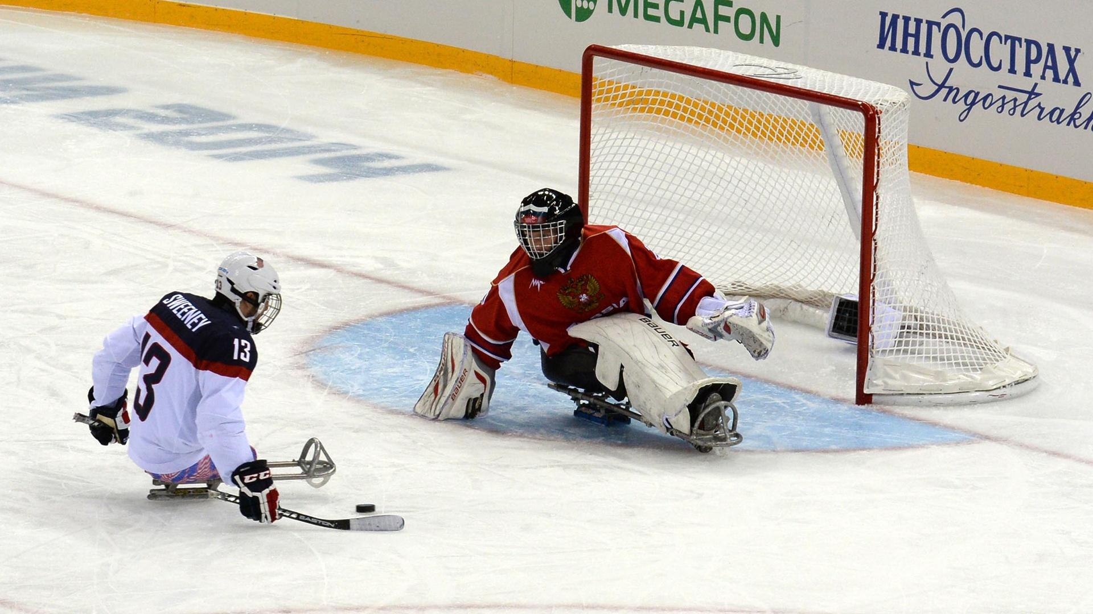
Volunteer Recruitment Step 4-On-Boarding/ Orientation
Follow agency procedure if it exists
Review specific tasks to be performed (computer or at event(s)/Job Title?
Get computer access if needed
If training required, inform of date/time
Set schedule
Review attendance expectations & ‘no show-no call’ policy
Have a sign-in/out sheet or database or digital like Volgistics
Notes:
-If organization-do they need to get a health clearance/do they need a badge
-if community-do they need to sign release form

Slide 16
Training-The Big Picture & Job Expectations
Have a written procedure broken down into discrete steps
Start small with one or two tasks and add as person shows proficiency & desire to do more
Match person not only by interest but also aptitude-consider mentor if long-term vols
Try not to discriminate by age or other demographic factors not related to task
Educate: Tell, Show, have person do it, have person teach another

Slide 17
Volunteer Lifecycle

Slide 18
It Pays to Retain Volunteers
In 2020, one volunteer hour was worth $28.54.
In 2025, the value of volunteer time is $33.49 per hour.
Recruiting, Orienting, Training, on-going education takes time and money
Organizational Knowledge is worth more than an hourly rate
Retaining volunteers makes your organization stronger
Retaining volunteers shows commitment to your programs and participants in terms of quality and continuity

Slide 19
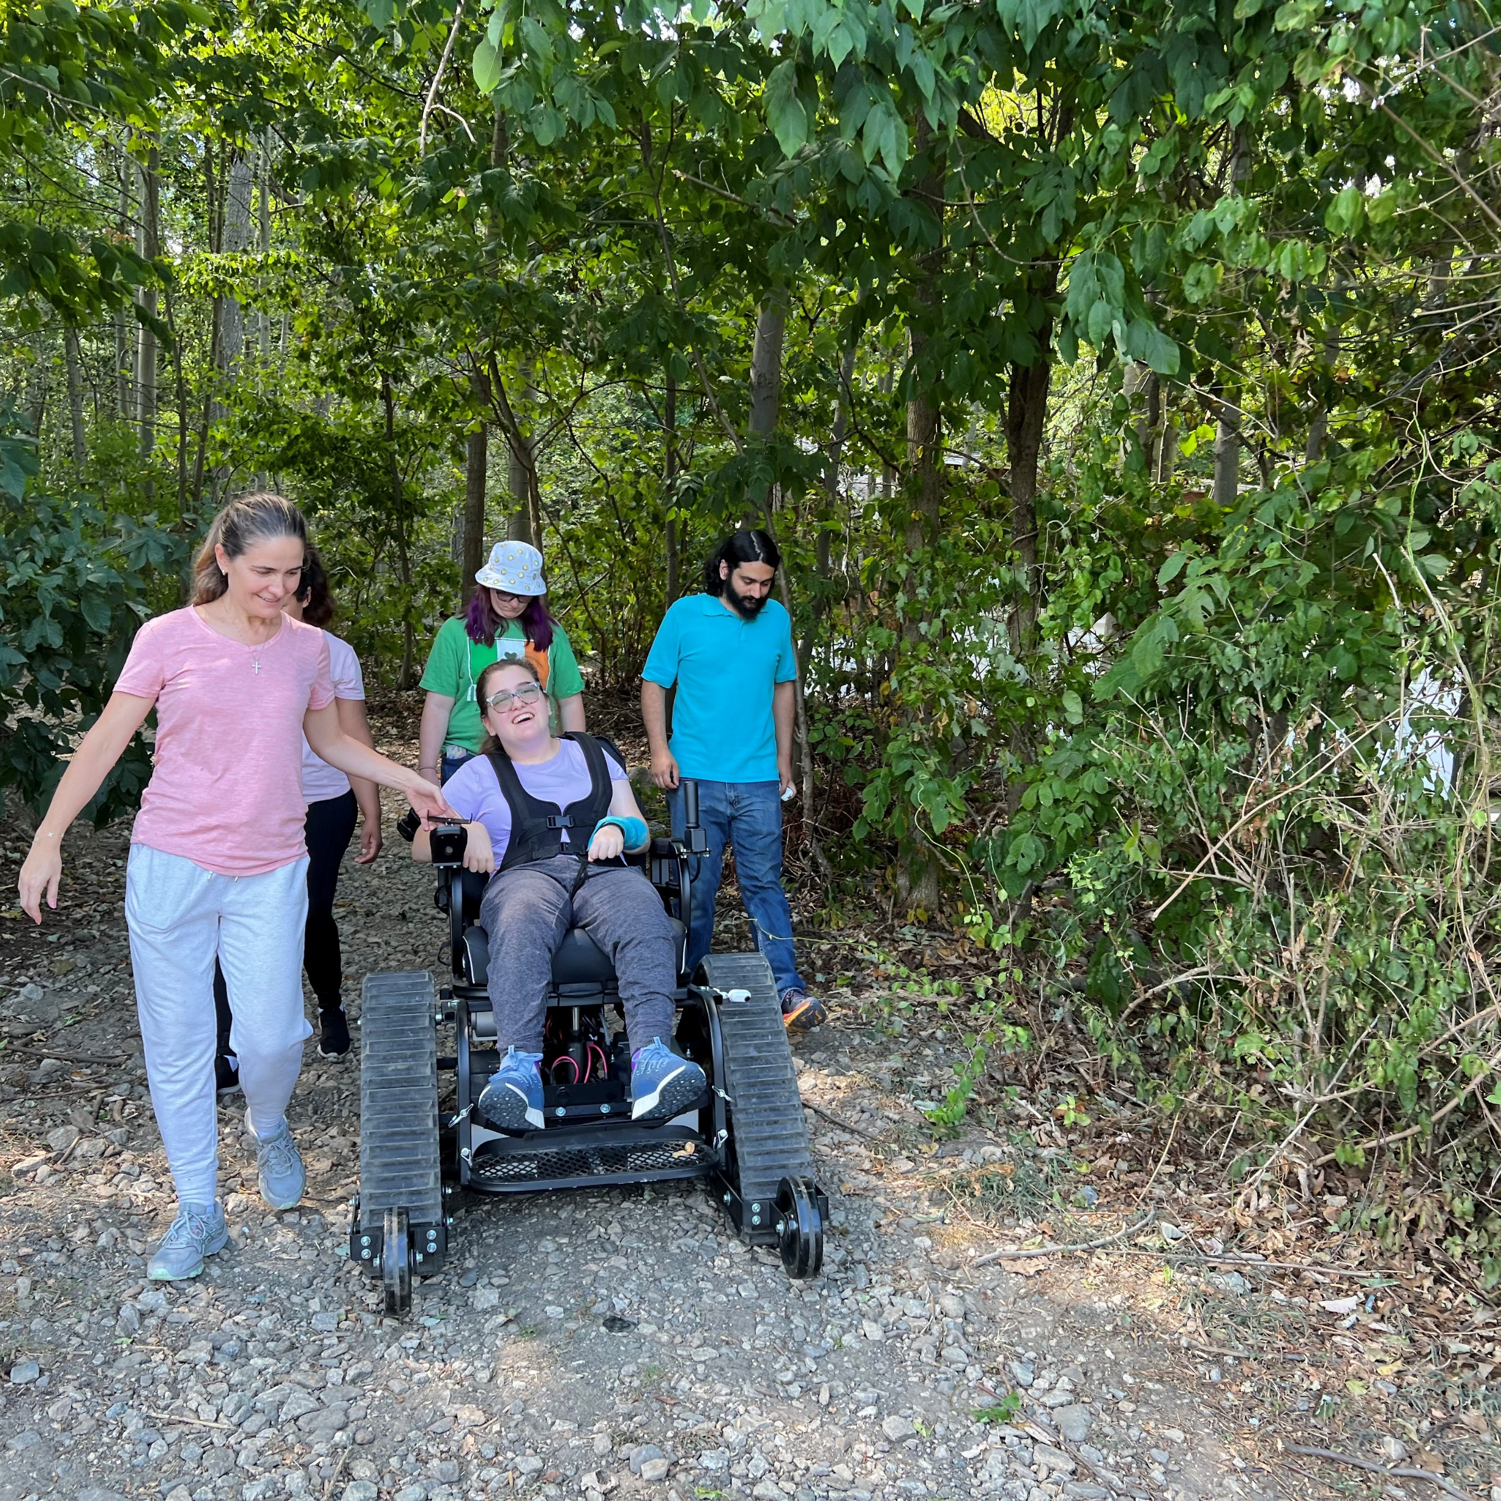
VOLUNTEER RETENTION STRATEGIES
Recognize relationship requiring mutual respect and trust
Useful, Valued volunteer role
Meet their expectations
Be Flexible
Regular Appreciation
Recognition
Offer organized social events
Respect volunteer time
Allow for growth
Consider part of Team/Agency Family
Be open to Ideas/Insights and Feedback
Notes:
Show Appreciation beyond annual day; Simple thank you each time; Can’t do it without you; thank yoou in emails/in person;
Events-breakfast, lunch, dinner, educational speaker, activity
Ensure volunteer feels useful
Allow for growth for longer term volunteers with interest in learning more
Know family members names-acknowledge they share the volunteer’s time with you

Slide 20
Little and Big things lead to Retention

Slide 21
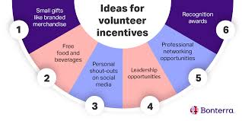
Retaining Volunteers-Incentives
People Love Recognition and T-Shirts

Slide 22
Be Aware of Personal Preferences
Some people love a public shout-out
Some people don’t
Some people love agency merchandise (shirts/hats/umbrellas/etc.)
Some people don’t
Some people will attend all events
Some will choose what they find most interesting or have time for
Some prefer to come, do their job and go home
Some love seeing their name in print yet some don’t

Slide 23
Engagement-Strategic Planning
Volunteer Programs require strong leadership and strategic planning
Leadership shouldn’t assume free labor doesn’t require investment
Leadership must devote time to strategically plan program inception and development
Assess financial resources
A Volunteer Director can be a volunteer
Make plan to find QUALIFIED volunteers
Set Expectations and Accountability for all
Notes:
Investment-Financial for staff, incentives, recognition,

Slide 24
Strategic Planning with Zero Based Budget
In 2022, researchers surveyed funders that provide
funding to nonprofits to support volunteer engagement.
Read the full report of interest to nonprofits that rely heavily on volunteers
May help make the case for investing in volunteer management capacity.
AmeriCorps, in collaboration with the U.S. Census Bureau, biennial Volunteering and Civic Life in America report in late January 2023.

Slide 25
Long-Term Retention
According to the Corporation for National & Community Service, about 1 in 3 volunteers will stop assisting your organization
Keep volunteers happy, satisfied, and motivated for long-term retention.
Build Trust and DELEGATE
Focus on effective communication, regular interaction with each volunteer, meeting their stated and hidden needs
Notes:
Average retention rate for volunteers? 65%

Slide 26
Engagement-A Key to Long-Term Retention
Listen closely –Talk Less
Be aware of each volunteer’s internal motivation (hidden)
Some common things people want/seek out:
Give Back
Feel a sense of belonging
Be part of something important that makes a difference in a person’s life
Develop new skills
Meet new people
Friendships
Use Prior Skill Sets
Notes:
Skill sets-leadership, program development, maintenance, fund raising

Slide 27
Provide Continuing Education
Allow for personal growth as desired
Identify volunteers who may want an expanded role and offer them more opportunities
Provide Advanced Training for on-site or office skill sets
Ask volunteers for topic suggestions
Offer a class taught by you or an experienced (perhaps prospective) volunteer
Encourage volunteers to attend/present at conferences
Notes:
Continuing Education opportunities are value added
On-Site Leadership; Program Management; Coordinating Food/Beverages; Finding Sponsors

Slide 28
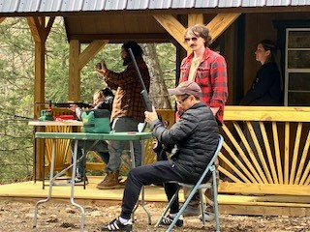
Your Leadership Counts
Ultimately, the buck stops at the top
Be an Inspiration and Role Model
Identify your strengths and not so strengths for managing your program(s)
Recruit volunteers who can help fill in gaps in your knowledge/skills sets/time limitations
Retain your happy, engaged, high performing volunteers
Realize its ok to have intermittent help from organizations
Volunteers move on for many reasons-it’s ok
Notes:
EA-TR does set-up and coaching; Everyone does hands on

Slide 29
Resources
https://bloomerang.co/guides-templates/downloads/intro-to-volunteer-communication/
https://www.councilofnonprofits.org/articles/new-data-and-resources-volunteers
The State of Volunteer Engagement: Insights from Nonprofit Leaders and Funders | Do Good Institute
https://www.councilofnonprofits.org/articles/new-data-and-resources-volunteers
Notes:
EA-

Slide 30
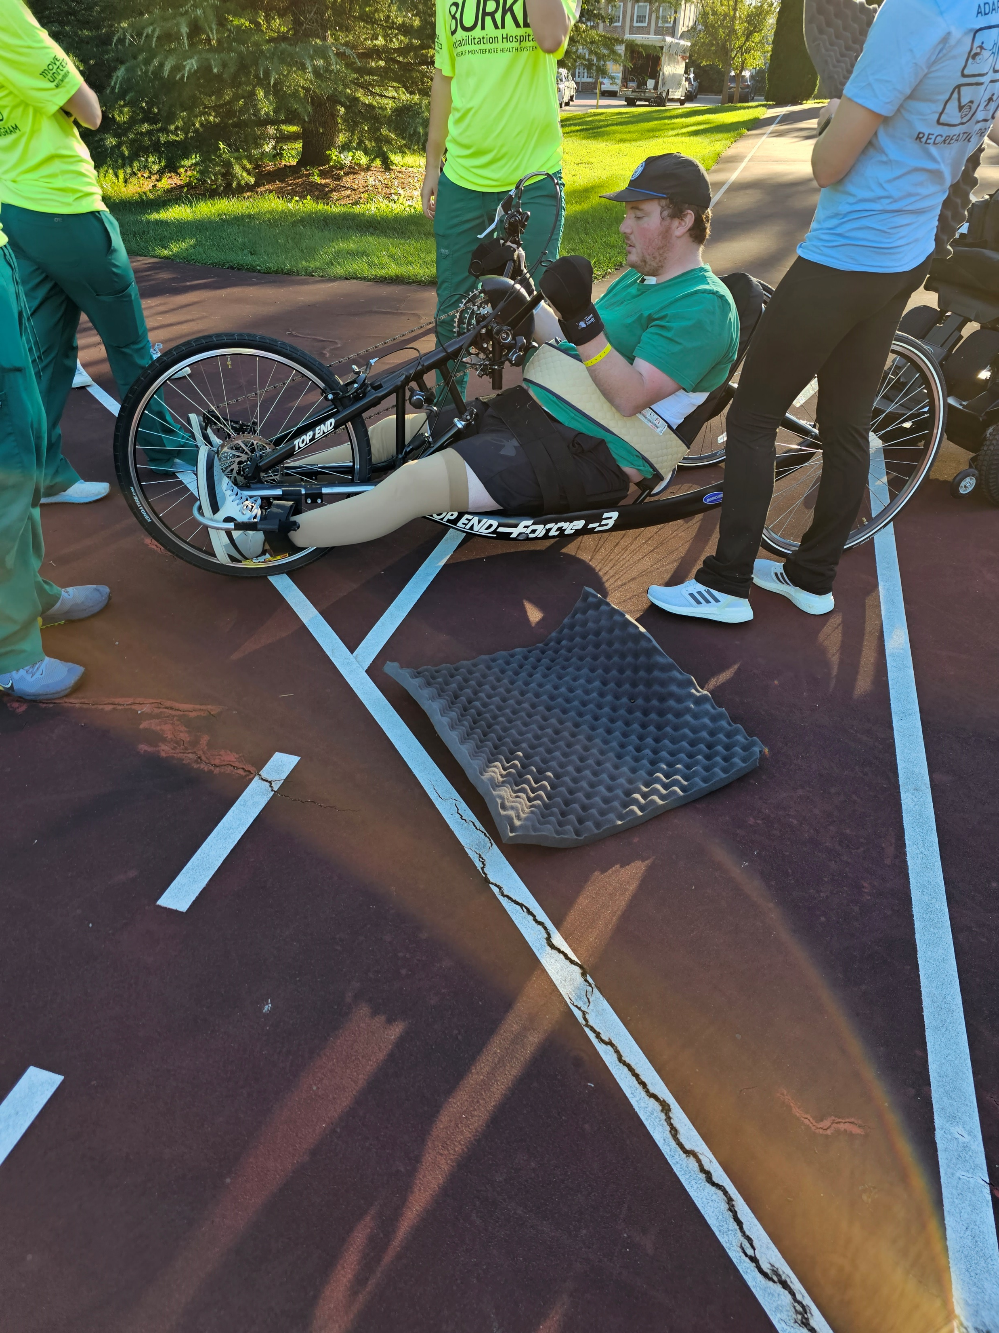
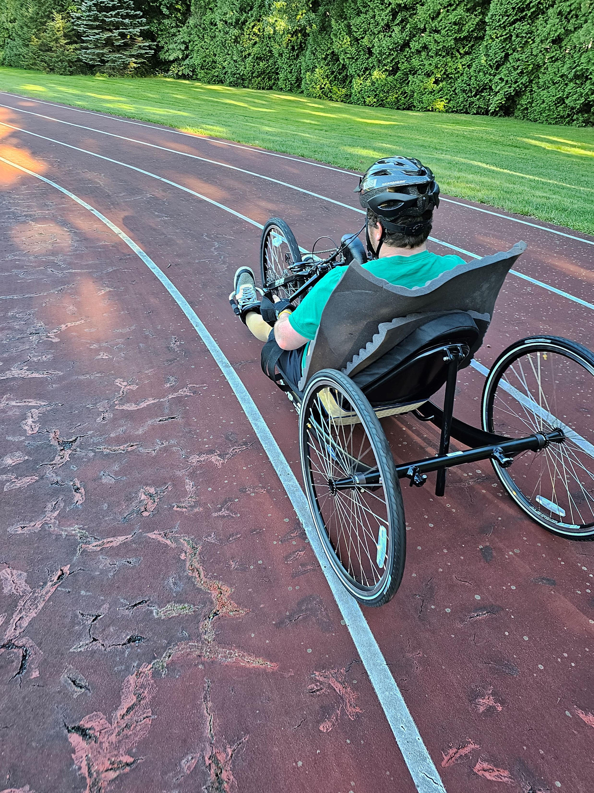
Questions?

