Slide 1
Paratriathlon Overview
Chris Palmquist
Dare2tri
USA Paratriathlon National Team Coach

Slide 2
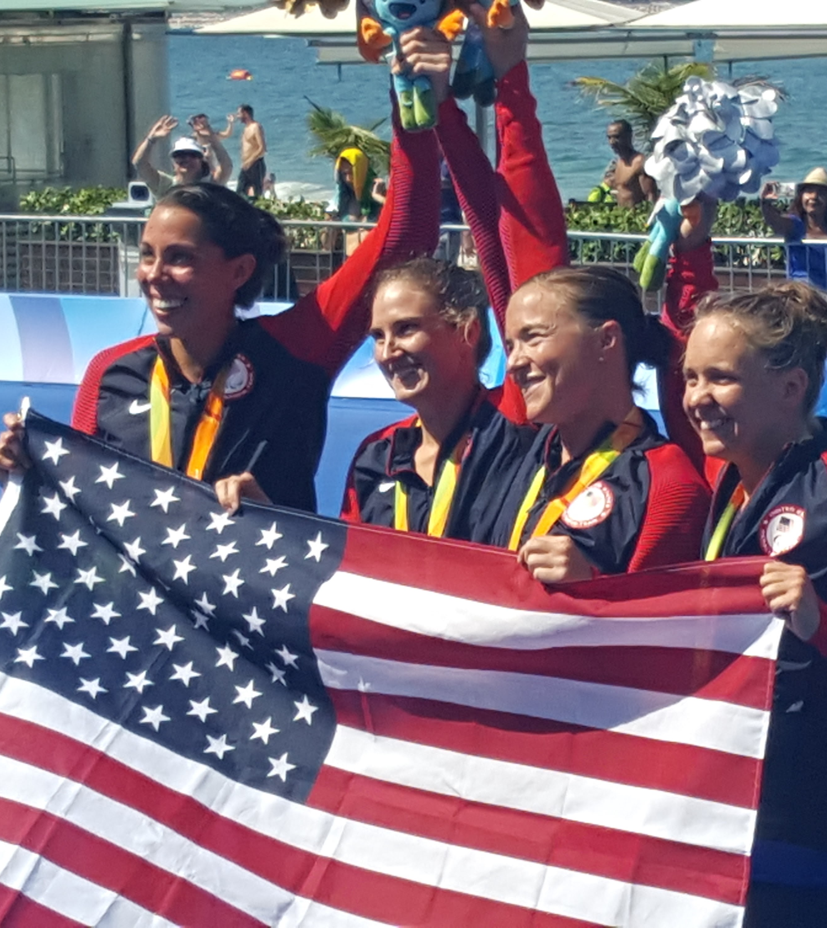
History of Paratriathlon
Governed by World Triathlon
2010: ITU and IPC announced Paratriathlon debut at Rio 2016
2010: USAT Paratriathlon begins
2016: Rio (4 USA medals, 2 Gold, 1 Silver, 1 Bronze)
2021: Tokyo (5 USA medals, 3 Gold, 2 Silver)
2024: Paris (8 USA medals, 3 Gold, 3 Silver, 2 Bronze)
2028: LA
2032: Brisbane

Slide 3
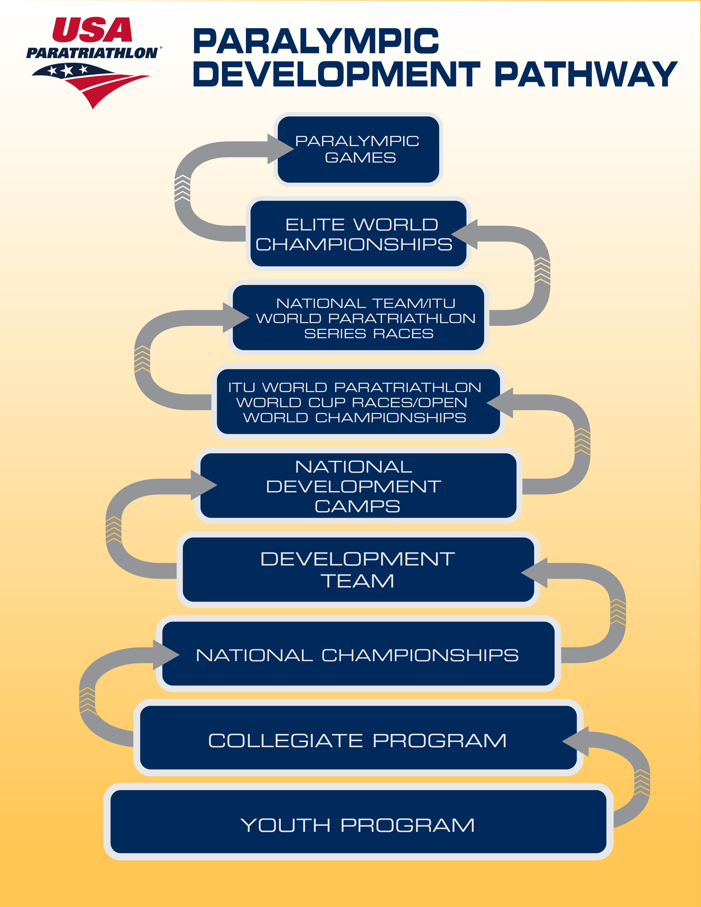
Paralympic Development Pathway
Youth/Junior/College Development
USAT Para Junior/U23 Development Team
USAT Youth and Junior Nationals (ages 7-18)
Collegiate Club Nationals
USAT Paratriathlon Nationals
Ages 16 and older
Paratriathlon Championship Division and ATD1 Division
Development
Virtual Combine
Talent ID Camps
USAT Paratriathlon Development Team (U23)
Para Development Series Races
National Team
OTPC Residency Program
High Performance Camps, Benefits
National and International Racing
Paris2024, LA2028, Brisbane2032 Paralympic Pipeline

Slide 4
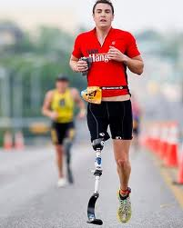
USAT Paratriathlon Race Divisions
Sprint distance: 750m swim, 20km bike, 5km run
Championship Paratriathlon
Paratriathletes who choose to follow USAT and World Triathlon Competition Rules
Must classify into one of the competition categories (PTWC, PTS2-5, PTVI)
ATD1 (formerly PC Open)
Those with a disability who do not wish to follow the rules of the Paratriathlon division OR do not fit into one of the competition categories

Slide 5
Championship Paratriathlon Classification Categories
PTWC1: Handcycle/wheelchair, most impaired
PTWC2: Handcycle/wheelchair, less impaired
PTS2: Standing, Severely Impaired
PTS3: Standing, Significantly Impaired
PTS4: Standing, Moderately Impaired
PTS5: Standing, Mildly Impaired
PTVI1: Visually Impaired, Completely Blind
PTVI2: Severe, Partially-Sighted
PTVI3: Less Severe, Partially-Sighted

Slide 6
Championship Paratriathlon Wheelchair Categories
These athletes race with a handcycle and a racing wheelchair.
PTWC1: Handcycle/wheelchair, most impaired
Paralysis of lower body, loss of core strength, may also have upper body impairments
Multiple impairments and/or loss of use of core muscles
PTWC2: Handcycle/wheelchair, less impaired
Have core muscles and control
Double leg amputees, spina bifida, etc.

Slide 7
Paratriathlon Standing/Ambulatory Categories
These athletes race with an upright bike and run the run with prosthetics, braces and/or crutches.
PTS2: Standing, Severely Impaired
Double leg amputees
“Above the Knee” Amputees (AKs)
Multiple impairments
PTS3: Standing, Significantly Impaired
Multiple limb impairments
Cerebral Palsy
Congenital limb deficiencies
PTS4: Standing, Moderately Impaired
“Below the Knee” amputees (BKs)
Single arm impairments (amputation, nerve damage)
PTS5: Standing, Mildly Impaired
Mild congenital limb deficiencies

Slide 8
Paratriathlon Visually Impaired Categories
These athletes must race with one guide throughout a triathlon. They must be tethered to the guide during the swim and run, and they must ride a tandem during the bike.
PTVI1: Visually Impaired, Completely Blind
Little or no sense of light or shapes
Must race with blackout goggles and sunglasses
Head start over other VI categories (M-3:21, W-3:48)
PTVI2: Severe, Partially-Sighted
Limited sense of shapes and light
PTVI3: Less Severe, Partially-Sighted
Example: Stargardt macular degeneration

Slide 9
ATD1 (formerly PC Open) Racing Divisions
ATD1 races may be subdivided into three competition categories:
ATD1 Wheelchair - athletes typically use a handcycle for biking and/or racing chair for running.
ATD1 Ambulatory - athletes have a physical impairment to one of more limbs. They may use an upright bicycle, trike, or handcycle for cycling.
ATD1 Visually Impaired - athletes race with a guide. They are tethered to the guide during the swim and run. They cycle on a tandem bike piloted by their guide.
ATD1 allows athletes to use a broader range of equipment combinations.

Slide 10
Adaptive Triathlon Division
USAT wants to welcome and support any person who wants to race a triathlon. USAT has created ATD categories and competition rules to cover those triathletes who require adaptations but do not fall under the paratriathlon categories.
Examples include:
ATD2 – Neuro-Diverse Athletes who require adaptations to compete (Down’s Syndrome, autism, etc.)
ATD3 - Physical impairments that do not fall under typical paratriathlon categories
ATD4 – Duo Racing – racing with a co-athlete as a team
ATTMI (Adaptive Triathlon Temporary Mobility Injury) – Significant and temporary injury that requires accommodations for participation

Slide 11
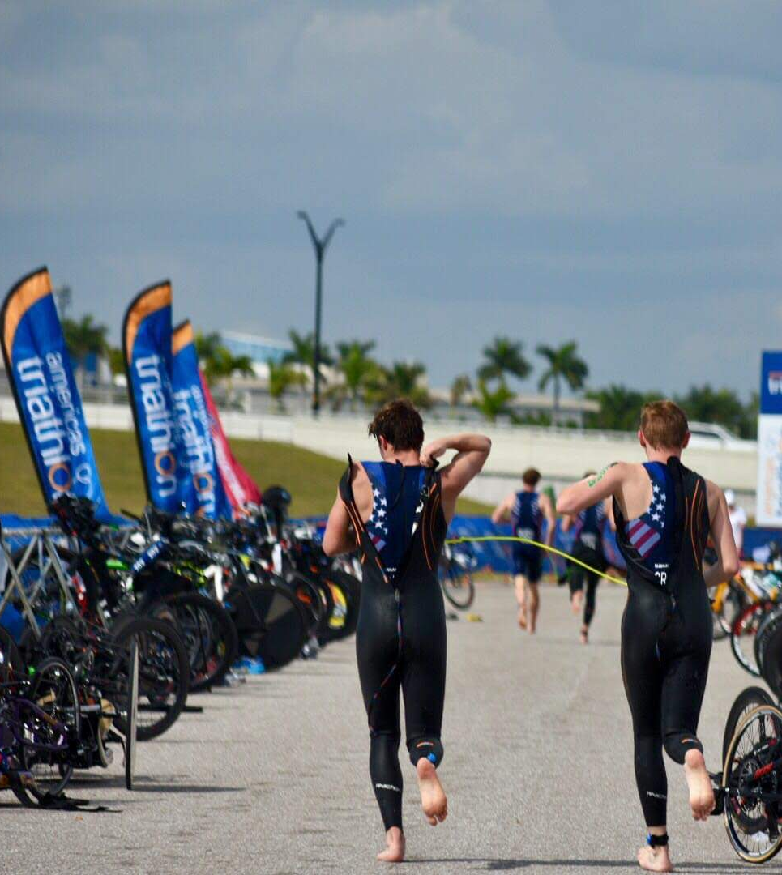
Racing Opportunities
USAT Paratriathlon Development Series
USAT Paratriathlon Nationals
USAT Youth and Junior Nationals
USAT “Paratriathlon Friendly” races
ATD1 in local/regional races
Age-Grouper in local/regional races
Call RD ahead to discuss accessibility

Slide 12
USAT Paratriathlon National Qualifier Series
2025 Races
CLASH Endurance – March 30, 2025– Miami, FL
St. Anthony’s Triathlon - April 27, 2025, St. Petersburg, FL
Lago Mar Triathlon -- May 18, 2025 – Texas City, TX
Leon's Triathlon -- June 1, 2025 -- Hammond, IN
Treasure Valley Triathlon – June 7, 2025 – Boise, ID
Got The Nerve Triathlon – June 22, 2025 – Ephrata, PA
Pleasant Prairie Triathlon – June 22, 2025 – Pleasant Prairie, WI
Long Beach Legacy Triathlon – July 20, 2025 – Long Beach, CA
USAT Paratriathlon Nationals – August 10, 2025 – Milwaukee, Wisconsin

Slide 13
USAT Youth/Junior Paratriathlon National Championships
August 1-3, 2025, West Chester, Ohio
Aug 1st – Free paratriathlon clinic in a.m.
Aug 1st – Dinner for athletes/families/coaches
Sunday, Aug 3rd – Para Youth National Champs
Ages 7-18 (as of December 31st)
ATD1 Rules
Classification not required
200m swim, 10km bike, 2km run
Racing Categories
ATD1 Wheelchair
ATD1 Ambulatory
ATD1 Visually Impaired

Slide 14
Racing in Local/Regional Triathlons
USAT Paratriathlon Friendly Designation (in process)
ATD1 or Age Group
Safe, accessible course? (Requires conversation with Race Director)
Swim start?
Swim exit volunteers?
Pre-transition area?
Are there hills on the bike or run course?
Grass, curbs, steps, sand, rocks, trails?
Is transition area accessible (curbs, steps, grass, sand)?
Are handlers, guides, race partners, co-athletes allowed?
Check to see if this race will offer awards for ATD1 athletes

Slide 16
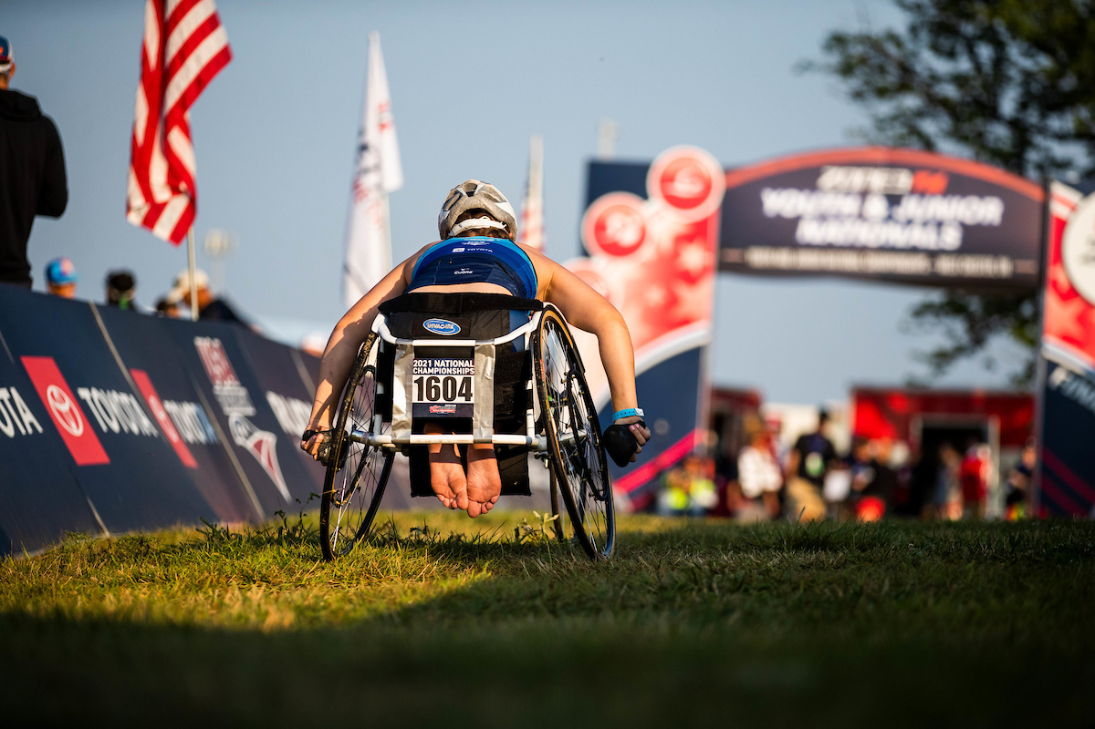

Slide 17
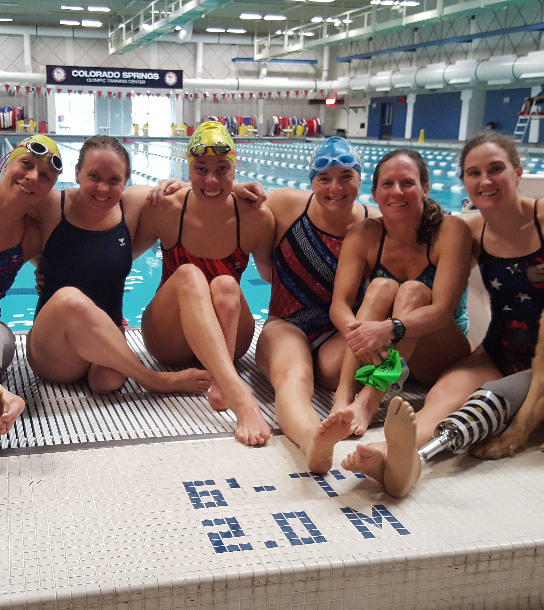
Questions?
Chris Palmquist
Email: cspalmquist@gmail.com
Phone: 630-779-0836
USAT Paratriathlon
Website: www.usaparatriathlon.org
Email: paratriathlon@usatriathlon.org
Notes:
General Template One A….

