Slide 1
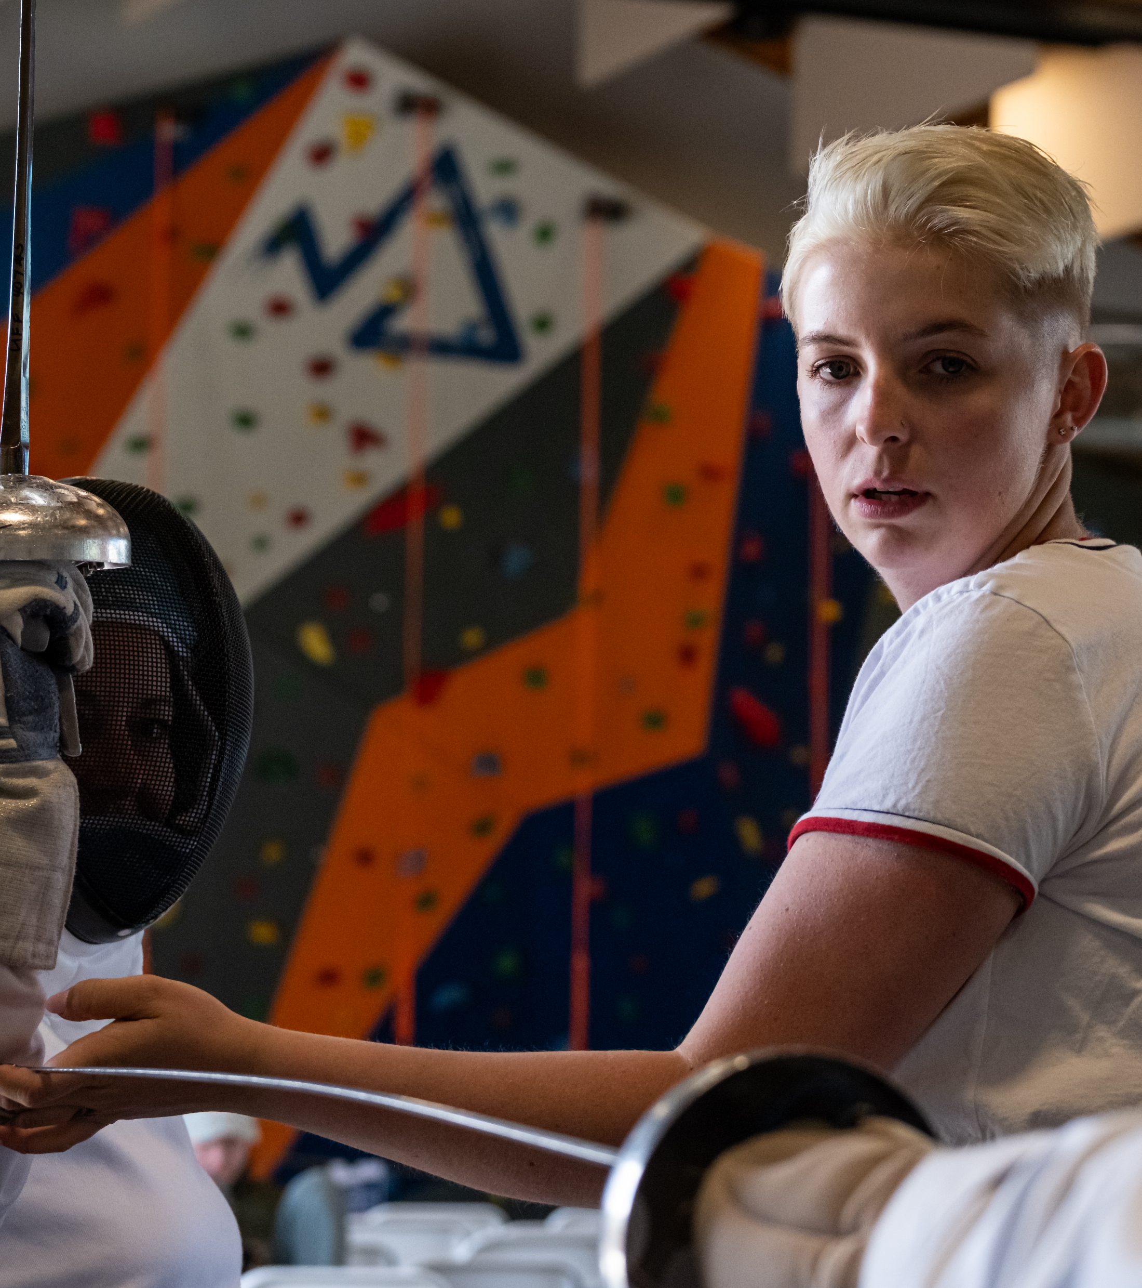
Writing a Winning Proposal for Presenting at the Move United Education Conference

Slide 2
Agenda:
Conference narrative refresh
Presentation format option overview
Tips & considerations for your proposal
Question & answer

Slide 3
Reminders:
Presenter applications due October 31st
Poster sessions applications due March 6th
All application can be found on Move United Education Conference website at:
www.moveunitededsport.org/edcon26

Slide 4
Connect to the Narrative:
Breaking Barriers,
Building Communities

Slide 5
Selecting Your Session Track:
Leadership & Organizational Excellence
Coaching, Recreation, Rehabilitation & Competition
Education & Community Programs
The Future of Adaptive Sports
You may select up to 2 tracks that your session relates to

Slide 6
Knowing Your Audience
Adaptive sport professionals
Medical providers
Education professionals
Parks & recreation professionals
National governing bodies
Disability resource groups
University faculty
Students
More!

Slide 7
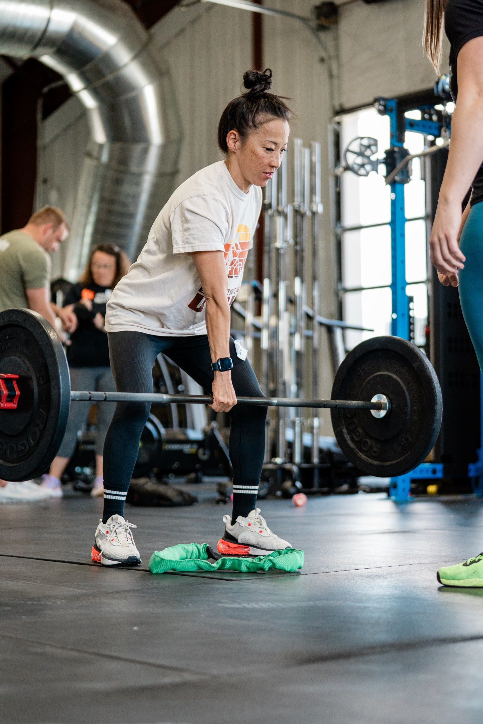
Choosing Your Session Format
Pre-Conference Workshop
Conference Workshop
Conference Session
Short Talk
Discussion Group

Slide 8
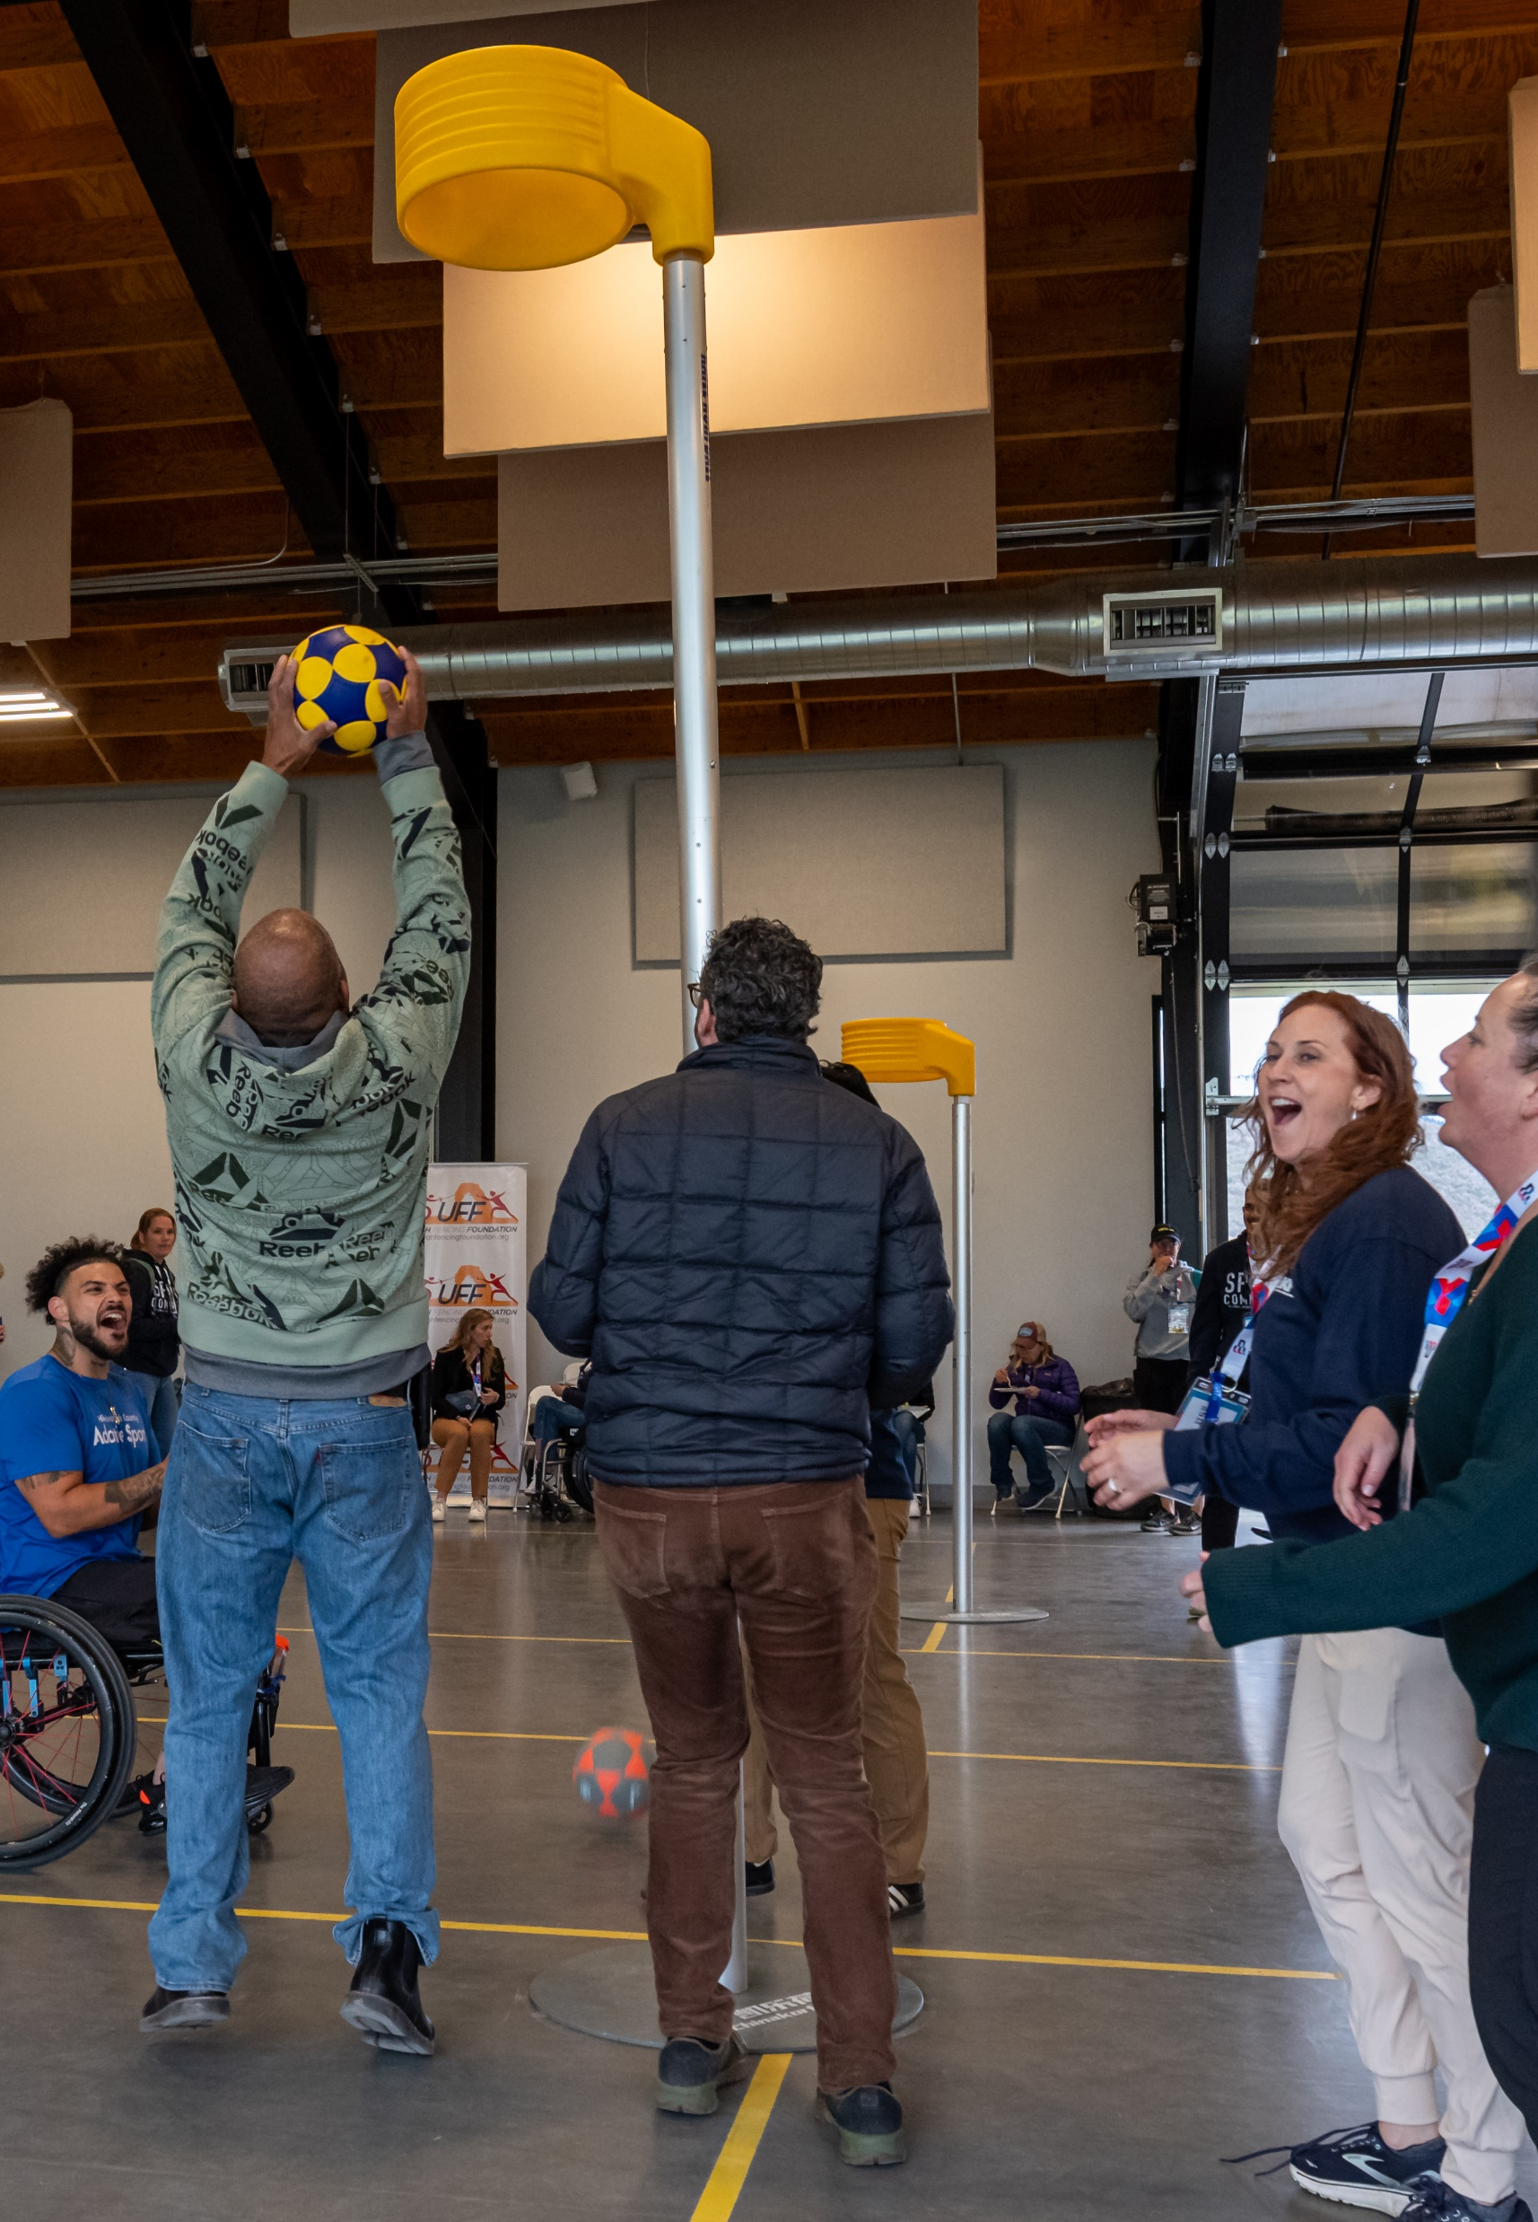
Conference Venues
Conference Center
Swimming Pool
Golf Course
Ice Rink
Sport Court
More… indicate request in your application

Slide 9
Craft Compelling Titles
Lead with outcome
Keep title concise (8-12 words)
Use active, engaging language
Examples:
Unlocking Potential: Using Sports Science to Elevate Adaptive Performance vs. Adaptive Sport Science Overview
From Rehab to Race Day: Bridging Therapy and Training for Adaptive Athlete vs. Rehabilitation and Training in Adaptive Sports
Leading the Way: Adaptive Sport Program Management for Community Impact vs. Adaptive Sport Program Management

Slide 10
Write Powerful Description
Why – What challenge/opportunity is being addressed?
What - Be concise about outcomes, include call to action
Who - Make audience-specific
Keep it concise

Slide 11
Description Example:
Athletes achieve their best when training programs are built on performance science. In this interactive session, coaches and therapists will gain evidence-based strategies to enhance mobility, strength, and recovery for athletes with disabilities. Walk away with practical tools you can apply immediately to elevate your athletes’ performance and participation. Bring your questions for a dynamic, hands-on discussion!

Slide 12
Define Clear Learning Objectives
Start with an action verb
Focus on outcomes, not activities
Keep concise and realistic
Strong Examples:
Demonstrate effective coaching communication strategies for athletes with sensory disability.
Identify key adaptations that make archery accessible for athletes with physical disabilities.
Weaker Examples:
Understand how to coach athletes with disabilities.
Learn about adaptive sports.

Slide 13
Highlight Presenter Expertise
Keep concise
Prioritize sharing relevant experience/qualifications
Establish credibility
Notable accomplishments

Slide 14
Avoid Common Pitfalls
Too broad
No objectives
Incomplete

Slide 15
What Reviews Look For:
Link to conference theme & tracks
Quality/thoroughness of application
Qualifications/experience of presenters
Clarity of session proposal/purpose
Identified need for session content
Tips:
Avoid repeating a topic you’ve presented in the last 1-2 years
If a repeat presenter, consider feedback received in past

Slide 16
Reminders:
If you are unavailable any days, please make sure to note this in the application
Presenters receive complimentary registration to the event

Slide 17
Questions?
Contact Cayla Hammaker chammaker@moveunitedsport.org

