Slide 1
The Hartford
Adaptive Sports Comp. Series
2026 Message Training

Slide 2

Agenda
Welcome and introductions
The Hartford’s Key Messages and Facts
Our Ask of You
Media Strategy
Q&A
Next steps and action items

Slide 3
Key Messages
3A. Community Relations 2026 Plan - Human Achievement: Adaptive Sports
As a leading disability insurer and advocate for the adaptive sports movement for more than 30 years, we’ve seen firsthand the transformative power of sport and how it helps people to regain independence after an illness or injury.
The cost of adaptive equipment is often a barrier to people’s participation in sports. Adaptive athletes pay approximately 16 times more for equipment than non-adaptive athletes.
The Hartford is on a mission to make adaptive sports and equipment more accessible to youth and adults with disabilities.
Over the past seven years, The Hartford has gifted more than 8,500 pieces of adaptive sports equipment across more than 100 communities, impacting the lives of more than 100,000 people.

Slide 4
Assets to Leverage: Adaptive Sports
For Team Hartford Athlete:
Key Program Facts
I am thrilled to be here today on behalf of The Hartford – a company that has been an advocate for the adaptive sports movement for more than 30 years.
I personally understand how important it is to have the right equipment to participate in sports and live an active life.
Adaptive athletes pay approximately 16 times more for equipment than non- adaptive athletes and that is why I am proud to partner with The Hartford to surprise athletes with custom- fit equipment.
The Hartford has been an advocate for the adaptive sports movement and sponsor of athletes with disabilities for more than 30 years.
As a leading disability insurer, the company has a long-held belief that sports are an important part of physical rehabilitation following a disabling illness or injury.
The company created its adaptive sports program to make adaptive sports and equipment more accessible to youth and adults with disabilities.
Over the past seven years the program has impacted the lives of more than 100,000 people and donated more than 8,500 pieces of adaptive sports equipment in 100+ communities across the country.
Our World Champion Team Hartford para-athletes are helping us raise awareness about equity in sports.
Our Team Hartford para-athletes also helps us surprise athletes at each competition event, and many of our local sports club donations, with custom-fit adaptive sports equipment. They announce our Human Achievement award winners and use their own personal social platforms to help inspire the next generation of athletes.
ABOUT THE HARTFORD ADAPTIVE SPORTS COMP SERIES: The Hartford Competition Series features five premier sanctioned events across the country and includes surprise custom equipment donations, the Human Achievement award and meet and greets with champion Para Athletes.
ABOUT SKI SPEC: The Hartford has been a proud to serve as the title sponsor of Ski Spectacular for more than 30 years. (Ski Spec language – longest winter sports festival – from press release)​
For HIG Spokesperson:
The Hartford is on a mission to make adaptive sports and equipment more accessible and has been supporting the adaptive sports movement for more than 30 years.
The cost of adaptive equipment is often a barrier to people’s participation in sports. Adaptive athletes pay approximately 16 times more for equipment than non-adaptive athletes. Over the past seven years. The Hartford has gifted more than 100,000 pieces of adaptive sports equipment.
In partnership with Move United we create opportunities for thousands of adaptive athletes to participate in sports and sanctioned competitions annually through The Hartford Adaptive Sports Competition Series, The Hartford Ski Spectacular., and events at local adaptive sports clubs.

Slide 5
Our Ask
Say the full/ formal name of the event on every reference
  Ex: “Texas Parasport Games In Partnership With The Hartford”
  2. Try to mention The Hartford’s name at the start of the interview
  3. Share your key messages
Reminders
  Speak in easy-to-understand terms
  Correct mistakes
  Provide background and data
  Use compelling anecdotes

Slide 6




Media Strategy and Timeline
LOC issues media release and begins media pitching
LOC
Follow – up with key interested media using press release
Move United/LOC
draft and submit
media release to HIG for approval
The Hartford issues gifting moment
media advisory
The Hartford is point on pitching gifting moment
Two months prior
2-4 weeks prior
One week prior to
gifting moment
One-week prior
2-3 days leading up to
Event
NOTE:
Move United to schedule and set agenda for two joint meetings with LOC and The Hartford on media strategy
10 business day approval window for The Hartford and Move United to review LOC press releases
The Hartford, LOC and Move United to compile media contacts in advance and maintained on SharePoint to track outreach and leads
Streamline media outreach leading up to the event to avoid multiple people calling same media with different messages
The Hartford to copy Move United and LOC on email distribution of media advisory to press outlets
For media that express availability to attend events outside of the gifting moment, The Hartford redirects media to LOC
Post-pitching at the discretion of local organization committee
Create a communications chain (text/phone list) for all parties to help coordinate media while onsite at event

Slide 7
The Hartford Social Media Best Practices for LOC’s
3/3/2026

Slide 8
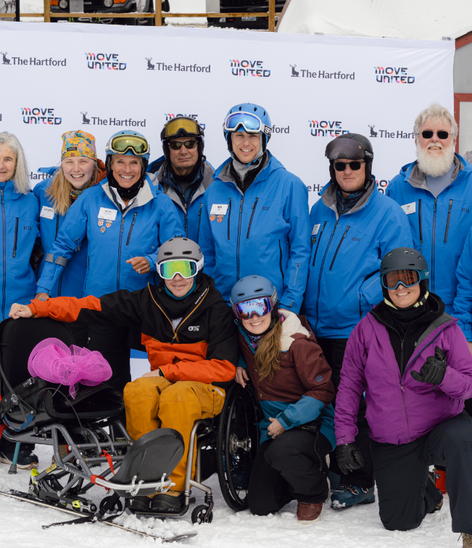
Agenda
The Hartford Social Media Strategy
Collaboration Post Best Practices
Utilizing influencers and Team Hartford Athletes
Cross Promotion and WOW Factor Opportunities
Plug and Play – Easy Templates
Athlete Recruitment Tactics
Questions

Slide 9
The Hartford Social Media Strategy – Chapter Activations & Comp Series
Chapter Activations:
One monthly recap post with all chapter activations that happened during that month
Use multiple different photos from different activations
Focus on:
  Athletes participating
  Community
  Emotion
  Gifting moments
  Collaboration post opportunities:
  On LinkedIn and Facebook will tag all LOC’s involved as well as Move United, and Team Hartford Athlete if they were present at event
  On Instagram – post will come from The Hartford and invite the LOC’s, Move United, and Team Hartford athlete to collaborate on the post
Competition Series Events:
Texas Parasport, Gateway Games, Desert Challenge, GLASA Great Lakes Games
One post per event – recap posted after event with photos taken during the games
Use multiple photos from event
Focus on:
  Competition moments
  Community
  Emotion
  Gifting moments
  Collaboration Post Opportunities:
  On LinkedIn and Facebook will tag hosting chapter as well as Move United, and Team Hartford Athlete if they were present at event
  On Instagram – post will come from The Hartford and invite the hosting chapter, Move United, and Team Hartford athlete to collaborate on the post

Slide 10
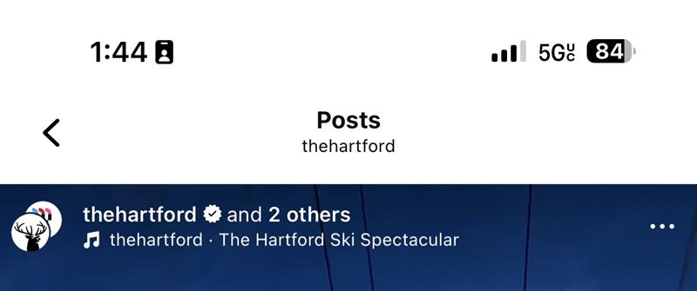
Collaboration Posts: When & How to Use Them
What is it?
A feature that allows you to invite up to 5 accounts to ‘co-author’ the same post so it appears on all collaborators profiles at the same time and is shown to all their followers.
Allows larger reach
Higher engagement
Cleaner feeds
Stronger partnerships and storytelling
When to use?
You should use a collaborator post when the goal of your content is maximum reach.
Best cases to use collaborator posts include:
Post event recaps
Key registration pushes
Events with multiple partners
When to Not Use
Routine reminders/logistics
Low stakes content
When a partner cannot accept the collaborator post in time
When planning a collaborator post – make sure the collaborators know when you will be sending the post out so they can plan to accept immediately to get the most reach
Suggested LOC Collaboration Strategy:
LOCs should use collaboration posts for key moments that benefit from maximum reach, such as event recaps and registration pushes.
Partnering with athletes and organizations through collaborator posts helps extend visibility beyond branded channels, tap into trusted community voices, and drive stronger awareness and attendance for upcoming events.

Slide 11



Utilizing Influencers and HIG Athletes
Choosing Influencers
Influencers should be viewed as trusted voices – people whose experience, credibility, and connection to the adaptive sports community can elevate content and help authentically promote events or messages. Their role is to extend reach and bring their story to life.
Something to remember – influencers reflect your brand. You should prioritize voices that align with your values and authentically reflect your commitments and goals.
How to Utilize Influencers
For LOC’s a best practice model could be asking an athlete in their chapter with a strong connection to the adaptive sports community to share on their personal platform why they are attending an upcoming event and collab with the LOC that is hosting.
By local athlete influencers telling their story – it is more powerful than a branded message and shows more insight into lived experiences. This post can then reach the influencers followers combined with the LOC’s to encourage them to register for upcoming adaptive sports events.
How The Hartford Will Support LOC’s
To support LOC event promotion, The Hartford will partner with Team Hartford Athletes to amplify content on their personal channels for events they attend, coordinating collaboration post invites with LOCs, Move United, and The Hartford ahead of each event.
This approach leverages authentic, athlete led storytelling to expand reach beyond branded channels while supporting LOC event promotion with participation thoughtfully planned to align with attendance and avoid over-posting.

Slide 12
Cross Promotion & WOW Factor Opportunities
Cross Promotion Content Ideas:
What Makes this LOC Special – Spotlight (Carousel and Reel): Highlight 2-5 WOW factors (venue, sports offered, athlete experience, accessibility perks, community partners) end with a clear Register/Learn More CTA.
Partner + Athlete Collaboration Posts: Use collaboration posts for key moments – registration pushes and post-event recaps – to maximize reach across LOC partner, and athlete audiences.
Next Stop on the Series Cross Promo: After an event recap, tease the next upcoming event in the caption or final carousel frame to keep momentum going.
Community Shoutouts + Bring a Friend CTA: Spotlight volunteers, sponsors, or partners and invite audiences to tag someone who should attend.
WOW Factor Content Angles:
Scale & Variety: number of athletes, number of sports,
Venue / Location Uniqueness: iconic facility, purpose-built accessible campus, multiple venues, easy spectator
Access & Impact: adaptive equipment, grant/gifting moments, why this matters
People & Emotion: athlete stories, first-time participation, community pride, you belong here
Behind the Scenes Credibility: sanctioned event, clinics, training, experienced staff – quick proof points that build trust

Slide 13
Plug and Play Possible Post Templates
Designed to be simple and fast: Plug and play templates remove the guesswork from social posting – anyone can quickly drop in photos, update text, and publish content with an easy design experience.
Built in Canva: Canva offers free, easy to edit social media templates for posts, carousels, and stories, making it simple for anyone to create consistent and professional looking content in just minutes
Keeps content consistent: Using the same templates helps maintain a cohesive look across posts while still showcasing their unique chapter, events, and athletes
Perfect for recurring content: Templates work especially well for event promotion, WOW factor spotlights, athlete recruitment reminders and post event recaps
Easy to reuse and share: once a template is created – you can reuse it as often as you want – saving time, reducing effort, and making it easier to stay active on social
Template A: 3 Card Carousel
Title: 3 reasons [LOC/Event] is special
WOW Factors: 2-3 proof points with 1 photo each
CTA: ‘Register/ Learn More’
Template B: 15-30 sec Reel
Ask participants, staff, volunteers – what is the best part of this event, why should someone come?
Template C: Post Event Recap that Cross Promotes
Best moments
What we’re proud of
Where we’re going next

Slide 14
Athlete Recruitment Through Social Media
Leverage Athlete Voices: Feature a blend of new and more seasoned athletes sharing why they participate and encourage others to join – peer to peer storytelling is often more compelling than branded messaging
Use Short-Form Videos: Capture quick interviews with athletes/coaches/volunteers who answer different questions such as “Why should someone try this sport?” or “What do you want to know about the Adaptive Sport community?” to help athletes picture themselves participating
Post in Local Facebook Groups: Share event information in relevant community groups (adaptive sports, disability advocacy, local recreation, veterans) and promote events that are upcoming
Be Discoverable: Include a mix of broad adaptive sports hashtags and sport specific tags so posts can surface beyond your existing followers. Additionally – try to pull keywords from your registration page. Use the same language people search for (sport name, location, adaptive, beginner friendly, etc.) in the caption to improve discoverability.

Slide 15
Q & A

Slide 16
APPENDIX

Slide 17

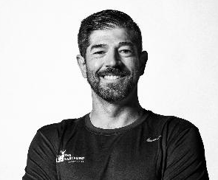
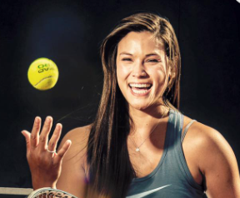
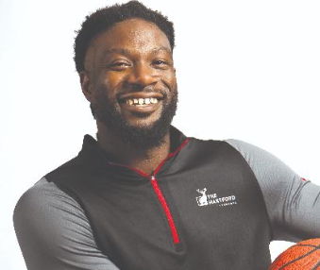
Team Hartford Roster
 | Hailey Danz Colorado Springs, CO | Keith Gabel Aspen, CO | Dana Mathewson Orlando, FL | Matt Scott San Francisco, CA
Near-term games | LA 28 TBD | Milano-Cortana 2026 | Retired | Retired
Sports | Para- Triathlon | Para-Snowboarding | Wheelchair Tennis | Wheelchair Basketball
Season | Summer | Winter | Summer | Summer
Medals | 1 Gold, 2 Silver | 1 Silver , 1 Bronze | N/A | 2 Gold, 1 Bronze
Games | 2024 (Gold) 2020 Tokyo (Silver) 2016 Rio (Silver) | 2022 Beijing (7th) 2018 PyeongChang (silver) 2014 Sochi (bronze) | 2024 Paris 2020 Tokyo 2016 Rio | 2022 Tokyo (Gold) 2016 Rio (Gold) 2012 London (Bronze) 2008 Beijing (4th) 2004 Athens (7th)
Contract end date | Dec 2026 | Dec 2026 | Dec 2027 | Dec 2026
Ambassador Role/Traits | All-around solid speaker | Winter sport medalist Relatable Loves the program Best in fireside chat format | Formerly U.S. #1 Female Wheelchair Tennis Player | Best all-around ambassador - magnetic Strong desire to give back Has expressed interest in working for HIG on this program

