Slide 1

EXPANDING ACCESS THROUGH UNIVERSITY-COMMUNITY COLLABORATION
Group Discussion
Abby Fines & Matt Lowery, 4/22/2026

Slide 2
INTRODUCTIONS
Who we are
Abby Fines, PhD
Matt Lowery, CAPE
University of Virginia, Charlottesville, VA
No Adaptive Athletics program

Slide 3
LEARNING OBJECTIVES
Open for Discussion ;)
Identify key factors that influence successful and unsuccessful collaboration between universities and community adaptive sport organizations
Explore creative strategies for building partnerships that expand access to adaptive sprot and physical activity opportunities
Develop actionable ideas to enhance communication, resource sharing, and program integration across sectors

Slide 4
THE EVOLUTION OF AN EVENT
Prequel
Wheelchair Takeover: Paralympic Pick-ups
Pick-up Games
Roll with Jim
REC ‘N’ ROLL
The Next Thing
Spring 2026 (Last Week!)
Fall 2026-Spring 2026
e.g., Coursework
Spring 2024
Fall 2024
Spring 2025

Slide 5
THE MISSION HAS STAYED THE SAME
Prequel
Wheelchair Takeover: Paralympic Pick-ups
Pick-up Games
Roll with Jim
REC ‘N’ ROLL
The Next Thing
Spring 2026 (Last Week!)
Fall 2026-Spring 2026
e.g., Coursework
Spring 2024
Fall 2024
Spring 2025
Mission: Sport is Sport

Slide 6
THE EVOLUTION OF PARTNERS
Wheelchair Takeover: Paralympic Pick-ups
Pick-up Games
Roll with Jim
REC ‘N’ ROLL
Prequel
The Next Thing
Spring 2026 (Last Week!)
Fall 2026-Spring 2026
e.g., Coursework
Spring 2024
Fall 2024
Spring 2025
Institutional Partners | Community Partners | Individual Partners

Slide 7
POSSIBLE PARTNERS
Whole group
Institutional Partners | Community Partners | Individual Partners

Slide 8
UVA PARTNERS
Across the Timeline
Institutional Partners | Community Partners | Individual Partners
Kinesiology Other Academic Departments Recreation Intramurals President’s Office School of Education ODEI Office of Communication Student Disabilities Access Center Facilities/Parking Athletics | Sportable Charlottesville Cardinals Piedmont Area Tennis Assoc. Blind Soccer Nation Additional Community Tables | Student-Athletes with Disabilities Students Volunteers
* Some names shortened, abbreviated, or not official titles.

Slide 9
Partner Mapping
Small group
 | HIGH ALIGNMENT (mission, incentives) | LOW ALIGNMENT (seemingly disconnected)
HIGH ACCESS (easy to reach, responsive) | ✅ Easy Wins | ⚠️ Hard Wins (e.g., Hidden Friction)
LOW ACCESS (hard to reach, nonresponsive) | 🔍 Hard Wins (e.g., untapped allies) | ❌ Losses (e.g., energy drains)

Slide 10
PREQUEL
Accessing Equipment

Slide 11
WHEELCHAIR TAKEOVER:
PARALYMPIC PICKUPS
First University Event in our Timeline

Slide 12
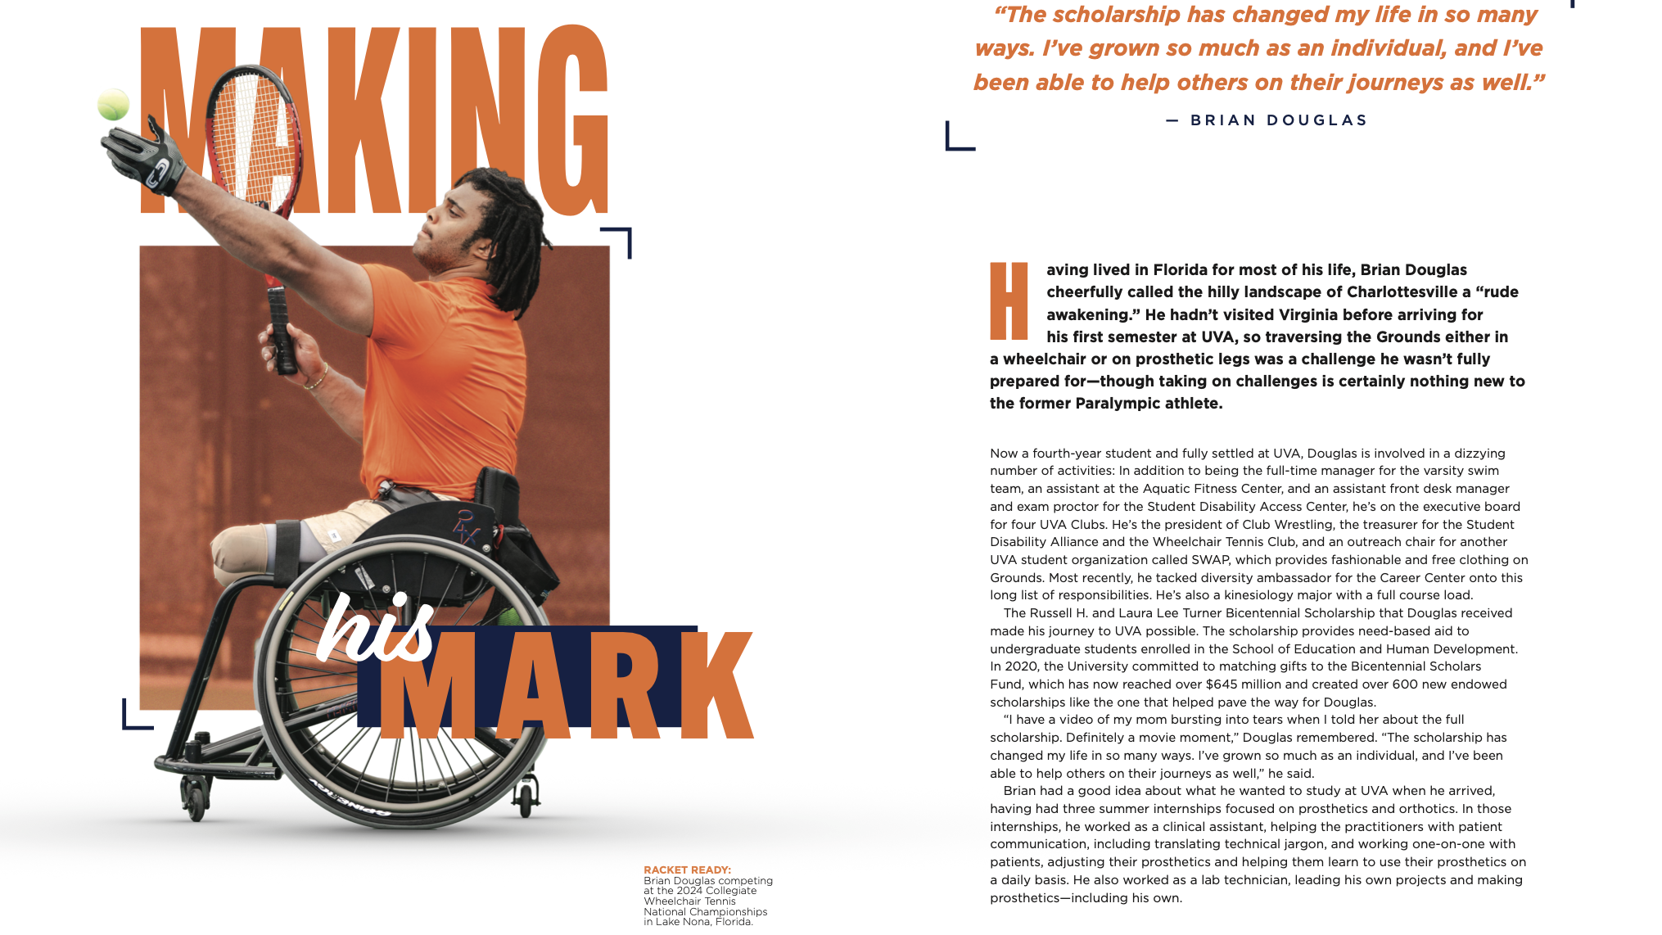
Notes:
https://education.virginia.edu/news-stories/making-his-mark

Slide 13
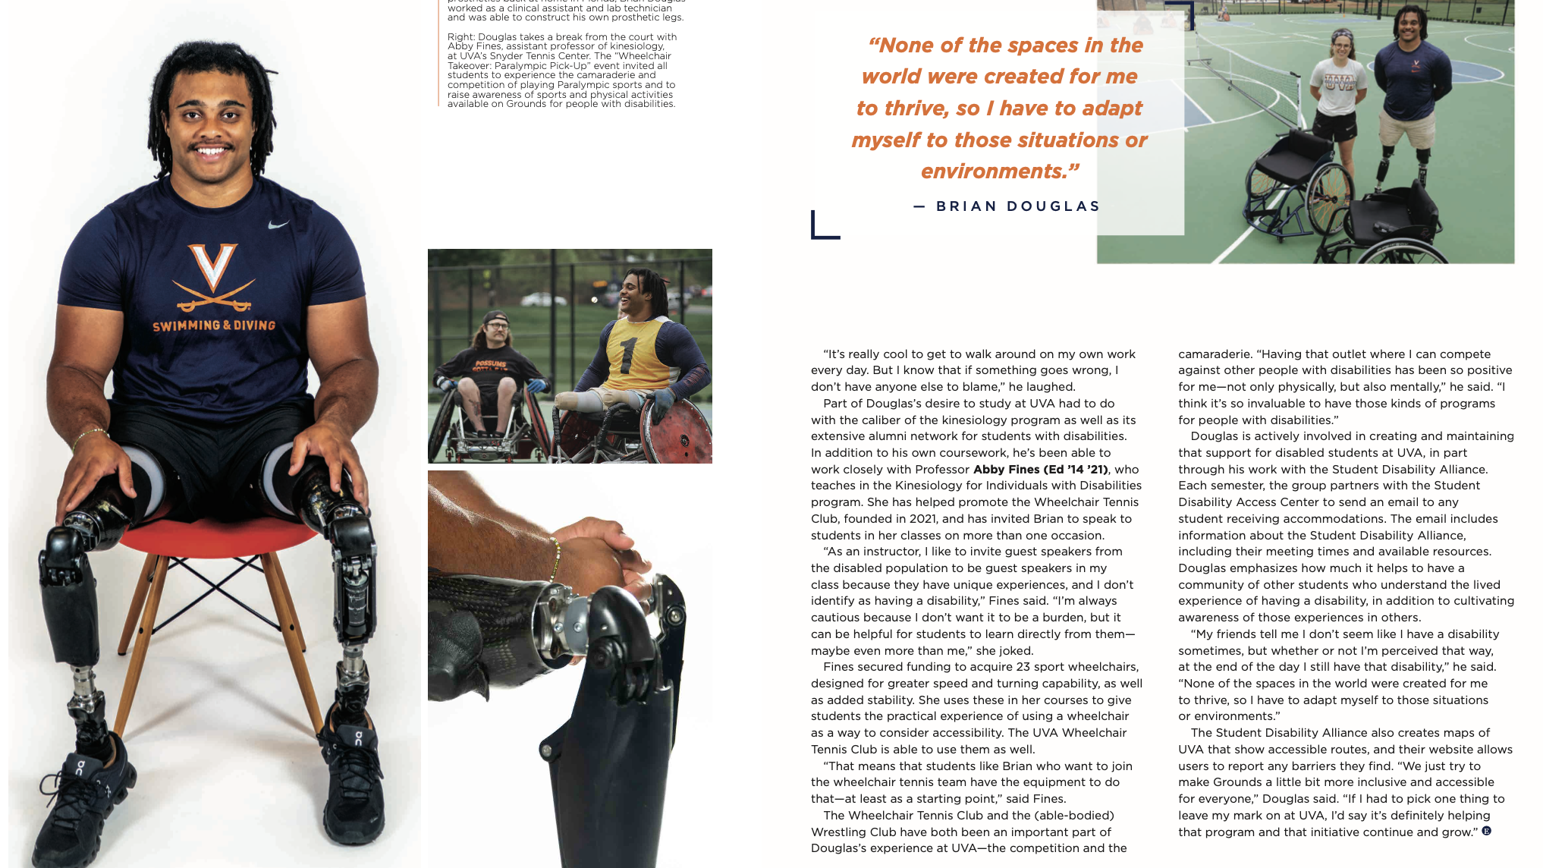

Slide 14
STUDENT ENGAGEMENT
Whole Group
How do you get students engaged?
Notes:
Recruitment
Volunteers
Participants
Disabled Champions

Slide 15
PICK-UP PARTNERS
Started simple
Institutional Partners | Community Partners | Individual Partners
Kinesiology Recreation School of Education ODEI | Sportable Charlottesville Cardinals | Student-Athletes with Disabilities

Slide 16
PICK-UP OVERVIEW
Simple works
Easy Wins | Hard Wins | Losses
Simple structure Easy Execution |  | Small Impact (~50)

Slide 17
ROLL WITH JIM
Adapting and leveraging a recognized name and event

Slide 18
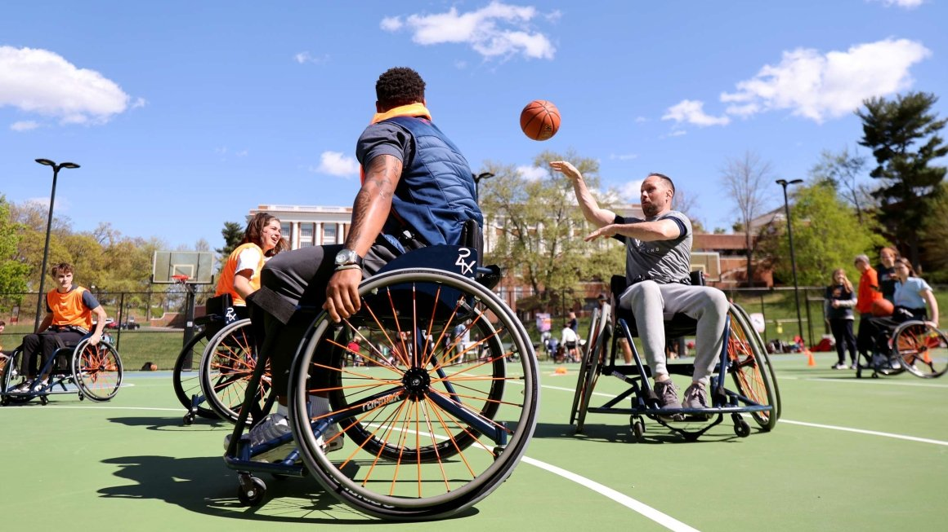
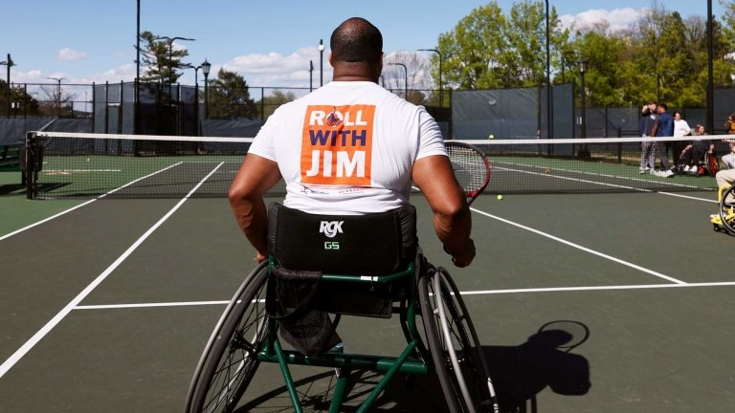
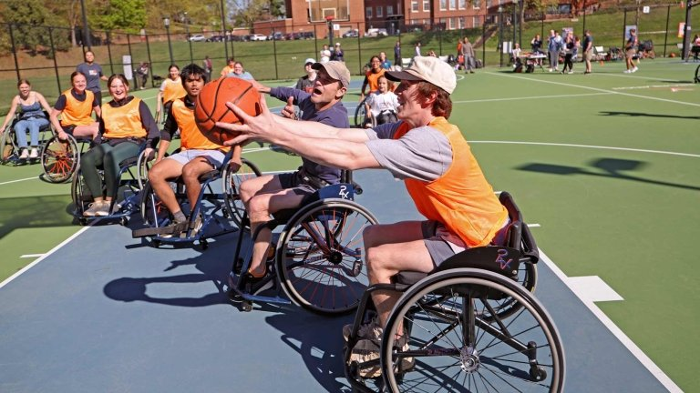

Slide 19
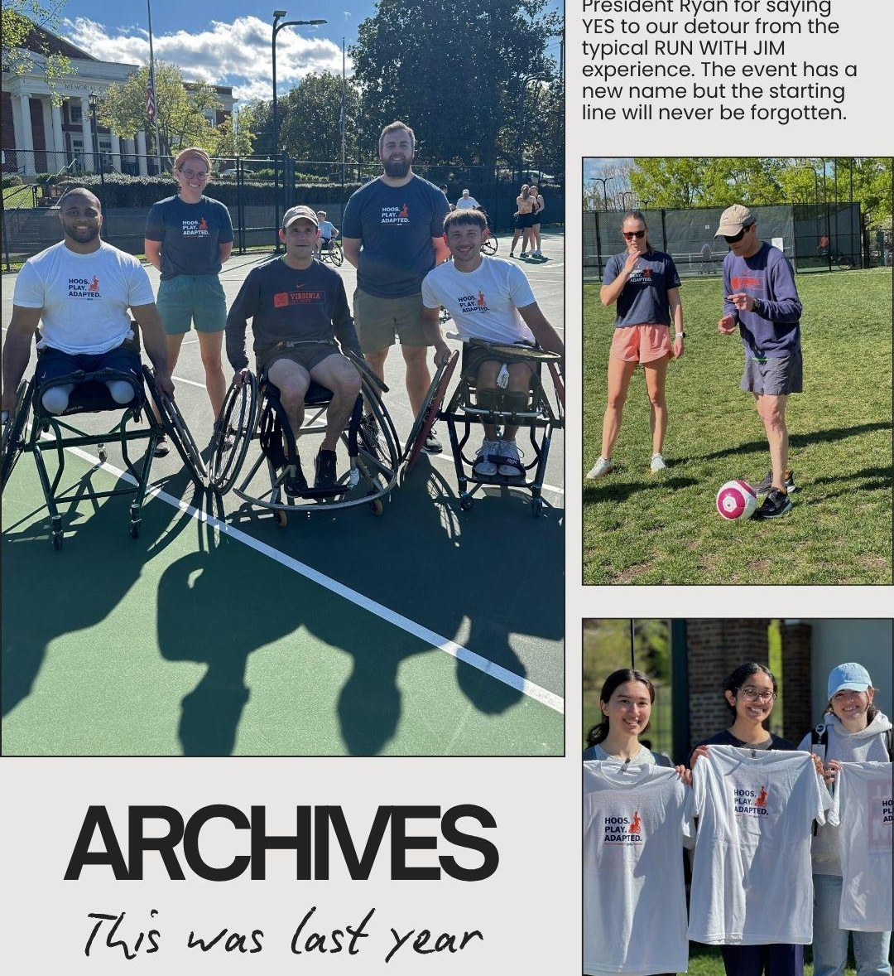
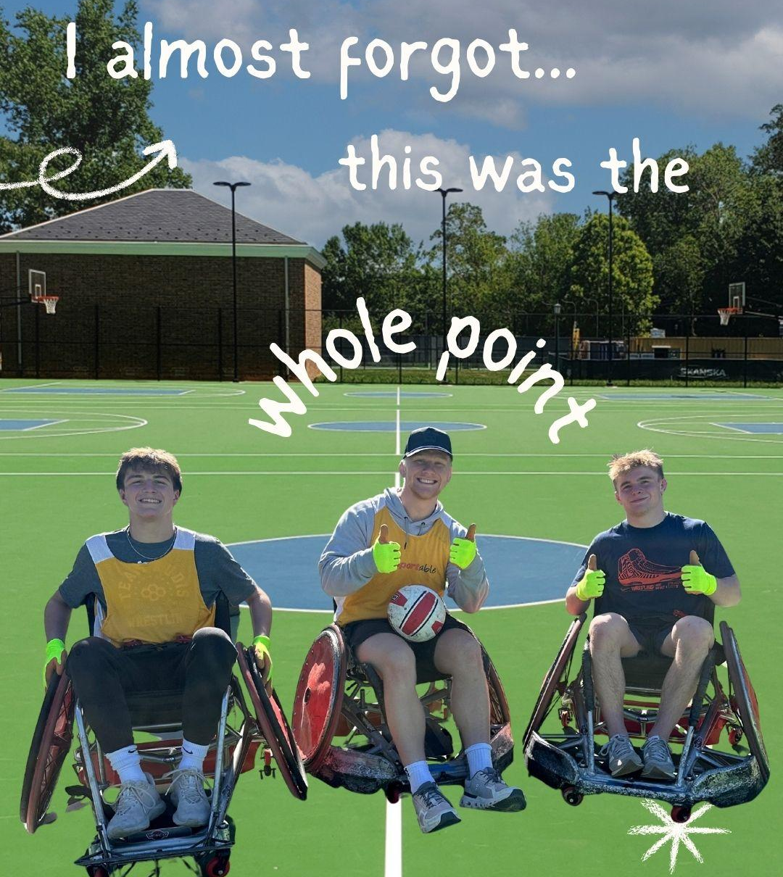

Slide 20
INSTITUTIONAL & COMMUNITY BUY-IN
Whole group
How do you create institutional or community buy-in?

Slide 21
ROLL WITH JIM PARTNERS
More Institutional Support
Institutional Partners | Community Partners | Individual Partners
President’s Office School of Education ODEI Office of Communication Other Academic Dept. Student Disabilities Access Center Facilities/Parking | Piedmont Area Tennis Assoc. | Students
* Table only includes partners added at this step/event.

Slide 22
ROLL WITH JIM OVERVIEW
Top-down support
Easy Wins | Hard Wins | Losses
Local para athletes Paralympian (easy yes, but $$) Foundational partnerships and events | Funding (multiple sources) Uncertainty (weather, participation) Inaccessibility (construction, location) Field Day structure | UVAToday (article) Kinesiology’s engagement

Slide 23
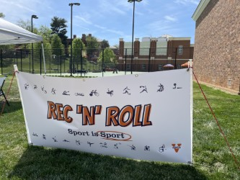
REC ‘N’ ROLL
Creating something sustainable

Slide 24
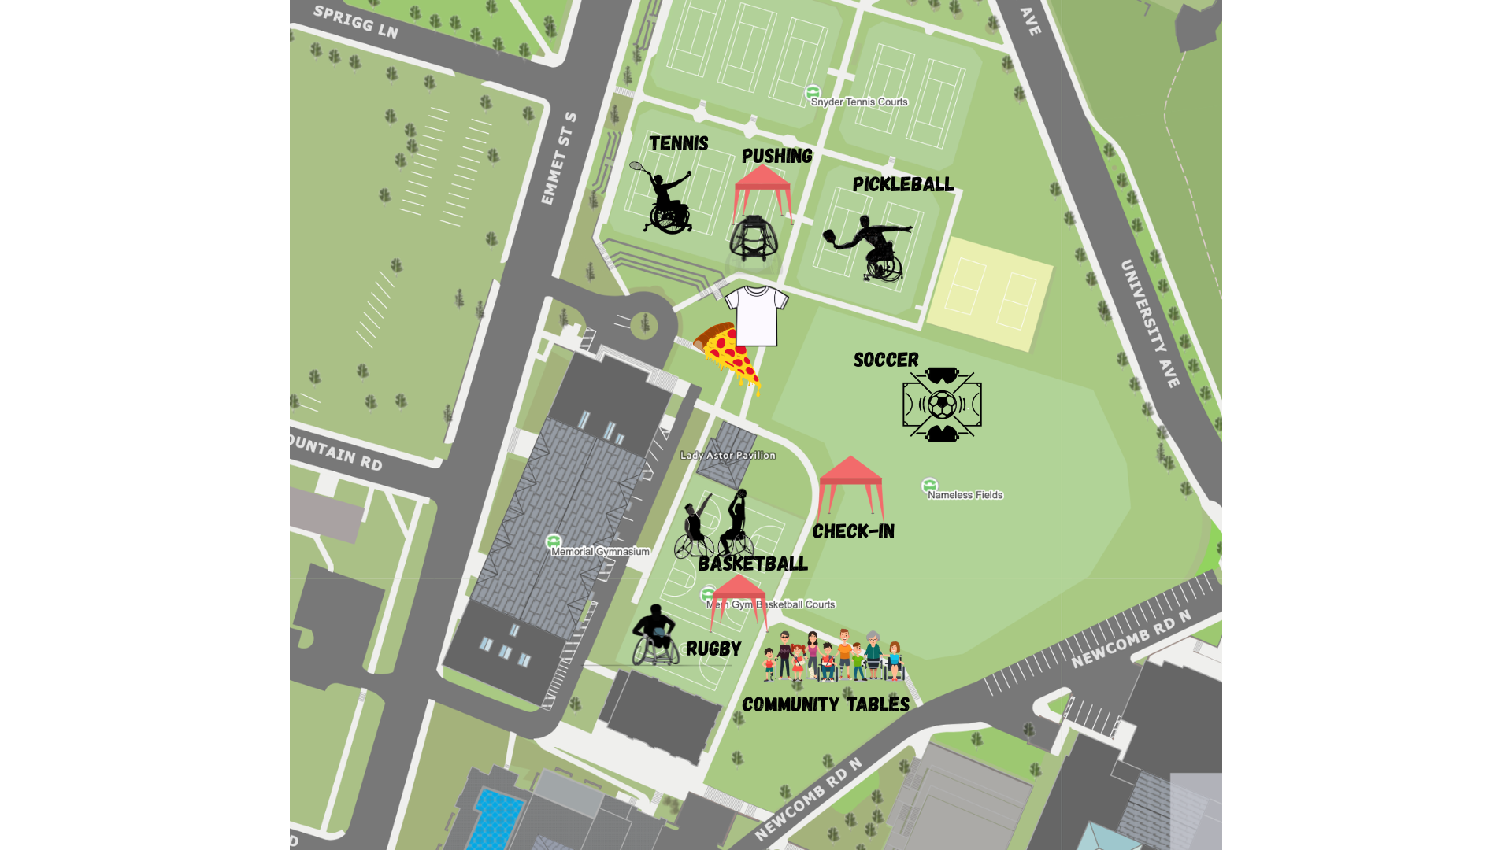

Slide 25
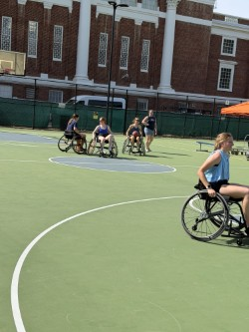
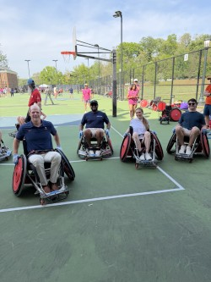
THREE-PHOTO SLIDE TITLE – HIDDEN

Slide 26
MISSIONAL OUTCOMES
Small group to whole group
How do you manage and assess outcomes?
Language Scenario

Slide 27
REC N ROLL PARTNERS
Most Complex
Institutional Partners | Community Partners | Individual Partners
Athletics Intramurals | Blind Soccer Nation Additional Community Tables | Volunteers
* Table only includes partners added at this step/event.

Slide 28
REC N ROLL OVERVIEW
Simple works
Easy Wins | Hard Wins | Losses
Existing Partnerships=$ Community Tables Freebies: shirts, pizza | Competitive Schedule Local Para Athletes (conflicts) Athletics Volunteers | Leadership Comments “The Jim Effect”

Slide 29
ACTION TO IMPACT
Next Steps

Slide 30
UNIVERSITY-COMMUNITY COLLABORATION
Your vision or needs…
How can University-community collaboration advance your mission?
What are next steps to make that happen?
 | HIGH ALIGNMENT (mission, incentives) | LOW ALIGNMENT (seemingly disconnected)
HIGH ACCESS (easy to reach, responsive) | ✅ Easy Wins | ⚠️ Hard Wins (e.g., Hidden Friction)
LOW ACCESS (hard to reach, nonresponsive) | 🔍 Hard Wins (e.g., untapped allies) | ❌ Losses (e.g., energy drains)

Slide 31
QUESTIONS? THANK YOU!
Abby Fines, atf2bz@virginia.edu – Matt Lowery, mkl3z@virginia.edu

