Slide 1

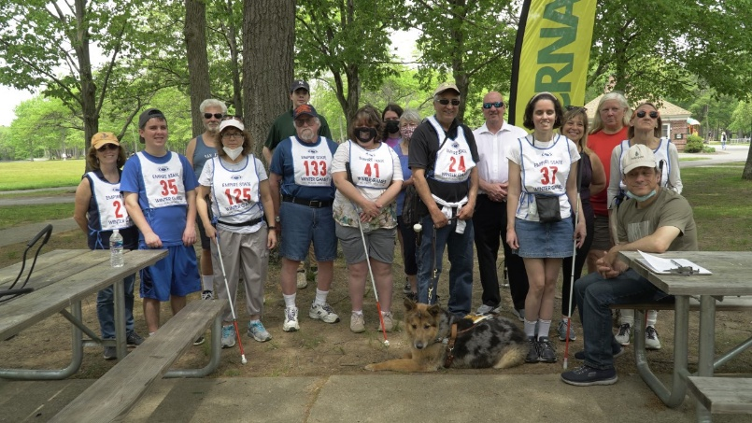
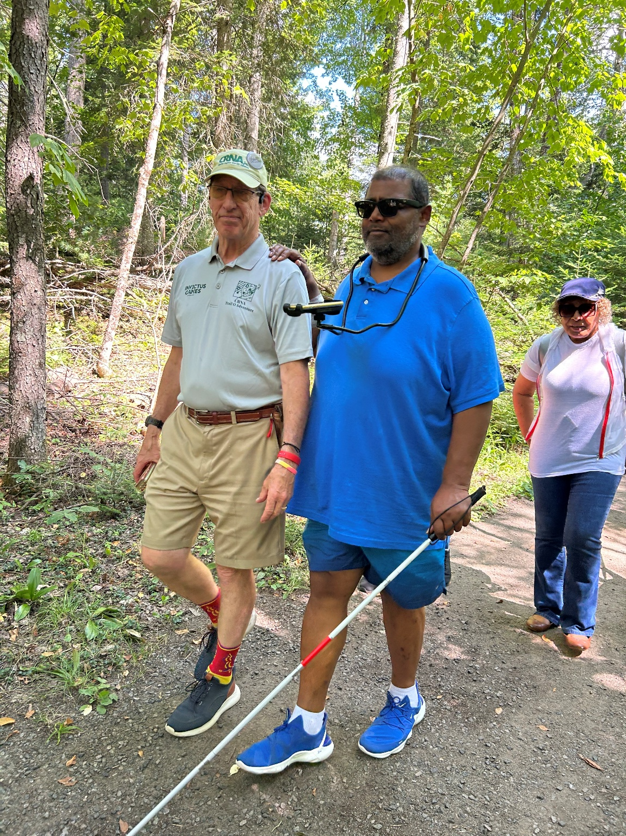
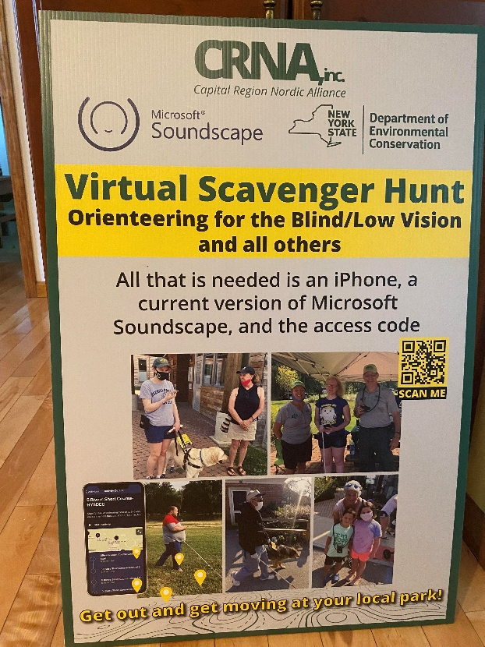

Capital Region Nordic Alliance Inc. & VibroGuide
Soundscape Community & VibroGuide
The Best of Both Worlds
for the Visually Impaired?
Soundscape Community & VibroGuide
“May all move in beauty, whether on Land or Water”
Notes:
The phrase "May you walk in beauty" is often associated with Native American cultures, particularly the Navajo, the Maya.
It is a traditional blessing that reflects a desire for the recipient to experience beauty, harmony, and peace in their life.
The phrase embodies a deep connection to nature and spiritual well-being.

Slide 2

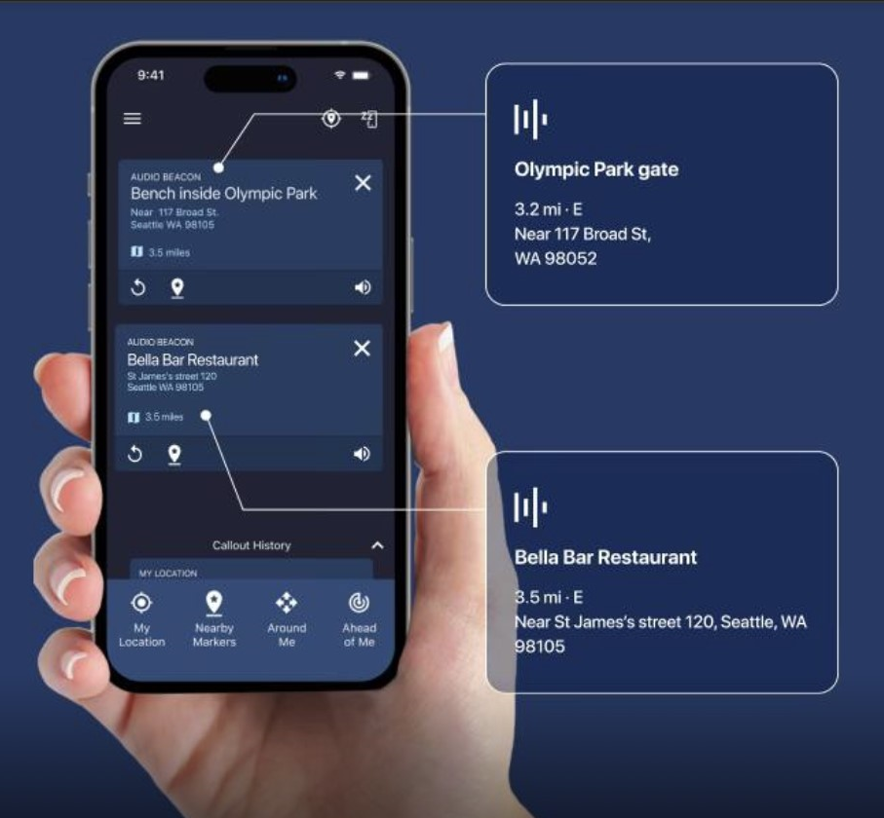
Closing slide with links
Download the Soundscape Community app
https://apps.apple.com/us/app/soundscape-community/id6449701760
Website https://soundscape.services
Video Links
Soundscape Community – YouTube channel: Soundscape Community – YouTube
Images from the collaboration with 3rd Eye Insight, Long island https://drive.google.com/drive/folders/1-0LTm5A2CF17aDCwlZwgJ1FJoKcKBxmL

Slide 3
Why Audio and/or Tactile Navigation Systems for the VI?
Extremely difficult to engage the VI due to fear of navigating safely (IGF &VI)
Reports High Frequency of:
  Depression/Anxiety
  Obesity
  Type II Diabetes
  High Unemployment
  Low ADLs & Quality of Life
  Low Participation in Society
  Fear of travel
  Safe, self-guided (Independent?) navigation goes a long way in mitigating major barriers

Slide 4
Soundscape Community, Russ Myer-CRNA
Introduction
Soundscape Community & CRNA
Accomplishments with Visually/Mobility Impaired
CRNA Video, VI Youth using Soundscape Community

Slide 5

What is Soundscape & how does it work…
3D spatial
audio
Audio delivery devices
iPhone
app
Services
layer
Open Street Map
(+ Search Provider)
An augmented reality experience delivered in 3D audio
Soundscape Community app is available in 15 languages (including English, French, Spanish!)

Slide 6
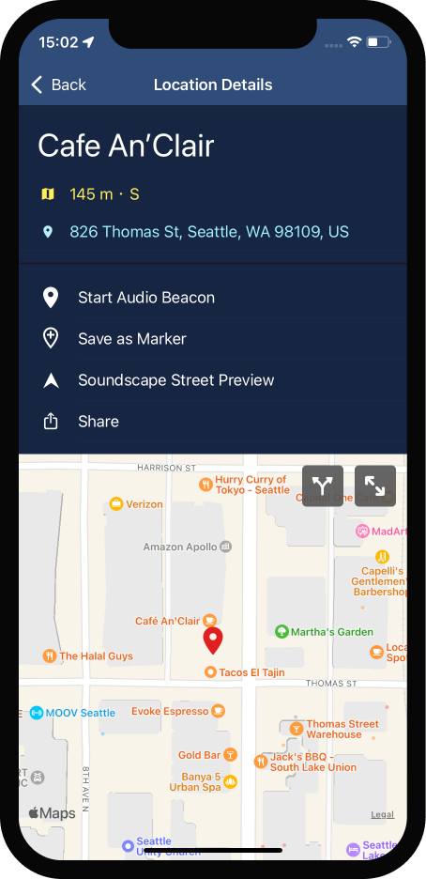
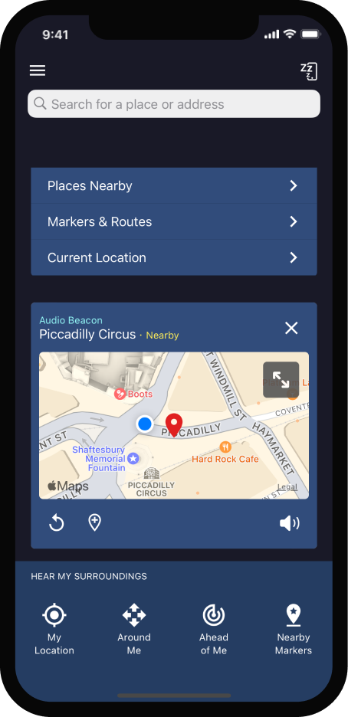
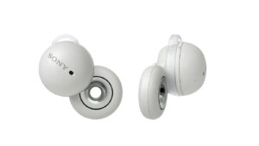

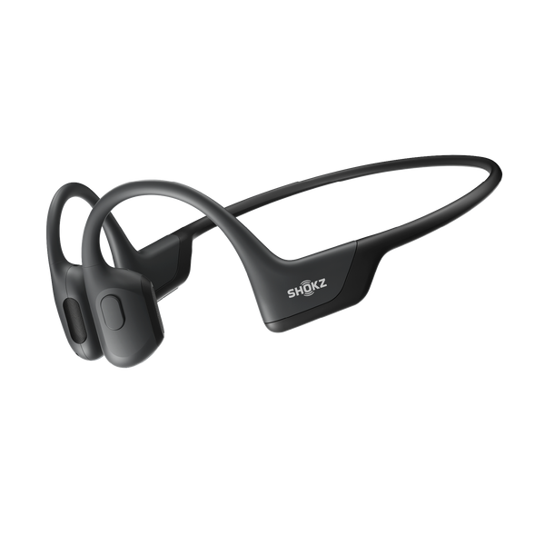
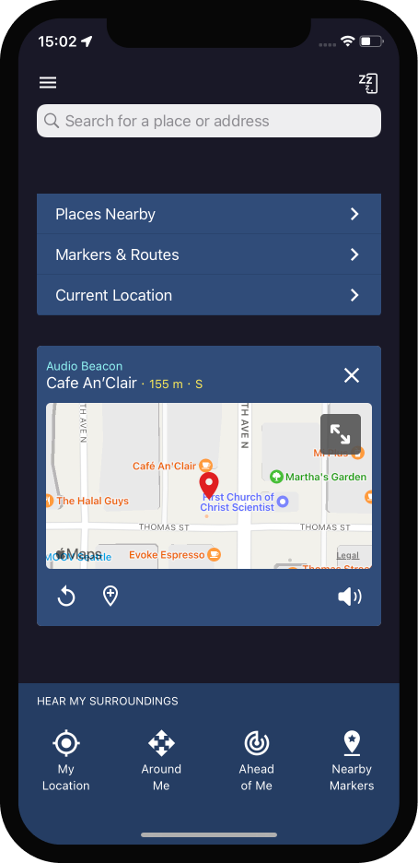
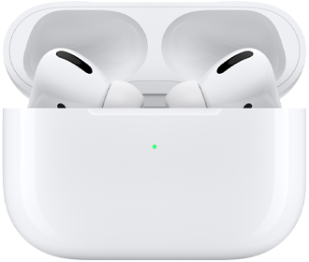
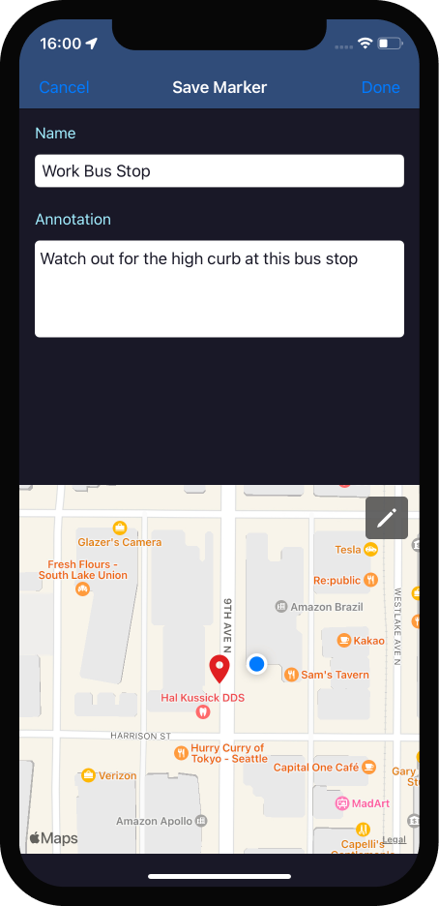
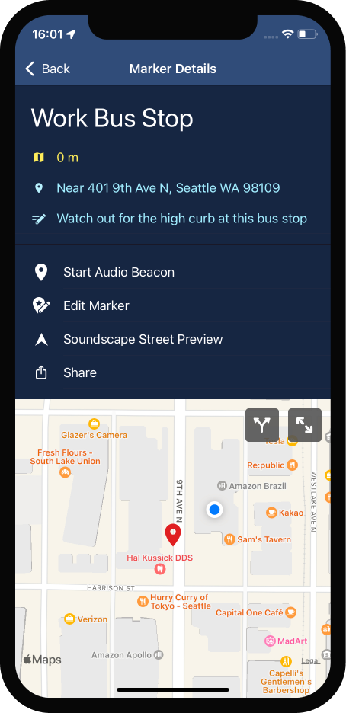
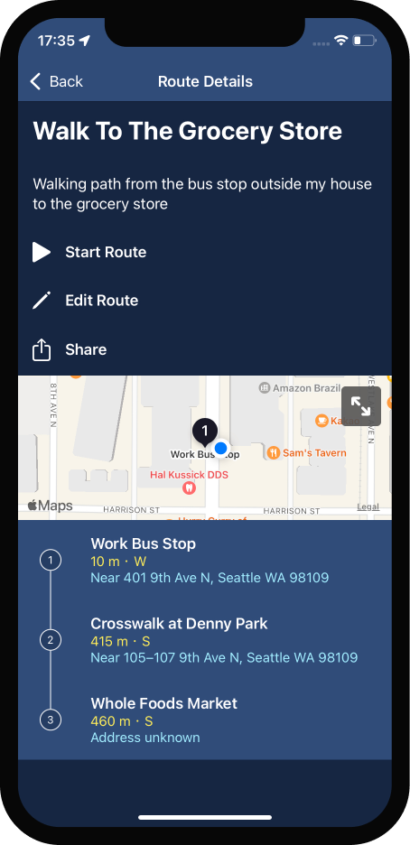
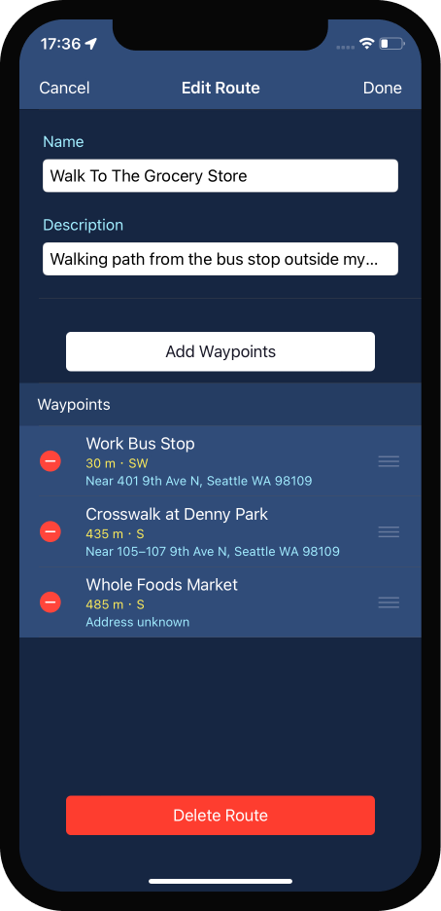
Core capabilities & experiences
Wayfinding/navigating with Audio Beacons
Configurable listening experience
“Beacon, 155 meters”
Core experience based on Audio Beacon and tailored callouts
Environment information: intersections, roads, landmarks & POIs
N
Headphones & phone speaker
Many headphone options e.g.,:
  Sony LinkBuds
  Apple AirPods Pro
  Shokz
W
E
S
Add Markers to ‘personalise’ the space around you
Create and share routes with others
Place a Marker anywhere
Annotate to personalize it for you
Share
Group Markers into specific ‘routes’
Audio beacon starts on 1st waypoint & automatically moves to the next one

Slide 7
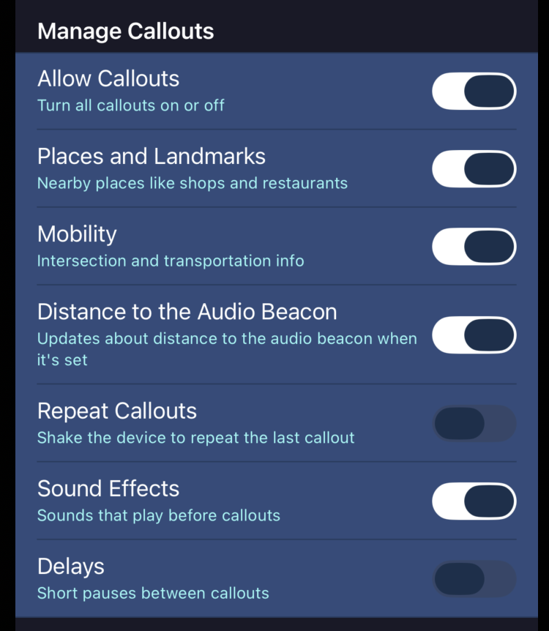
RCOS Software Updates-Yashasvi Kishore, RPI RCOS
What We Built
Added user-controlled settings to disable audio sound effects and adjust callout timing to give users more control over their navigation experience
Fixed display issues affecting how on-screen text is rendered in the app
Both changes contributed to the open-source Soundscape Community codebase on GitHub
Why It Matters
Users can now customize how the app speaks to them which is critical for low-vision users who find constant audio feedback overwhelming
Cleaner text display reduces friction for new users learning to navigate with the app
Status & Next Steps
Changes submitted as pull requests to the Soundscape Community repository
Ongoing evaluation of deeper integration between Soundscape audio cues and VibroGuide haptic signals
RPI RCOS team continues active development on the open-source platform
Notes:
Blind and low vision users rely on Soundscape to narrate the environment as they move through it, Users could already control what the app called out, what was missing was control over the audio delivery itself, the sound effects that play before callouts and the short delays between them. I added 2 toggles that could fine tune those experiences. For someone who finds the sound effects and the immidiete follow up of audio jarring, there are now options to edit those too.

Slide 8
POverview
Goal: Evaluate the possibility of linking or synchronizing Soundscape Community (SC) and VibroGuide (VG) together, both can reinforce each other to provide unmatched safe navigation for those with visual and/or audio impairments-as well as general public-UNIVERSAL DESIGN! Rensselaer Polytechnic Institute RCOS evaluating viability of integration
Programme: Currently, both SC and VG are effective on both land and water, being used for both trail and terrain routes in any setting. For those with any level of hearing impairment, VG adds extra confidence and safety due to awareness through vibratory stimulation around one’s torso
Both have 360 degree spatial capability enhancing the intended direction the end user wishes to travel, on land or water
Beneficial in improving balance, vestibular and concussion rehabilitation, gait improvement, sensory-motor integration
Key Activities
Assess each modality for strengths and weaknesses in architecture and operation
Perform a deep dive into how the two can be linked, offering the end user unparalleled safety and enjoyment using both audio and vibratory stimulation and integration
Other
Value
Based on the level of technologies integration and participant and stakeholder feedback, the initiative will help contribute to improving access to any environment. Regardless of ability, those with visual and/or hearing impairments will reap the tangible benefits of a healthier lifestyle and improved quality of life…regardless of the level of sight and/or hearing

Slide 9
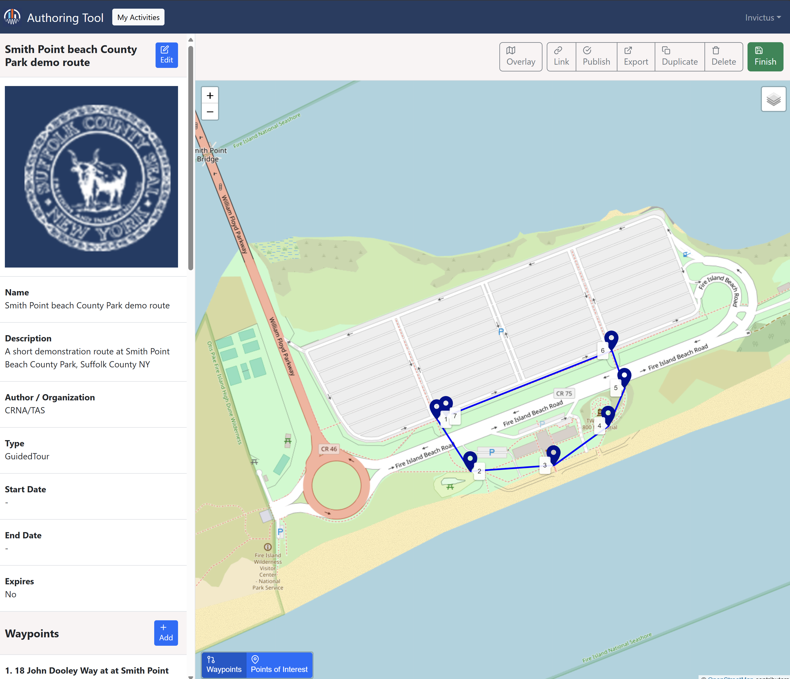
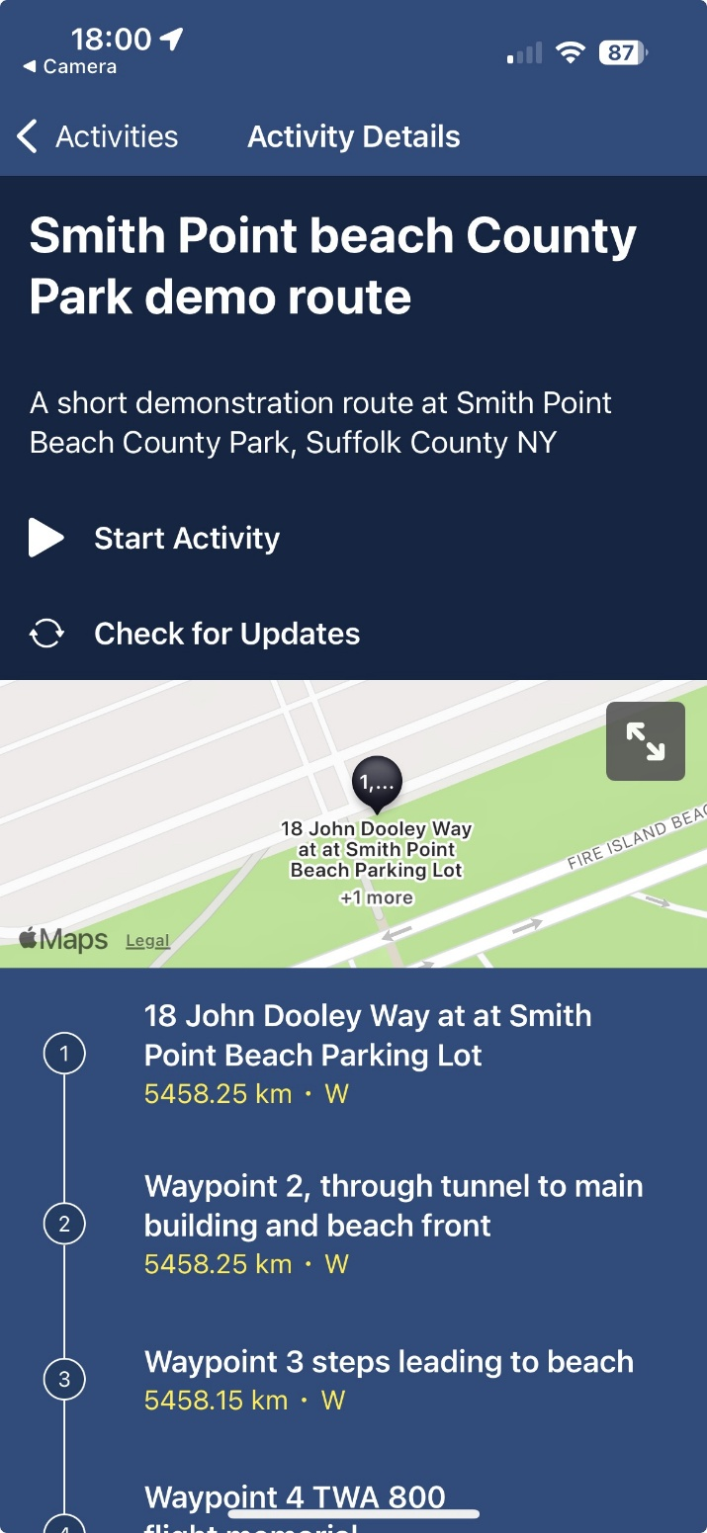
Soundscape Community Authoring Tool - overview
Route-based experiences and events are delivered through our web-based ‘Authoring Tool’
Designed specifically for the Soundscape Community inspired experiences which are delivered through the app
‘Orienteering’ mode focuses on point-to-point navigation with simple and clear instructions
‘Guided Tour’ mode supports a range of media (audio, images, text) for a more immersive and ‘richer’ experience
Each experience is customizable re: informational text, arrival and departure callouts, incorporation of additional points of interest, start/end dates etc.

Slide 10
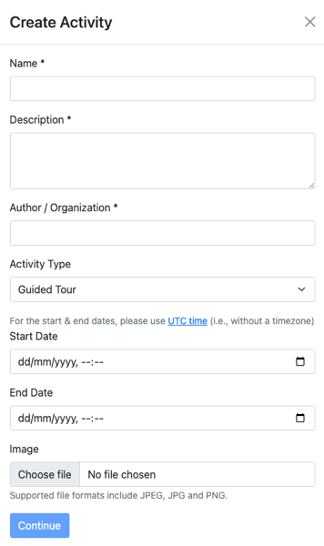
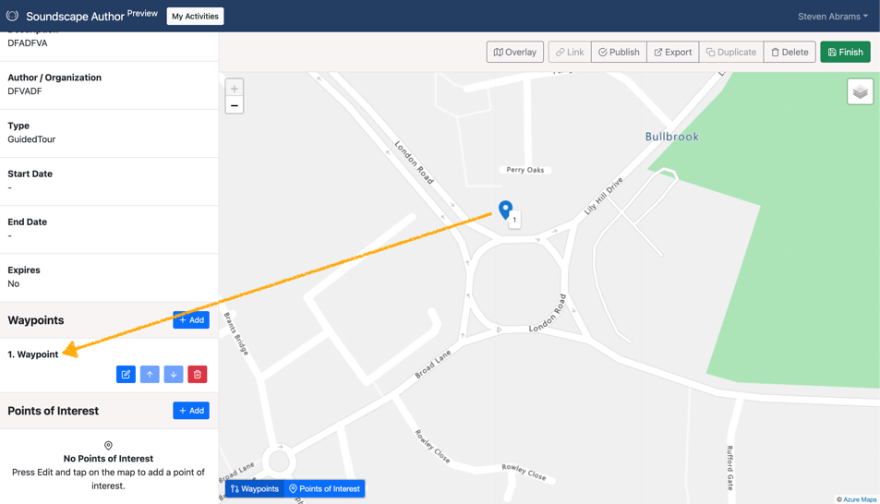
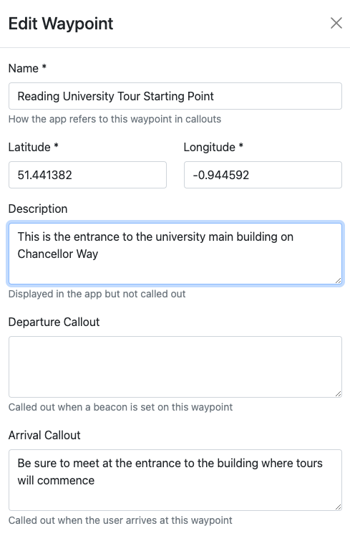
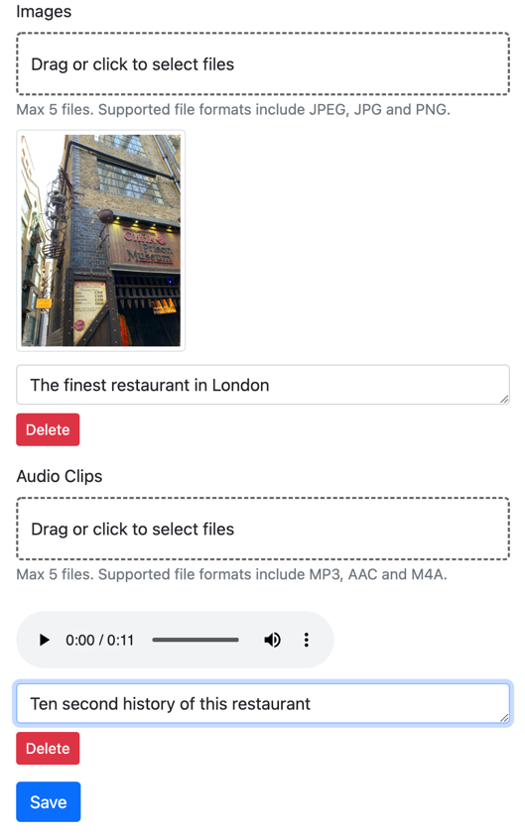
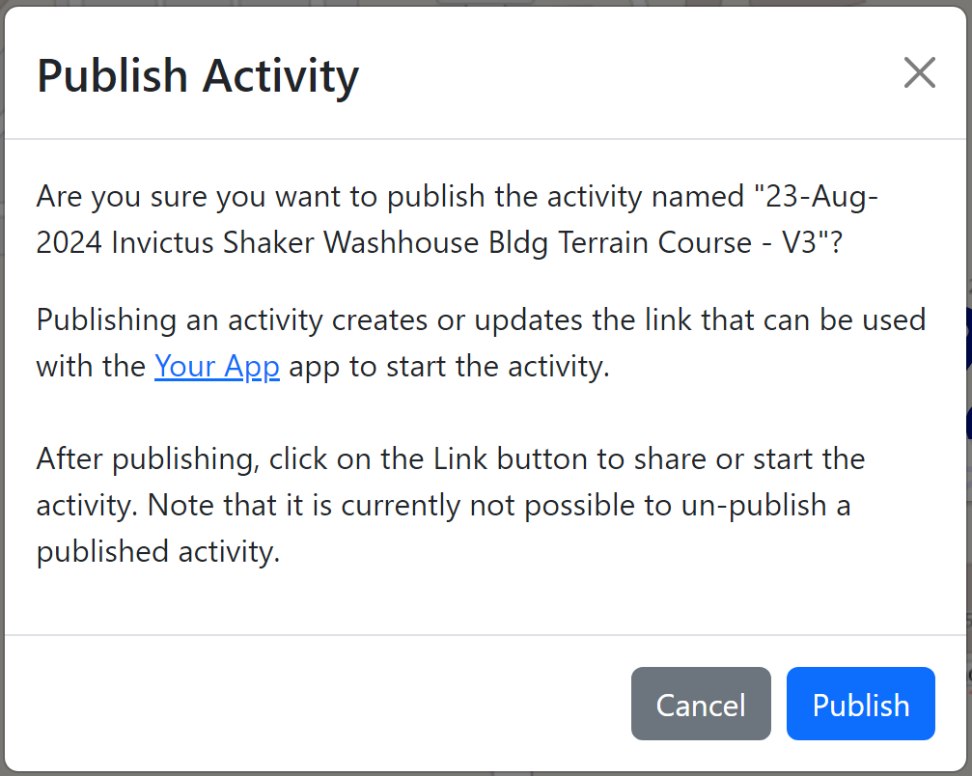
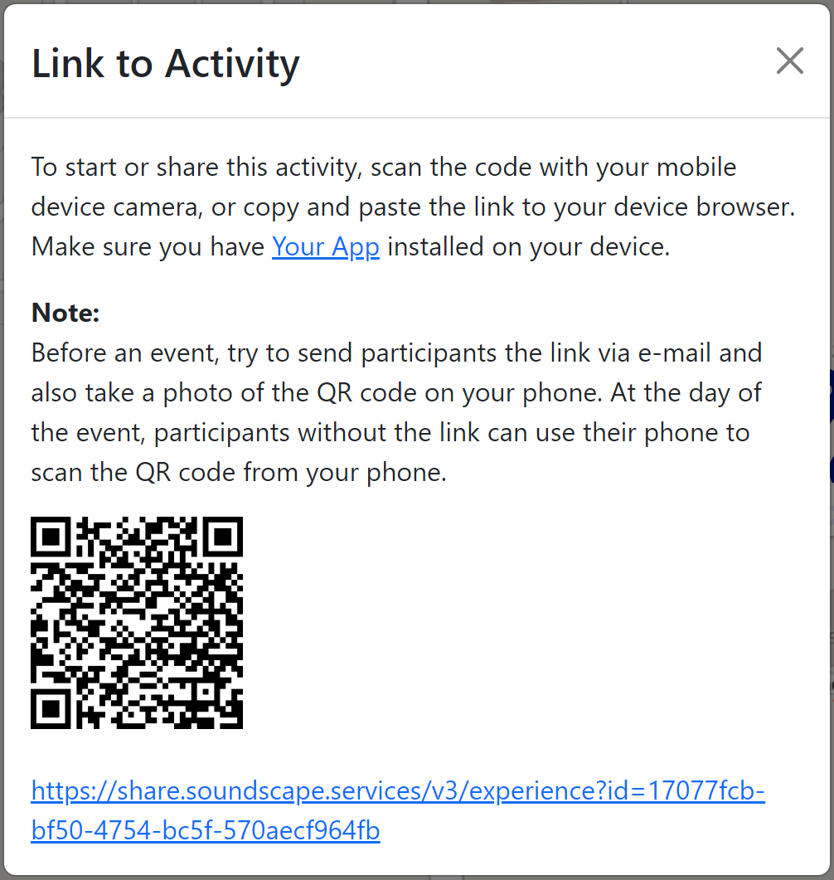
Authoring Tool – how it works
1. Create your activity
Name & describe it
Set start/end dates
2. Establish your waypoints by selecting them on the map
You can arrange them in any order you wish
Support by adding POIs!
3. Populate each waypoint with key information:
Name & description
Departure & arrival callouts
Add up to 5 images and audio files
4. When you’re done, simply publish it and create a QR code or link you can share

Slide 11
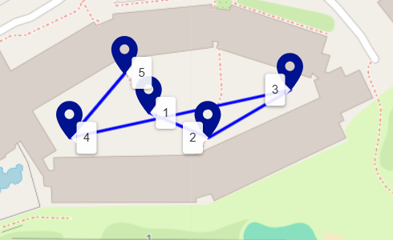
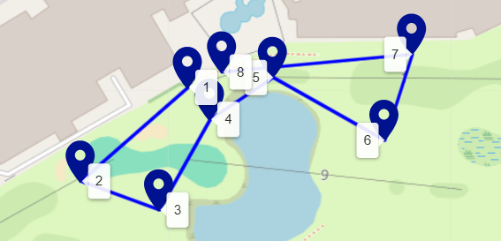
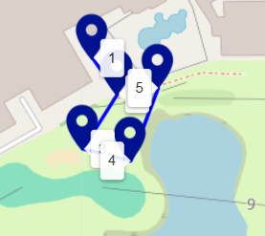
CRNA Soundscape Community Routes @ MU Conference
2 terrain guided tours with photos and audio clips
1 Orienteering terrain route

Slide 12
Engagement considerations SC & VG Integration
Nominate SC-VG team project sponsor(s) and project lead(s)
A CRNA dedicated server space for the SC-VG Authoring Tool will be created for the project
SC-VG will design and validate the trails, ensuring they meet requirements and comply with best practices garnered from experience and expertise regarding content, challenge, inclusion, and access
Ongoing collaboration re: the design of each course between SC-VG team and end user entity
The created routes will be made available to the project team to remotely go through the content, ensuring integration remains intact
SC-VG team will provide an overview on the use of the new Authoring Tool. E.g., the process of creating route-based experiences and the use of various tools and processes (e.g. external verification in the actual trail space)
Participant considerations re: data storage, safeguarding, waivers, use of images, end-user testimonials etc. to be covered through SC-VG team
Each team participant to ensure they have access to a suitable iPhone/vest and stereo headset

Slide 13



Timeline – sample activities (for presentation purposes only)
Timeframe | Activity
Month 1 | Stakeholder workshop to define scope of routes and content to be included Prepare content and promotional materials Design and develop the routes and publish to the Soundscape Community app
Month 2 | Review and test courses with key stakeholders (online and in-person) Update courses and publish for general use Design user participant survey
Month 3 | Course experiences general availability Collate user feedback
Month 4 | Mid-point review with project sponsors Refine and update routes and trail experiences as agreed
Month 5 | Collate user feedback Collaborate on developing a shared and sustainable business model development
Month 6 | Analyse user feedback & prepare findings report Develop proposal for next phase

Slide 14
Budget considerations, and Next Steps
Activities | $ USD
Course design and development (mix of existing trail-based courses and their respective costs) | 5000
Route management, support, and training | 2500
Expenses i.e., travel & subsistence (based on number of on-site sessions) | 1500
Future business model development considerations e.g.: License fee for use of software Dedicated training to upskill Suffolk County staff to manage dedicated instance of Authoring Tool* | N/A
Infrastructure costs and hosting of dedicated instance of the Authoring Tool | 1000
Contingency = 10% | 1000
Total | 11000
Overview
The budget considerations presented are intended to provide a framework for discussion
Our objective is to work through the details with you so that we together, and collectively, shape the proposal according to your needs and the outcomes you seek
We are committed to working in a collaborative and co-operative spirit and will work with you to develop a proposal which provides a fair value-exchange and meets our respective needs and objectives
As a commitment to this partnership, we will deduct the pilot fee from any future commercial relationship
Next Steps
Arrange meeting to review and discuss the proposal and agree on mutual scope, timing, and cost.
* Provide training and user guides specifically for training trail developers on using the Authoring Tool

Slide 15
SOUNDSCAPE COMMUNITY
SUPPORTING SLIDES

Slide 16
Closing slide with links
Download the Soundscape Community app
https://apps.apple.com/us/app/soundscape-community/id6449701760
Website https://soundscape.services
Video Links
Soundscape Community – YouTube channel: Soundscape Community – YouTube
Images from the collaboration with 3rd Eye Insight, Long island https://drive.google.com/drive/folders/1-0LTm5A2CF17aDCwlZwgJ1FJoKcKBxmL

