Slide 1
Stories We Tell
Shaping Organization Decision Making
Presented by: Katie Ahern & Sarah Keith

Slide 2


Slide 3

Key Points
Identify barriers
Encourage change
Opportunity to reflect

Slide 4

But, why?
Stories of opportunities for change

Slide 5


Who are YOU?
Clients — athletes, participants
Parents/Guardians — designated caregivers
Providers — coaches, instructors, volunteers
Administration — program staff and/or decision makers
Where are there opportunities for communication between these perspectives?

Slide 6



Client perspective
?
Provider perspective
Administrative perspective

Slide 7

Client perspective
An
Informed Organization
Provider perspective
Administrative perspective

Slide 8
Conversations…..
Listen
Curious
Values
Facts
Feelings

Slide 9


Slide 10

Where and When? Activity
Link…

Slide 11
Again, why?
Stories of when collaborative communication works

Slide 12
Bonus Slides

Slide 13
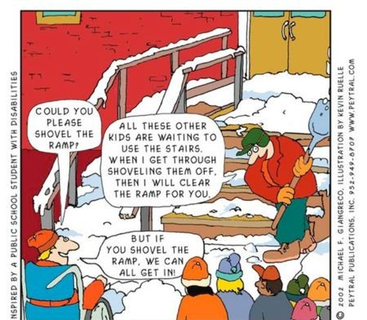
Ramps instead of stairs….

