Slide 1

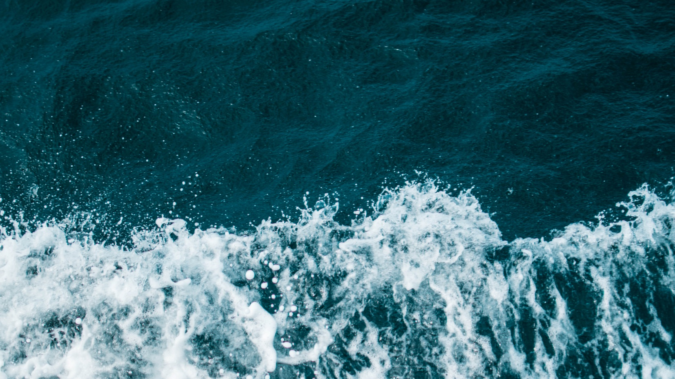
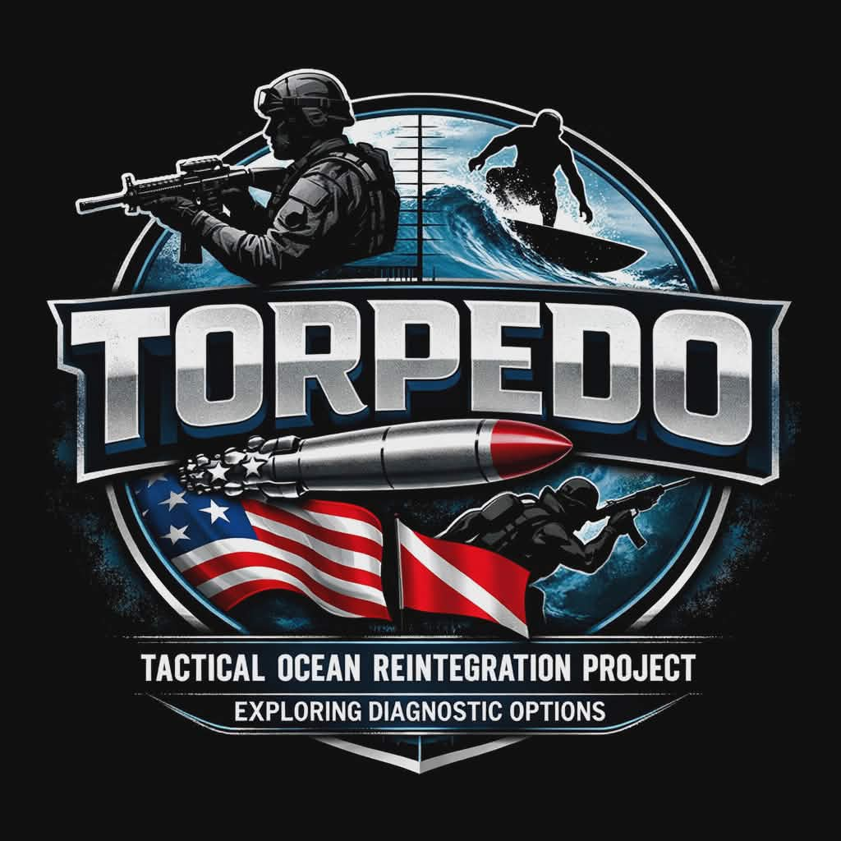
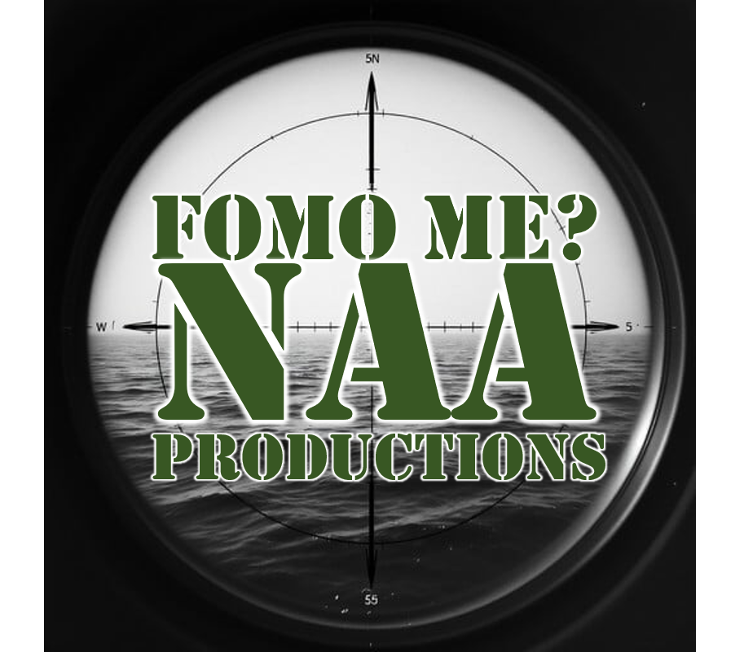

Notes:
Give a description of the logos

Slide 2
Exploring Human Performance, Healing, and Diagnostics Through Ocean-Based Immersion
Breezy Grenier, FRGS, MN’17
Co-Founder, FOMO Me? NAA Productions Captain [Director], TORPEDO Vet Series
Notes:
AFTER-I am a blonde female mermaid, who gets my fashion inspiration from Ms. Frizzle. I am wearing a navy-blue collared shirt with white sailboats, pink mermaid pants, and flip flops, because I am from New England. I am a Coast Guard Veteran who wear many hats, I make the joke I am a boat captain, so I can afford to be a scientist, I am a volunteer firefighter and my favorite job title is snowboarder for the Federal Government, as I recently am taking over as the Director of Snowsports at West Point.

Slide 3
The Blue War
This fight isn’t external- it’s internal, environmental, and systemic. We are facing:
Rising Veteran suicide and unresolved TBI/PTSD
Environmental stressors: EMF, toxins, noise pollution
Gaps in diagnosis, treatment, and understanding
The battlefield has changed. So must the solution.
Notes:
AFTER- My business partner is a combat Marine Veteran who was misdiagnosed with bipolar disorder and prescribed medications that did more harm than good. The side effects disrupted his body’s ability to produce dopamine—leading to severe fatigue, loss of motivation, difficulty concentrating, and a diminished sense of purpose.
Because dopamine also controls movement, he began experiencing muscle stiffness, tremors, and symptoms similar to Parkinson’s, along with sleep and digestive issues.
My own experience navigating the system wasn’t much different. I live with severe bilateral plantar fasciitis from my time in service, and after a serious car accident, I reached a point where I couldn’t walk.
I saw six or seven VA doctors. X-rays, ultrasounds, MRIs, CT scans—they wanted to do exploratory surgery.
Then, by chance, I ended up in the ER at the Newington VA. One doctor asked, “Have you ever seen a physiatrist?” I didn’t even know what a physicatrist was, and to answer your question, its an MD version of a physical therapist.
After 3 months of waiting, I was finally able to see one, and I took five steps in front of him. He immediately saw the issue—my hips were misaligned.
After Four weeks of physical therapy, I could walk again. Four more weeks, I was pain-free.
And looking around this room, I’m confident in saying this: nearly every Veteran here who has interacted with the VA has a story like this—or knows someone else who has.

Slide 4
Why This Matters Now
Traditional treatments are not enough
Veterans are seeking purpose-driven recovery
Wearable tech + environmental sensing now enable real-time insight
The ocean remains one of the most underutilized therapeutic environments
We have the tools. We need a new model.
Notes:
BEFORE- I was laughing to myself—when we talk about needing real metrics, objective data, things we can’t fudge…
But then so often, the question becomes something like, “On a scale of one to ten, how warm and fuzzy do you feel today?”
And you start to wonder—are we actually measuring anything meaningful?
Because behind the scenes, in conversations like the ones many of us have had, the real question keeps coming up:
Why aren’t we asking better questions—questions that actually lead us to real answers for the problems we’re facing?

Slide 5
What is TORPEDO?
A Veteran-led documentary and research initiative where science, human performance, and ocean exploration converge.
Each episode:
Test therapies in real-world conditions
Captures biometric and environmental data
Tells the human story behind recovery
Science in motion. Healing in action.
Notes:
BEFORE- So before I tell you what TORPEDO is, I want to tell you what inspired it. A few of my combat buddies—you know, big, strong, tough guys who don’t complain—told me they were getting headaches surfing in one specific spot. Bad enough that they stopped going. That same location? Submerged AC cables had just been installed there over the winter. It made me ask myself, why was it effecting my combat buddies and not my civilian surf buddies? What else in our environment could be impacting us in ways we don’t yet fully understand? SO WHAT IS TORPEDO…

Slide 6
Our Mission
Use ocean-based activities to explore recovery and performance
Bridge science, storytelling, and service
Create new pathways for diagnosis, therapy, and reintegration
Heal people. Understand the system.
Protect the planet.
Notes:
We want to heal people, understand the system, and protect the planet.

Slide 7
Learning Objectives
Examine how adaptive watersports support physical and mental health recovery through measurable, science-based mechanisms
Understand how environmental factors- sound, EMF, and water immersion- impact human performance, resilience, and cognition
Identify scalable opportunities to expand inclusive programming, research partnerships, and training models.

Slide 8
Why Watersports Work
Cold exposure → increases dopamine & reduces inflammation
Hydrostatic pressure → improves circulation and recovery
Rhythmic movement → regulates stress response
Blue space exposure → lowers cortisol and anxiety
Result:
Improved mood, resilience, sleep, and cognitive function

Slide 9
Watersports as Therapy
Surfing → balance, neuroplasticity, emotional regulation
Diving → pressure therapy, focus, breath control
Paddlesports → rhythm, endurance, somatic integration
Sailing → teamwork, sound exposure, cognitive engagement
Every activity is both therapy and data collection.
Notes:
AFTER What better way to get someone to go to the doctor, is to not tell them it’s a doctors visit.

Slide 10
Environment & Human Performance
Sound/ Noise Pollution
Ocean frequencies and nervous system regulation
Tinnitus and acoustic therapy potential
EMF- Electromagnetic Frequecies
Exposure tracking in marine environments
Potential effects on sleep, cognition, and stress
Water Immersion
Sensory reset and parasympathetic activation
Reduced inflammation and improved recovery
The environment is not passive—it is active medicine.
Notes:
BEFORE We study how the environment shapes recovery, both ENVIRONMENTAL AND HUMAN PERFORMANCE

Slide 11
A Living Lab Laboratory
Biometrics: HRV, sleep, stress, SpO₂
Environmental data: EMF, sound, water conditions
Behavioral + cognitive performance
Goal:
Understand the relationship between exposure and outcome
Notes:
We measure both the human and the environment in real time

Slide 12
The TORPEDO Model
1. Baseline – cognitive + biometric assessment
2. Exposure – adaptive sport + environment
3. Monitoring – continuous data collection
4. Analysis – AI + research interpretation
5. Reintegration – purpose, training, community
A repeatable system for recovery and discovery

Slide 13
The Teams
Team Alpha Veterans participating in full-docseries recovery journey
Team Bravo Veterans testing specific therapies, technologies, and interventions per episode
Together: They generate both human insight and scientific data

Slide 14
The Episodes
One Sport. One Science. One Story.
Each episode explores:
A specific adaptive sport
A targeted therapy or scientific concept
A Veteran’s personal journey
Measurable outcomes
Examples:
Diving → Hyperbaric Oxygen Therapy
Surfing → Immersion-based regulation
Sailing → Sound therapy
Notes:
Each episode is a pilot with the potential to evolve into its own series—grounded in a research proposal. We already know these sports are effective. Our goal is to translate that into education, expand its reach, and unlock funding—while capturing the data needed to support and scale what we know works.

Slide 15
Ocean Science in Motion
EMF exposure in marine environments
Sound and its impact on brain function
Toxins and microplastics in human performance
Marine biology insights linked to neurological health
Science moves beyond the lab—into the field.
Notes:
We are investigating

Slide 16
Research & Innovation
Nutrition and metabolism under stress
Adaptive prosthetics in motion
Drug response in extreme environments
Continuous biometric monitoring
Every data point contributes to a larger system of understanding.
Notes:
We test human performance in real-world conditions

Slide 17
Diagnostics Across Disciplines
AI-based retinal biomarkers for PTSD
Neurocognitive testing for TBI
Wearables tracking stress, sleep, and recovery
Comparative communication patterns
Toward earlier, more accurate diagnosis
Notes:
We explore emerging tools—and here’s the cool part: we’re comparing our results to emfs affects to sharks and TBIs in whales.

Slide 18
Technology Integration
Wearables → real-time health metrics
Environmental sensors → EMF, sound, conditions
Adaptive equipment → access and performance
Technology enables both inclusion and insight
Notes:
It all boils down to people don’t know what they don’t know. This gives creates the opportunity for discussion.

Slide 19
Measured Outcomes
Stress resilience (HRV)
Sleep quality
Cognitive performance
Emotional regulation
Physical recovery
From story → to data → to evidence
Notes:
We track changes across

Slide 20
Education & Engagement
Citizen science initiatives
Open data and shared discovery
Classroom and community integration
Connecting research, recreation, and learning
Notes:
Our reach goes beyond Veterans—we’re connecting the sports, ocean, and adaptive communities into one unified effort.

Slide 21
Partnership Model
Clinical → VA, hospitals, rehabilitation centers
Academic → neuroscience, marine science, engineering
Industry → wearables, prosthetics, ocean tech
Community → adaptive sports organizations
Collaboration drives scale

Slide 22
Training & Workforce Development
Adaptive sports certification pathways
Veteran-to-coach leadership pipelines
Embedded research fellowships
“Blue Therapy” specialization development
Building the next generation of practitioners

Slide 23
Impact Goals
Reduce Veteran suicide through purpose-driven recovery
Advance non-pharmaceutical therapies
Establish the ocean as a diagnostic and therapeutic environment
Build global awareness and stewardship

Slide 24
Vision & Next Steps
Expand to national and global expedition sites
Integrate additional environments (deep-sea, snow, altitude)
Develop the Blue Economy and Defense workforce pipeline
Scale research and training partnerships
This is a platform—not a project.
Notes:
Right now we are specific to Southern New England and the Tri-state area on purpose. Our next step is taking it to national, then global with talks already in the works with Australia and the UK.

Slide 25
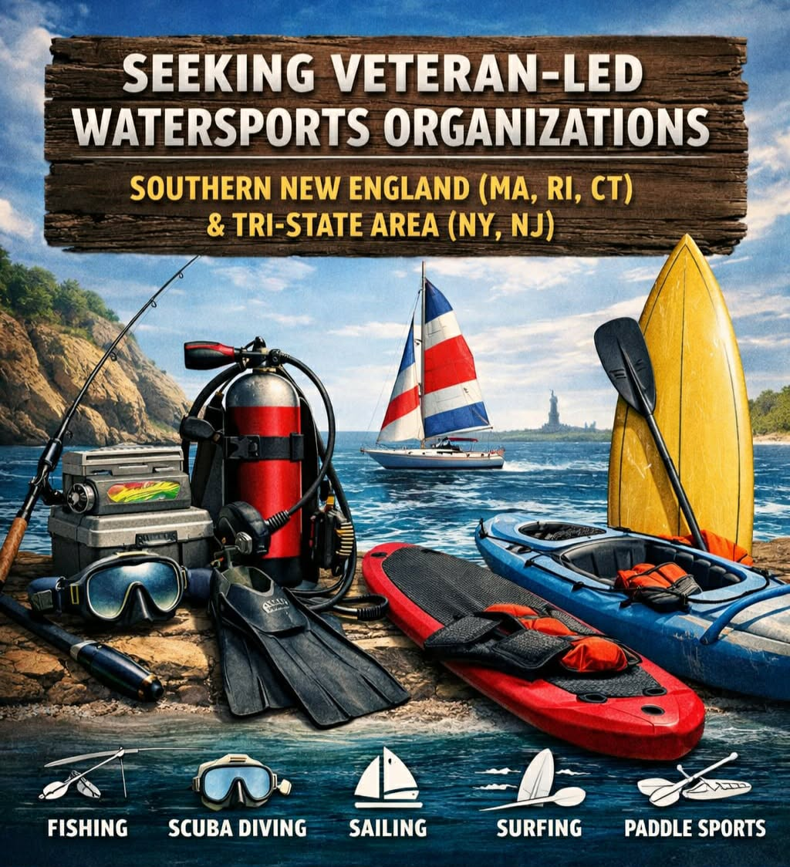
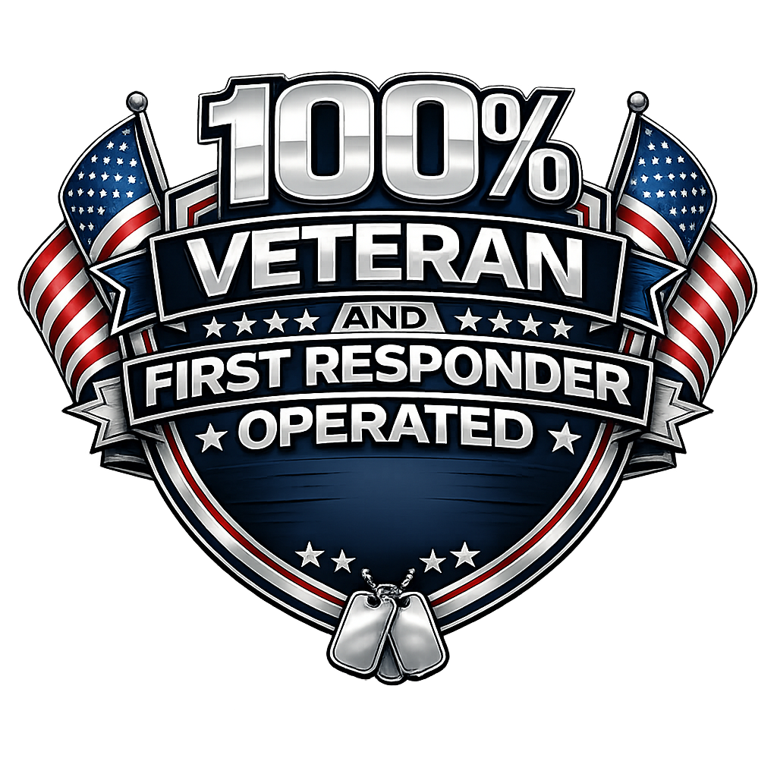


Slide 26
QUESTIONS?

Slide 27

Contact
Captain Breezy Grenier, FRGS, MN’17
Breezy@TheBlueVet.com www.TorpedoVetSeries.com
www.FOMOMeNAA.com

